Slide 1

Building CBME Into Faculty Development
Wednesday, May 15, 2024
Olivia Rae Wright, MD
Priyanka Tulshian, MD, MPH
Linda Montgomery, MD
Notes:
Priyanka

Slide 2

Faculty Development Webinars
stfm.org/cbmewebinars
What You Need to Know About ACGME and ABFM Expectations for a Shift to Competency-Based Medical Education
Reflections, Goals, & Objectives – Oh My! Best Practices for Creating ILPs
Let’s Talk About Entrustment
Assessment Tools for CBME and the Core Outcomes
Building CBME Into Faculty Development
Advisors and Coaches: The Evolving Role of Faculty and Resident Relationships
Individualized Learning and Resident Assessment: A CBME Orientation for Residents
Fostering Master Adaptive Learning and a Growth Mindset in Your Program
How to Effectively Use Electives to Help Residents Attain Competency in the Core Outcomes
The Role of Resident Portfolios in Competency-Based Assessment
Managing Assessment Burden in CBME
How to Have Reflective Feedback Conversations and Develop a Culture of Effective Feedback
Notes:
Priyanka
STFM has planned a series of CBME webinars. These are co-branded and co-marketed with AFMRD. We have had record-breaking registration for the live events and excellent viewership of the recordings.
Each webinar has at least one member of the task force. We’ve also included presenters from an open call we put out for CBME subject matter experts.
Also presented a ADFM Hot Topic Webinar and are participating in the development of an AAFP Residency Program Director On-Demand CME Course

Slide 3

POLL
What's your primary role in your program?
Program Director
Associate Program Director
Core Faculty
Program Coordinator/administrator
Notes:
Priyanka
STFM will run the poll for us.

Slide 4
POLL
Time in GME?
Less than five years
5-10 years
10-20 years
>20 years
Notes:
Priyanka

Slide 5
Objectives:
Upon completion of this session, participants should be able to:
perform a gap analysis to identify focus areas for faculty development.
list two best practices in creating faculty development focused on CBME principles and application.
begin to create a longitudinal plan for implementing ongoing faculty development in this area.
Notes:
Priyanka

Slide 6
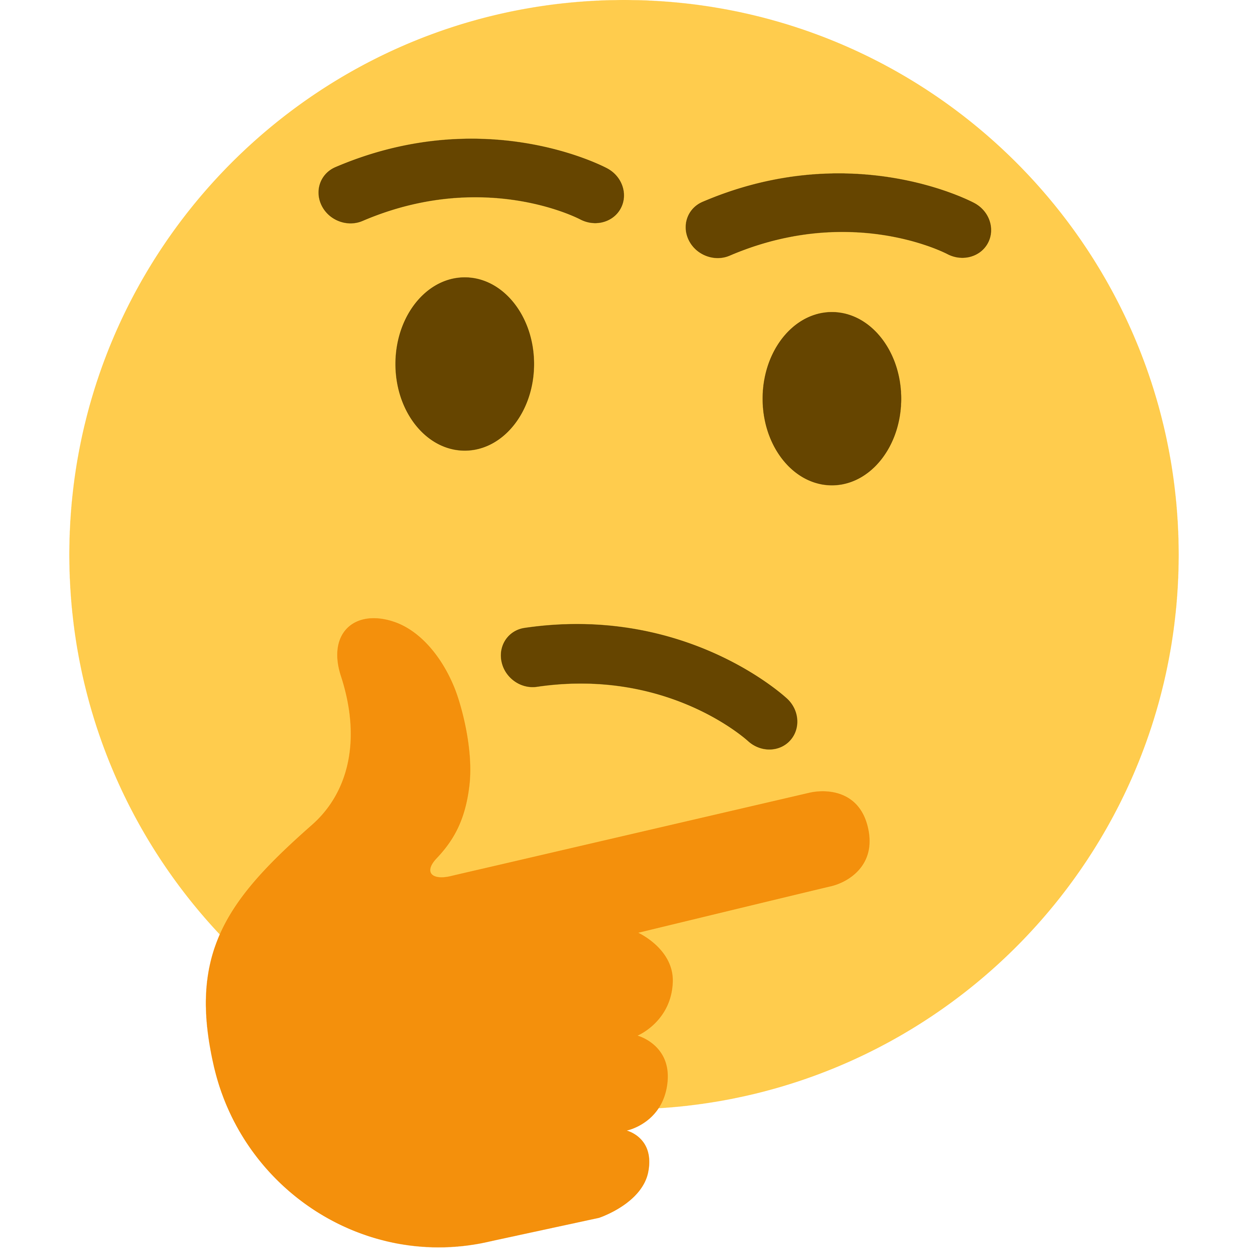
Why are we doing this?
Increase quality of care to those we serve
Insure competency of our graduates to do the essential things
More patient and community centered
This Photo by Unknown Author is licensed under CC BY-NC
Notes:
Priyanka

Slide 7
What is CBME?
Curriculum
Flexible
Electives
Assessment
Resident Engagement
Lots of it
ILPs
Not just time based
Formative Feedback
Direct Obs
Feedback to faculty
Coaching
Outcome focus
Learner Focused
SMART CB Goals
Resident Development
Notes:
Rae
Will try to break it down to something more relatable.

Slide 8

What is a gap analysis?
Needs assessment
Compares where you are with where you want to be
Systematic approach
Notes:
Rae
Like shopping for the ingredients for a recipe.

Slide 9
Why?
Internal
What?
What else?
How?
Get Started!
Current
Ideal
Collect
(SWOT)
(PDSA)
Data
and
External
Need
(Surveys)
vs
Notes:
Rae
Elements of a Needs Assessment

Slide 10
ABFM
ACGME
Local Community
Milestones
Program Requirements
Sponsoring Institution
Patients
Preceptors
Partners
Time
KSAs
PI Activities
Board Exam
PEC
GMEC
DIO
CCC
Curriculum
Program Accreditation
Outcomes
Board Eligible
Recruitment
Board Certified
Notes:
Rae – How it all works
Certification Activities Requirement: Earn a total of 50 certification points by completing ABFM self-assessment and performance improvement activities.
Earn 10 points by completing a minimum of one (1) Knowledge Self-Assessment activity.
Earn 20 points by completing a minimum of one (1) Performance Improvement activity.
Earn 20 points by completing additional self-assessment or performance improvement activities, or a variety of approved self-assessment alternatives to reach your 50-point total.
Professionalism Requirement: Continuously comply with ABFM’s Guidelines during your training.
Certification Exam Requirement: You may be eligible to take the one-day exam in the spring of your third year of training, providing the opportunity to earn initial certification upon completion of residency. Visit your MyABFM Portfolio to review important dates and begin your exam application.
Residency Training Requirement: Satisfactorily complete residency training according to ACGME and ABFM guidelines.
Licensing Requirement: Upon completion of training, obtain a valid, active, and full license to practice medicine. It is required to report your medical license within your MyABFM Portfolio to obtain initial certification.

Slide 11
Program priorities and solutions
Resident priorities and solutions
Data Collection
Notes:
Rae
At a minimum, also consider institutional leaders and patient advisory committee, for the sake of CBME, start with just these 2.

Slide 12
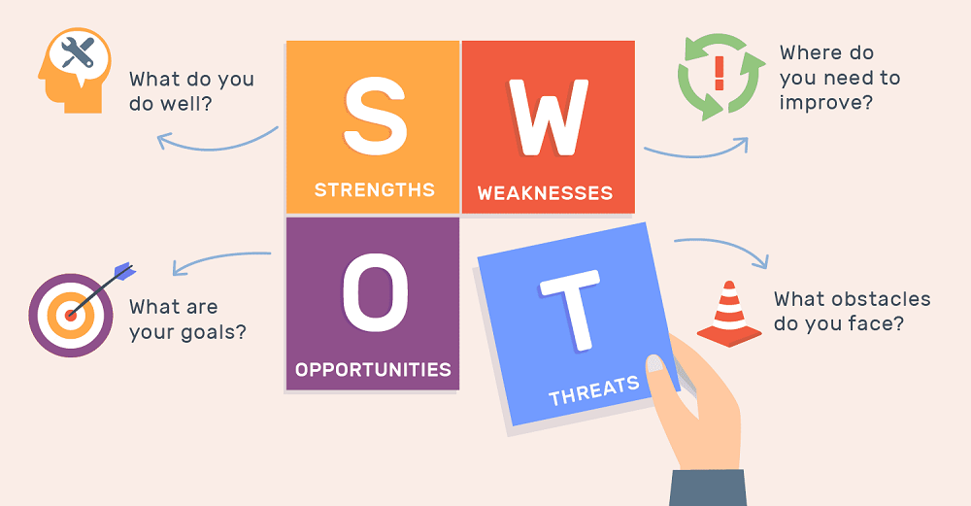
Notes:
Rae
Use this to help know where to start.

Slide 13
Surveys
Interviews
Focus groups
Work groups
Data Collection
Notes:
Rae

Slide 14
Recommendations to address the gaps
Expected impact
Discuss with stakeholders
Modify as needed
Current situation
Share with your institution
Notes:
Rae
Come prepared with the current concerns/situation, what the gaps are and how you want to fill them, what the benefits will be. Then discuss with stakeholders and modify if needed.

Slide 15
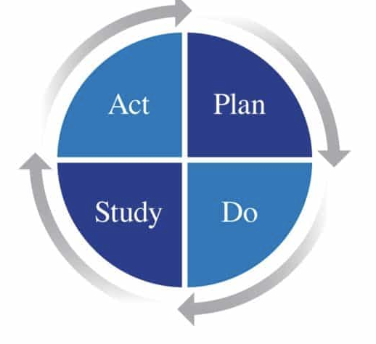
Act on it!
Update your plan based on the information
Make a plan!
Address your gaps
Identify the resources you have
Create a timeline
How to measure success?
Study it!
Analyze the information at defined intervals
Do it!
Implement the plan
Gather information along the way

Slide 16

Getting started:
Design with the end in mind – Outcomes!
Engage, look for champions, mentors
Create a curriculum with a schedule to complete
Personalize the curriculum to your program
Identify resources
Workshops and teambuilding, get buy in
Maintain momentum
Notes:
Rae

Slide 17

Suggested Curriculum
Review of CBME
Addressing the Family Medicine Outcomes
Creating competency-based Goals and Objectives
Developing and Using Competency-based Assessment Strategies
Giving Feedback and Using Direct Observation
Advising and Coaching with ILPs
Notes:
Rae

Slide 18

Millers Pyramid
Does
Shows How
Knows How
Knows
Notes:
Rae
Keep the focus at the top of the pyramid.

Slide 19


Family Medicine Outcomes
What are they?
How does our program address them?
Where are the gaps and how can we fill them?
What resources to we have?
What resources do we need going forward?
Goal: Curriculum designed to target them
Notes:
Priyanka
Fac Dev Goal is to update curriculum to address the Outcomes

Slide 20
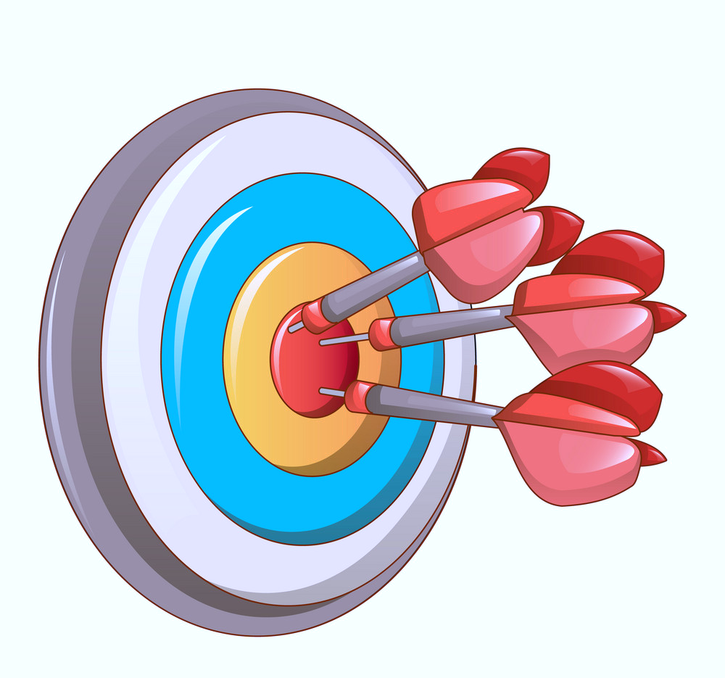
Competency Based Goals and Objectives
Target the Outcomes
Identify where best demonstrated
Make progressive
Limit to the most essential
Be SMART:
  Specific
  Measurable
  Relevant
  Timebound
  Goal: Create and update…
Notes:
Priyanka
Fac Dev Goal is to update curriculum Goals and Objectives.
Example:
Faculty Jane Smith will update the Internal Medicine Goals and Objectives to target the applicable Outcomes sing progressive language by the end of this academic year.

Slide 21

Teaching
Precepting models
Feedback models
Coaching
Goal: Faculty commitment
Notes:
Priyanka
Fac Dev Goal is to get engagement from faculty in proven models of teaching,
SNAPPS precepting model
ADAPT Feedback model
Develop skilled coaches

Slide 22

CBME Assessment
Multiple points and methods
Timely, and meaningful using direct observation.
Match stated Goals and Objectives
Incorporate Milestones
Progression based on entrustment
Goal: Effectively use designated CB assessment tools
Notes:
Priyanka
Fac Dev Goal is to update assessment tools to focus on competency and Outcomes

Slide 23
How to Overcome the Barriers to CB Assessment:
Gradually update tools
Use more efficient tools such as mobile assessment
Train the supervisors and the learners
Notes:
Priyanka
We know this may seem daunting.
It does not need to all happen right now. It’s a gradual process that starts with identifying your program needs and gaps.
More assessments require tools that are quick ad easy to use.
Changing the culture to include more direct obs and regular use of a mobile app will take some time.
It all starts with faculty development and resident training to created a shared mental model.
Your CCC depends on it!

Slide 24

Feedback and Direct Observation
Formative vs summative
Timely, in the moment
Combine with teaching
Includes resident perspective
ADAPT (Ask/Discuss/Ask/Plan Together)
Goal: Provide feedback using a proven model and document
Notes:
Priyanka
ADAPT, 1 minute preceptor, etc

Slide 25

Advising and Coaching with ILPs
What is coaching?
What makes a great coach?
What makes a great advisor?
How does faculty facilitate a meaningful ILP with the resident?
Goal: Provide coaching to advisees regarding their SMART goals documented on the ILP
Notes:
Priyanka
Have your faculty do their own ILPs
Have faculty watch each other during precepting and provide Feedback using your chosen feedback model.

Slide 26

How to maintain momentum?
Review concepts and do a SWOT to determine next steps
Create a planning committee – CCC? PEC? Other?
Create a curriculum that best meets your needs
Schedule it out for 1-2 years
Utilize existing resources and create your own as needed
Faculty and resident engagement….
Notes:
Rae

Slide 27

Engagement
Designated time to meet and plan, retreat
Combined workgroups
Rapid cycle PDSA
Make goals and results well known
Incentivize both sides who use the tools
Make it fun: games, signage, team building
Start early: rotating students, orientation
Notes:
Rae

Slide 28

Measuring Success
Observe faculty giving feedback, and give feedback
Bi-directional feedback
Track the number of assessments done over time
Monitor use of resident ILPs
Faculty ILPs
Pre and post surveys regarding satisfaction with teaching and learning
Notes:
Rae

Slide 29

Program Evaluation and Clinical Competency Committees
Make recommendations to PD regarding final competence in the Family Medicine Outcomes.
Extra faculty development
May lead the way for Faculty Development
Need time to strategize
Notes:
Rae
Why does the CCC depend on it. We don’t want the CCC to be going by their gut. We need our CCCs to have enough data to make a summative assessment of a residents progress for both promotion and graduation. Are they on track? If not, how can the program help and intervene early enough in the process to make a meaningful difference.
In the end, the PD has to feel comfortable saying the resident is competent for independent practice in all of the Outcomes. The CCC is the conduit to that.

Slide 30

Final Goal = Action Plan
Priorities | Next Steps | Person Responsible | Follow-up Dates | Measurement of Success
Notes:
Rae

Slide 31

Resources
STFM CBME Toolkit, Webinars
Faculty Development Delivered
ACGME Learnings
AFMRD-PD Toolbox
Learning collaboratives
Faculty sharing from national/regional conferences
Notes:
Rae

Slide 32

STFM Toolkit
https://stfm.org/teachingresources/resources/cbme-toolkit/assessment-tools-strategies/
*Outcome Assessment Starter Pack
Notes:
For more details, you can go to the STFM website for CBME and access the toolkit using the link you see here. This sight contains a document titled the Outcome Assessment Starter Pack which has details about assessment including links to some recommended tools and instructions for both New Innovations and MebHub. We plan to do ongoing updates as needed as well.

Slide 33

Objectives met?
Poll
Can you now:
perform a gap analysis to identify focus areas for faculty development in your program?
list at least two best practices in creating faculty development focused on CBME principles and application.
begin to create a longitudinal plan for implementing ongoing faculty development in this area.
Notes:
Priyanka
We hope this met your expectations and you are now more able to meet the stated objectives. One one way to find out is to ask!

Slide 34

Questions
Notes:
Priyanka
We are now happy to answer any questions.

