Slide 1
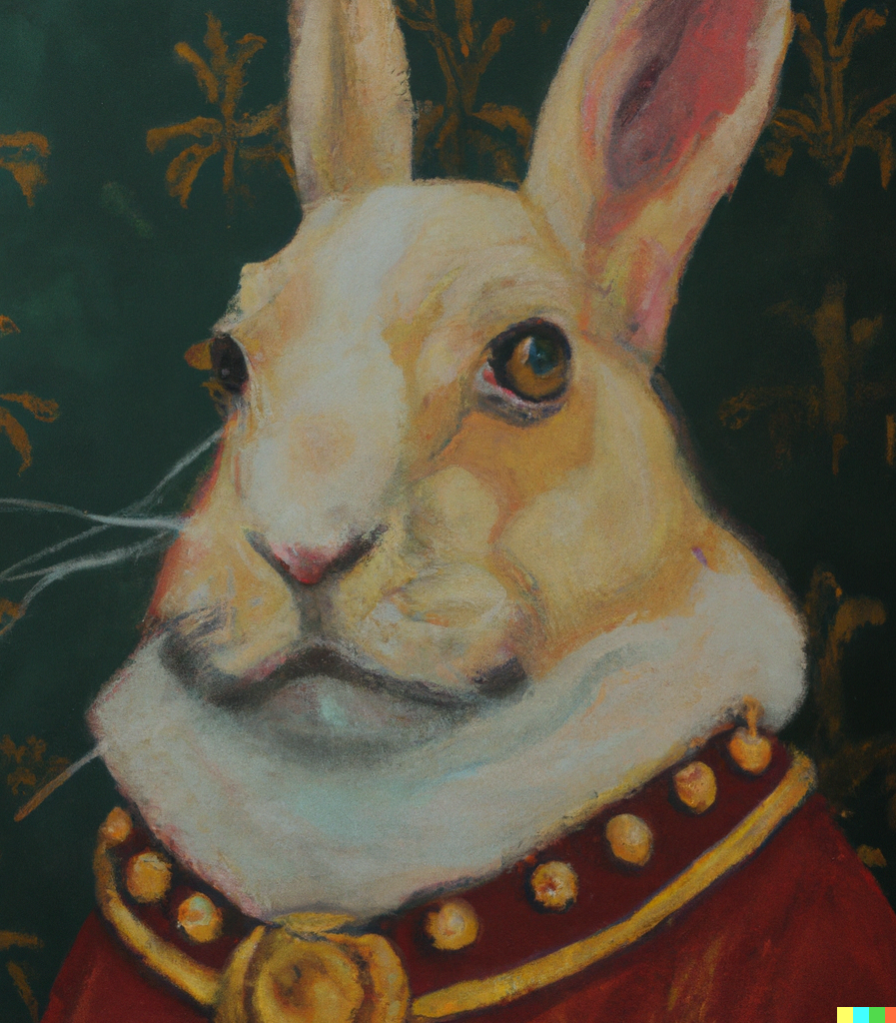
Generative AI for Research and Education: From Theory to Practice
Tanner Dean D.O.

Slide 2
Disclosures
NONE

Slide 3
Bio
Assistant Professor of Internal Medicine – Wichita
Residency – Internal Medicine KUMC-Wichita
Medical School- A.T. Still University - Kirksville College of Osteopathic Medicine
Undergraduate: BYU
Major: Microbiology

Slide 4
Bio
Assistant Professor of Internal Medicine – Wichita
Residency – Internal Medicine KUMC-Wichita
Medical School- A.T. Still University - Kirksville College of Osteopathic Medicine
Undergraduate: BYU
Major: Microbiology
*NO COMPUTER SCIENCE

Slide 5
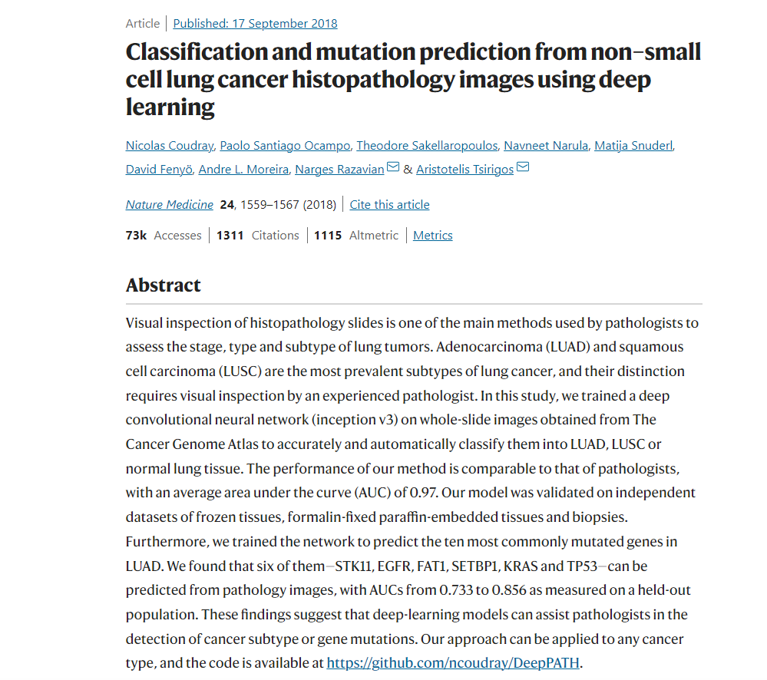

Slide 6
Medical Education
Illness Script

Slide 7
Medical Education
Illness Script
Computer script

Slide 8
Presentation Roadmap
Assumptions
Outline
Rapidly evolving
Generative AI is easy to access so we will focus on it
If I can learn machine learning, you can learn it too
Focus on “Key Ideas”
Nuts and Bolts of Generative AI (ChatGPT)
Prompting
Generative AI in medical education
The future

Slide 9
Presentation Roadmap
Assumptions
Outline
Rapidly evolving
Generative AI is easy to access so we will focus on it
If I can learn machine learning, you can learn it too
Focus on “Key Ideas”
Nuts and Bolts of Generative AI (ChatGPT)
Prompting
Generative AI in medical education
The future

Slide 10
Key Ideas

Slide 11
Definitions
Artificial intelligence
The capability of a machine to imitate intelligent human behavior. It encompasses techniques that enable computers to solve problems, make decisions, and learn from data.
Machine learning
a branch of artificial intelligence that focuses on developing algorithms and statistical models that enable computers to perform tasks without explicit instructions, by using patterns and inference derived from data.

Slide 12
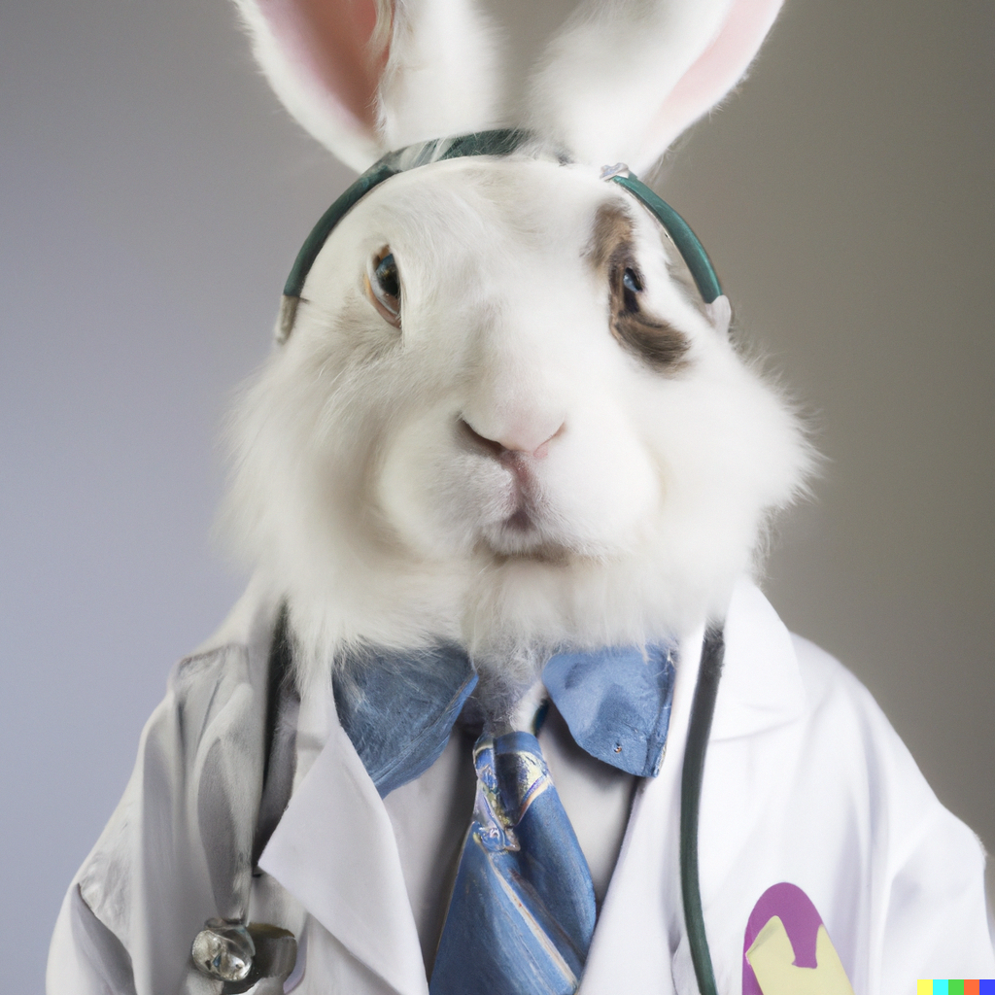
Generative AI
A form of artificial intelligence that generates novel text, videos, sound, etc. based off instructions called prompts.

Slide 13
Generative AI
A form of artificial intelligence that generates novel text, videos, sound, etc. based off instructions called prompts.

Slide 14
Generative AI
A form of artificial intelligence that generates novel text, videos, sound, etc. based off instructions called prompts.

Slide 15
Generative AI
A form of artificial intelligence that generates novel text, videos, sound, etc. based off instructions called prompts.

Slide 16
Available Generative AI – LLM
ChatGPT
Gemini
Copilot
LLAMA
PaLM
Claude
……….
As of 4/30/24 ~ 129 models

Slide 17
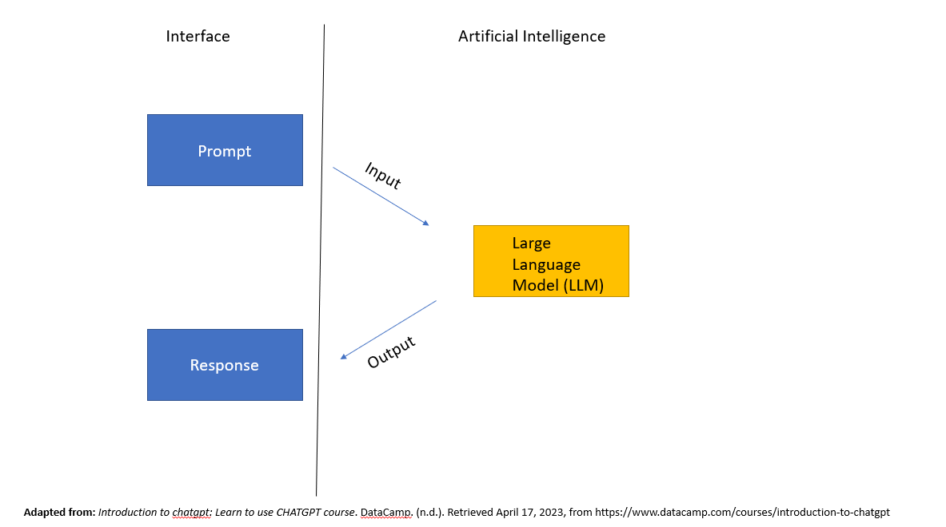

Slide 18
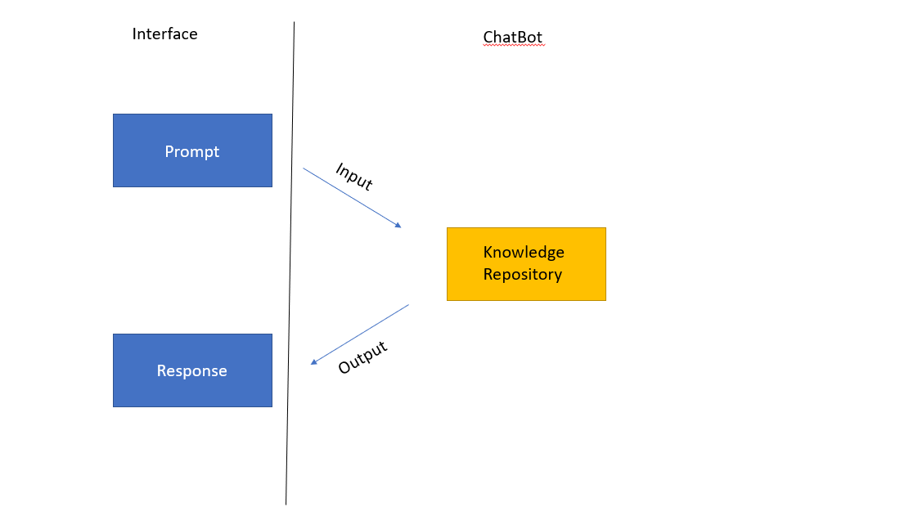

Slide 19
Dataset
Reinforcement Learning

Slide 20
Large Language Model – Simplified
Training
Dataset = “Word Wall”
Algorithms detect patterns within the “Word Wall”
Fine-Tuned with Reinforcement Learning from Human Feedback (RLHF)
Calcium | Is | The | Most | Abundant
Cation | Found | In | The | Human
Body | And | Plays | An | Integral
Role | In | Neural | Transmission | enzyme
Adapted from: Introduction to chatgpt: Learn to use CHATGPT course. DataCamp. (n.d.). Retrieved April 17, 2023, from https://www.datacamp.com/courses/introduction-to-chatgpt

Slide 21
Large Language Model – Simplified
Training
Dataset = “Word Wall”
Algorithms detect patterns within the “Word Wall”
Fine-Tuned with Reinforcement Learning from Human Feedback (RLHF)
Calcium | Is | The | Most | Abundant
Cation | Found | In | The | Human
Body | And | Plays | An | Integral
Role | In | Neural | Transmission | enzyme
Adapted from: Introduction to chatgpt: Learn to use CHATGPT course. DataCamp. (n.d.). Retrieved April 17, 2023, from https://www.datacamp.com/courses/introduction-to-chatgpt

Slide 22
Algorithm and Detection
Pre-GPT
Transformer + Attention Mechanism

Slide 23
Algorithm and Detection
Pre-GPT
Transformer + Attention Mechanism

Slide 24
Algorithm and Detection
Pre-GPT
Transformer + Attention Mechanism
Self-attention or multi-head attention

Slide 25
Large Language Model – Simplified
Training
Dataset = “Word Wall”
Algorithms detect patterns within the “Word Wall”
Fine-Tuned with Reinforcement Learning from Human Feedback (RLHF)
Calcium | Is | The | Most | Abundant
Cation | Found | In | The | Human
Body | And | Plays | An | Integral
Role | In | Neural | Transmission | enzyme
Adapted from: Introduction to chatgpt: Learn to use CHATGPT course. DataCamp. (n.d.). Retrieved April 17, 2023, from https://www.datacamp.com/courses/introduction-to-chatgpt

Slide 27
Key Idea- Training
LLM’s get their power from:
The Transformer
Reinforcement learning with human feedback

Slide 28
ChatGPT (GPT4) – What can it do?
Strengths
Limitations
Summarize text
Explain concepts
Remembering conversation history
Brainstorming / creating ideas
Code/debug code
Knowledge limit
GPT4 = early 2022
Biases in dataset
Loss of context tracking
Hallucination
Legal and Ethical uncertainties
Cannot ask for clarifying data (LLM to user)
For more see: Introducing ChatGPT (openai.com)

Slide 29
ChatGPT (GPT4) – What can it do?
Strengths
Limitations
Summarize text
Explain concepts
Remembering conversation history
Brainstorming / creating ideas
Code/debug code
Knowledge limit
GPT4 = early 2022
Biases in dataset
Loss of context tracking
Hallucination
Legal and Ethical uncertainties
Cannot ask for clarifying data (LLM to user)
For more see: Introducing ChatGPT (openai.com)

Slide 30
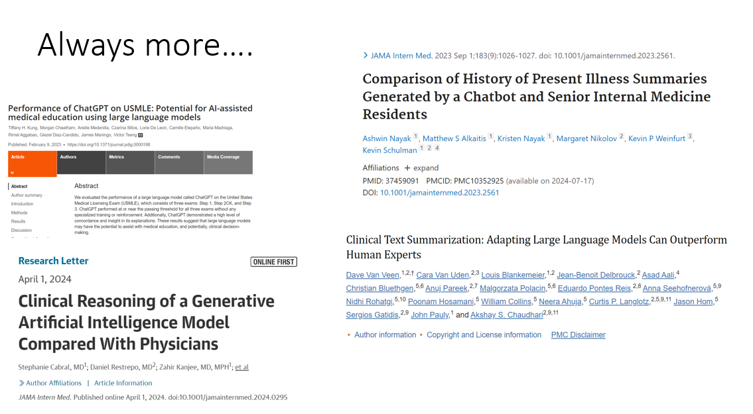

Slide 31
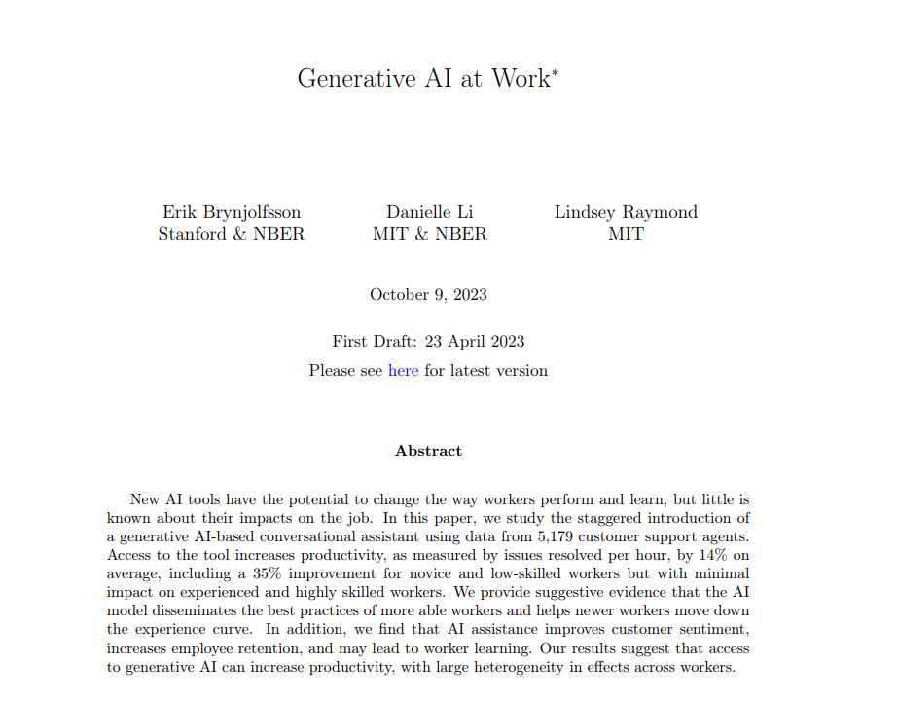
What can it do

Slide 32
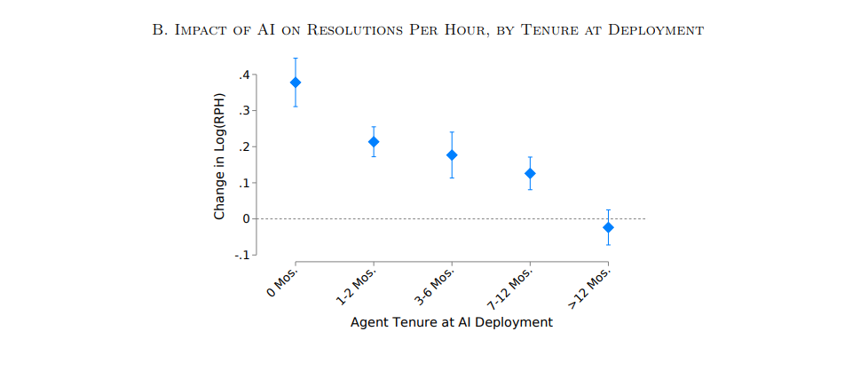
What can it do
14% average increase in “productivity”
Stratified by skill level:
35% increase for novice / low skill
“minimal” impact experienced or highly skilled workers

Slide 33
Key Idea-Capabilities
Every day new studies come out showing what GPT’s can do in an experimental (or not) manner.
May help the “lower” skilled, catch up with those of “higher” skill

Slide 34
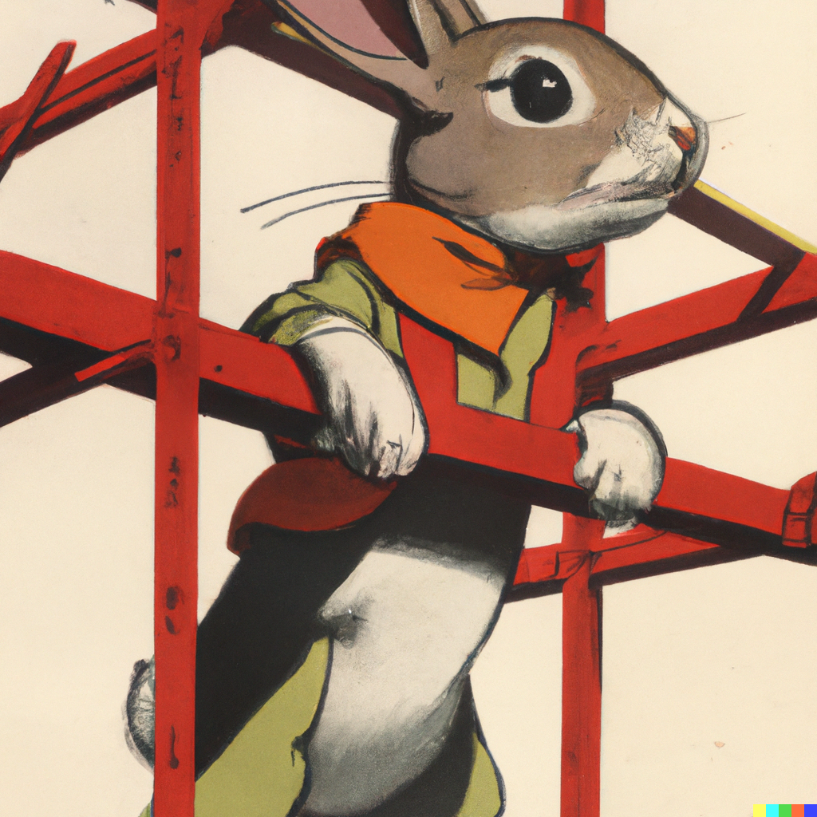
Prompt Engineering
Thoughtful responses are based on thoughtful prompts
Restrictions Breed Creativity

Slide 36
Prompt Engineering – How ChatGPT interprets prompts
Step 1: What does the input mean? (words, relation to other words, topics, relation to other topics)
Step 2: What is being requested?
Step 3: Generate a response based off of probability

Slide 37
Best practices prompts – My observations*
Essential practices
Super-power prompts practices
Write clear instructions
Give all the needed context and information
Clear and specific
Keep it concise (extra words distract it)
Split complex tasks into smaller tasks
Human – Computer - Human
Give examples
Think in synonyms/re-phrasing
Give it an identity
“You are a data scientist…”
Set restrictions to responses
“5 sentences or less”
Only ask for something you could do given enough time
Have it generate prompts for other prompts
Avoid negative commands
“Don’t be formal” vs “keep it casual”
Intentional Verbs
Instead of “write a hook…” use “hook the reader”

Slide 38
Best practices prompts – My observations*
Essential practices
Super-power prompts practices
Write clear instructions
Give all the needed context and information
Clear and specific
Keep it concise (extra words distract it)
Split complex tasks into smaller tasks
Human – Computer - Human
Give examples
Think in synonyms/re-phrasing
Give it an identity
“You are a data scientist…”
Set restrictions to responses
“5 sentences or less”
Only ask for something you could do given enough time
Have it generate prompts for other prompts
Avoid negative commands
“Don’t be formal” vs “keep it casual”
Intentional Verbs
Instead of “write a hook…” use “hook the reader”

Slide 39
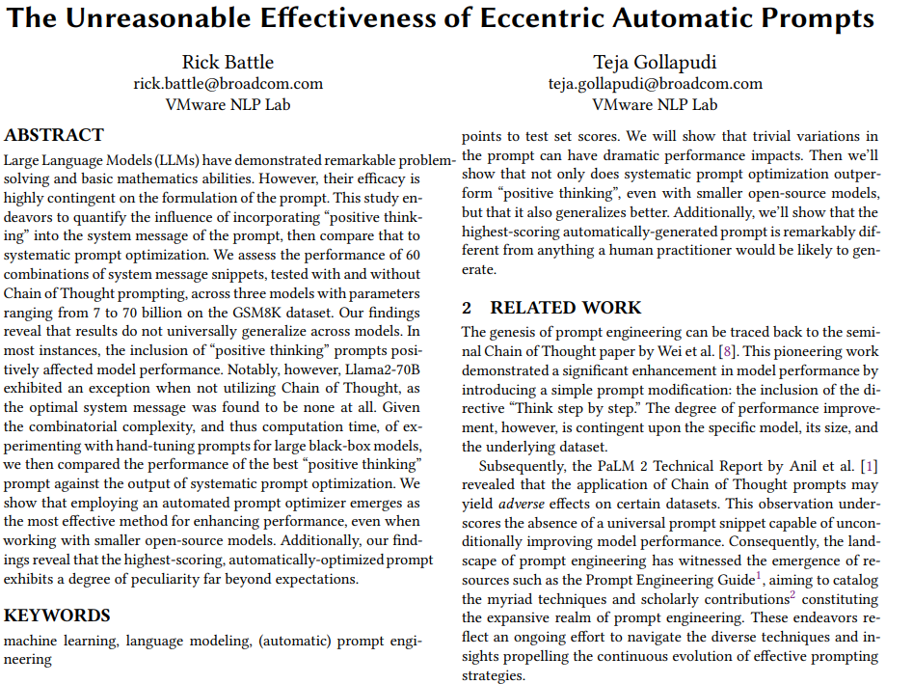
*Evidenced Prompting Studies
Eccentric

Slide 40
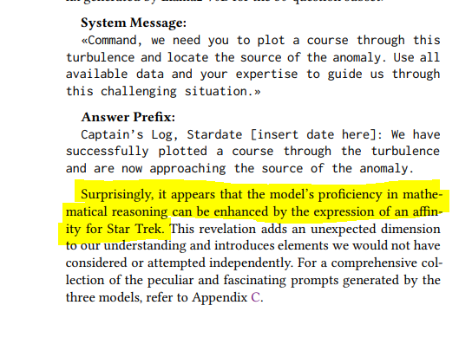
*Evidenced Prompting Studies
Eccentric

Slide 41
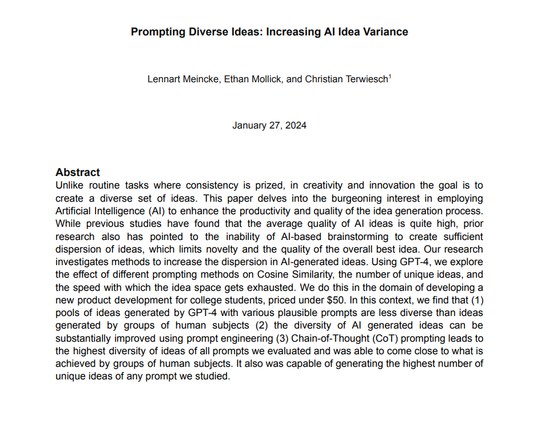
*Evidenced Prompting Studies
Chain of thought

Slide 42
*Evidenced Prompting Studies
Chain of thought

Slide 43
*Evidenced Prompting Studies
Chain of thought

Slide 44
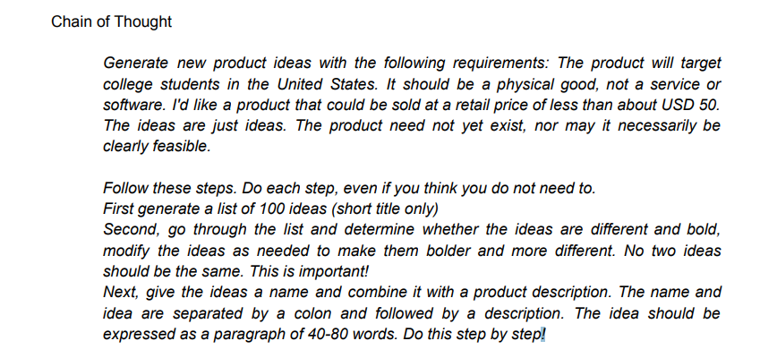
*Evidenced Prompting Studies
Chain of thought
BASE
CoT

Slide 45
Technical Prompting Techniques
Zero Shot Prompting
Few Shot Prompting
Machine Learning Principle
Relies on the models baseline knowledge without providing any new training
“When is Christmas celebrated in America?”
This is using the base training of the model
Machine Learning Principle
Based off additional training data provided to the model
“What is my favorite cooking spice?”
Provide several examples of foods I think taste good

Slide 46
Technical Prompting Techniques
Zero Shot Prompting
Few Shot Prompting
Machine Learning Principle
Relies on the models baseline knowledge without providing any new training
“When is Christmas celebrated in America?”
This is using the base training of the model
Machine Learning Principle
Based off additional training data provided to the model
“What is my favorite cooking spice?”
Provide several examples of foods I think taste good

Slide 47
Technical Prompting Techniques
Zero Shot Prompting
Few Shot Prompting
Machine Learning Principle
Relies on the models baseline knowledge without providing any new training
“When is Christmas celebrated in America?”
This is using the base training of the model
Machine Learning Principle
Based off additional training data provided to the model
“What is my favorite cooking spice?”
Provide several examples of foods I think taste good

Slide 48
Key Idea-Prompting
One shot vs Zero shot
Chain of Thought
Eccentric?
Restrictions breed creativity

Slide 49
Pitfalls
“Hallucination”
Authoritative confabulation
PHI
Without private mode, OpenAI can see everything
Lack of subject matter expertise
Unable to verify validity of output
No editing, using output as is
Bias
Data set is trained on things as they are done, not how they should be done

Slide 50
Pitfalls
“Hallucination”
Authoritative confabulation
PHI
Without private mode, OpenAI can see everything
Lack of subject matter expertise
Unable to verify validity of output
No editing, using output as is
Bias
Data set is trained on things as they are done, not how they should be done

Slide 51
Pitfalls
“Hallucination”
Authoritative confabulation
PHI
Without private mode, OpenAI can see everything
Lack of subject matter expertise
Unable to verify validity of output
No editing, using output as is
Bias
Data set is trained on things as they are done, not how they should be done

Slide 52
Pitfalls
“Hallucination”
Authoritative confabulation
PHI
Without private mode, OpenAI can see everything
Lack of subject matter expertise
Unable to verify validity of output
No editing, using output as is
Bias
Data set is trained on things as they are done, not how they should be done

Slide 53
Pitfalls
“Hallucination”
Authoritative confabulation
PHI
Without private mode, OpenAI can see everything
Lack of subject matter expertise
Unable to verify validity of output
No editing, using output as is
Bias
Data set is trained on things as they are done, not how they should be done

Slide 54
Pitfalls
“Hallucination”
Authoritative confabulation
PHI
Without private mode, OpenAI can see everything
Lack of subject matter expertise
Unable to verify validity of output
No editing, using output as is
Bias
Data set is trained on things as they are done, not how they should be done

Slide 55
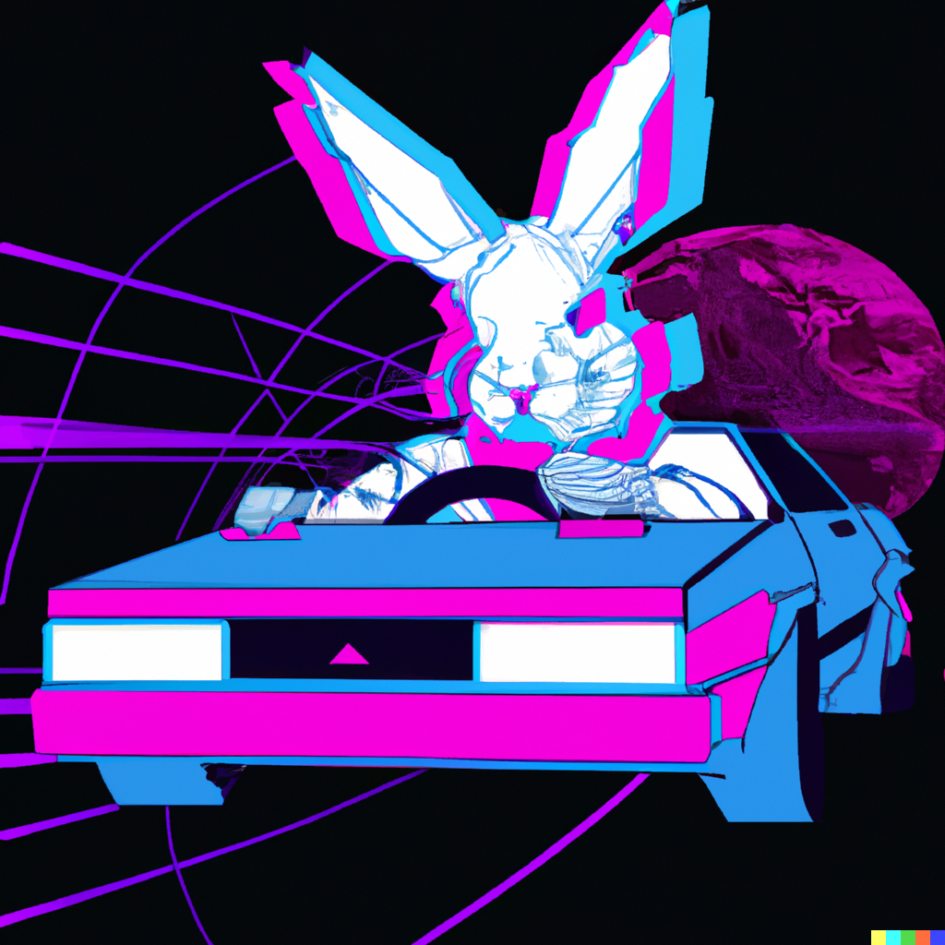
Medical Education and Research

Slide 56
Moore's Law: The number of transistors on a microchip doubles about every two years, though the cost of computers is halved.

Slide 57
Moore’s Law, if true…
Now – Education

Slide 58
Moore’s Law, if true…
Now – Education
Now – Research

Slide 59
Moore’s Law, if true…
Now – Education
Now – Research

Slide 60
Implications of Moore’s Law
Now
10 years (current undergrads)

Slide 61
Key Idea-Moore’s Law
10 years (current undergraduates)
What does this mean for future learners?
What does this mean for us as educators and investigators?

Slide 62
What are the core skills of primary care?
How does that change what we teach as medical educators?

Slide 63
Dr. Dean’s Ideas
Core Skills:
Influence / change
Critical analysis / check and balance
Health Advocate

Slide 64
Dr. Dean’s Ideas
Core Skills:
Influence / change
Critical analysis / check and balance
Health Advocate

Slide 65
Dr. Dean’s Ideas
Core Skills:
Influence / change
Critical analysis / check and balance
Health Advocate

Slide 66
Evaluation
Please evaluate this presentation in the conference mobile app.

Slide 67
Thank You

Slide 68
Links:
Classification and mutation predictors form non-small cell lung cancer histopathology images using deep learning.
Classification and mutation prediction from non-small cell lung cancer histopathology images using deep learning - PubMed (nih.gov)
Performance of ChatGPT on USMLE: Potential for AI-assisted medical education using large language models
Performance of ChatGPT on USMLE: Potential for AI-assisted medical education using large language models - PubMed (nih.gov)
Clinical Reasoning of a Generative Artificial Intelligence Model Compare With Physicians
Clinical Reasoning of a Generative Artificial Intelligence Model Compared With Physicians - PubMed (nih.gov)
Comparison of History of Present Illness Summaries Generated by a Chatbot and Senior Internal Medicine Residents
Comparison of History of Present Illness Summaries Generated by a Chatbot and Senior Internal Medicine Residents - PubMed (nih.gov)
Clinical Text Summarization: Adapting Large Language Models Can Outperform Human Experts
Clinical Text Summarization: Adapting Large Language Models Can Outperform Human Experts - PMC (nih.gov)
The Unreasonable Effectiveness of Eccentric Automatic Prompts
arXiv:2402.10949v2 [cs.CL] 20 Feb 2024
Prompting Diverse Ideas: Increasing AI Idea Variance
https://arxiv.org/pdf/2402.01727

