Slide 1
Towards Health Equity and Justice: Navigating the Emotional Toll from the Heavy Lift
Kathryn Fraser, PhD, Halifax Health FMR, Daytona Beach, Florida
Jeffrey Ring, PhD, Independent Practice, Los Angeles, California

Slide 2
objectives
Describe the emotional toll of doing DEIA work in academic medicine
Discuss personal experiences with the DEIA toll that they and others experience
Identify strategies to mitigate and counteract the DEIA toll in their work and the work of their colleagues

Slide 3
Poll—Who are you?
Med student
Resident or fellow
UME faculty
GME faculty
Administrator or coordinator

Slide 4
POLL – DeI Work
Do you find the DEI work that you do:
Thoroughly energizing
Somewhat energizing
A balance between energizing and depleting
Somewhat depleting
Thoroughly depleting
N/A—not currently doing DEI work

Slide 5
“We are Tired.” Strategies to
Mitigate the Personal Toll of
Diversity, Equity, Inclusion
And Anti-Racism Work.
STFM 2023 Preconference

Slide 6
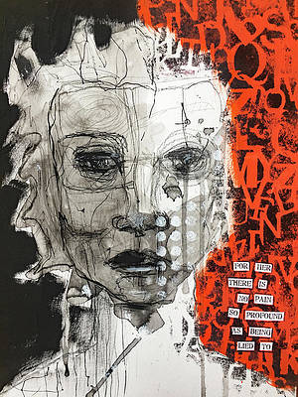
What is the toll of deia work?
Toll: “having an adverse effect, especially so as to cause damage, suffering or death.”
Minority tax: “the additional responsibilities placed on minority faculty to achieve diversity”

Slide 7
What is the toll of deia work?
Personal
Psychological: experience of micro/macroaggression; tokenization; isolation; not belonging; imposterism; depression
Exhaustion: “It is emotionally exhausting to put your difference on display.”
Emotional labor: the constant need to explain yourself
Physical fatigue: HTN; higher cortisol Racial Battle Fatigue
“…pressure to be exceptional to prevent tarnishing the reputation of your race, gender, or sexual orientation.”
Cyrus, 2017; Zambrana, 2018; Quaye et al., 2019; Carvajal et al., 2023

Slide 8
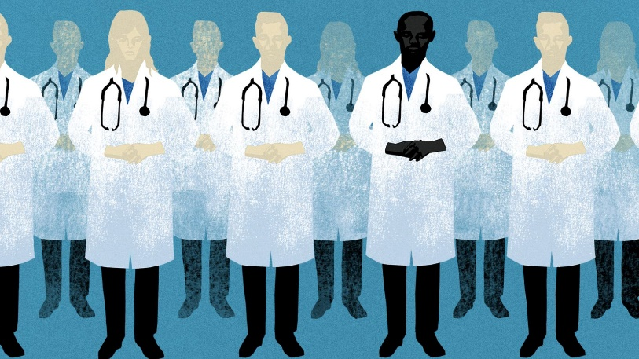
Professional consequences of DEIA toll
URiM faculty: lower career satisfaction/higher social isolation
DEIA work often uncompensated, unrecognized, detrimental
Non DEIA interests can suffer: lack of mentors, collaborators
Nivet, et al., 2008; Rodriguez & Campbell, 2015; Xierali, et al., 2021, Zambrana, 2018; Cyrus, 2017

Slide 9
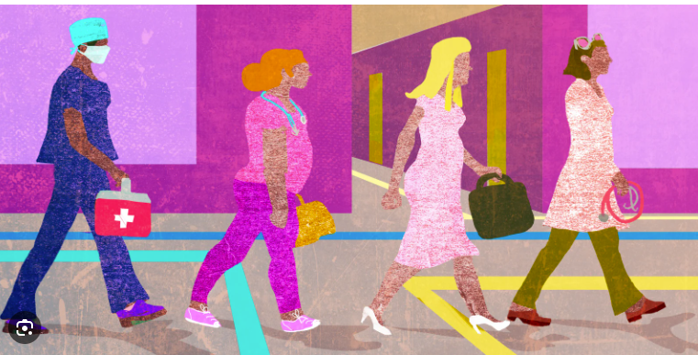
Professional consequences of DEIA toll
Fewer promotions
Fewer resources
Greater exodus from Academic Medicine
Fewer URiM leaders
Less recruitment and retention
Nivet, et al., 2008; Rodriguez & Campbell, 2015; Xierali, et al., 2021, Zambrana, 2018; Cyrus, 2017

Slide 10
What are our stories???
3 questions for Jeff
3 questions for Kathryn

Slide 11
What depletes you in your DEI work?—respond in chat
What sustains you in your work?—respond in chat

Slide 12
Questions?
Comments?
Next steps?

