Slide 1
The Role of Resident Portfolios in Competency-based Assessment
Priyanka Tulshian MD MPH FAAFP
Aaron Lambert MD FAAFP
Pamela MacMillan
October 9, 2024

Slide 2

Faculty Development Webinars
stfm.org/cbmewebinars
What You Need to Know About ACGME and ABFM Expectations for a Shift to Competency-Based Medical Education
Reflections, Goals, & Objectives – Oh My! Best Practices for Creating ILPs
Let’s Talk About Entrustment
Assessment Tools for CBME and the Core Outcomes
Building CBME Into Faculty Development
Advisors and Coaches: The Evolving Role of Faculty and Resident Relationships
Individualized Learning and Resident Assessment: A CBME Orientation for Residents
Fostering Master Adaptive Learning and a Growth Mindset in Your Program
How to Effectively Use Electives to Help Residents Attain Competency in the Core Outcomes
The Role of Resident Portfolios in Competency-Based Assessment
Managing Assessment Burden in CBME
How to Have Reflective Feedback Conversations and Develop a Culture of Effective Feedback
Notes:
STFM has planned a series of CBME webinars. These are co-branded and co-marketed with AFMRD. We have had record-breaking registration for the live events and excellent viewership of the recordings.
Each webinar has at least one member of the task force. We’ve also included presenters from an open call we put out for CBME subject matter experts. For those of you who have joined us on this journey of adapting CBME into family medicine education, we appreciate your audience and participation. For those of you just joining us, please note that all of the material we present today and have presented in the past is located within the CBME toolkit on the STFM website – you can find past webinars, one pagers on best practices, and other templates.

Slide 3
Objectives:
Discover the benefits of a portfolio system and its significance with Competency-Based Medical Education
Demonstrate objective and subjective assessments that can be included in the portfolio
Discuss incorporation of portfolios and corresponding assessments into residency programs while implementing CBME
Notes:
Today’s webinar is focused on diving into the resident portfolio and its role in adapting CBME culture into your residency.

Slide 4
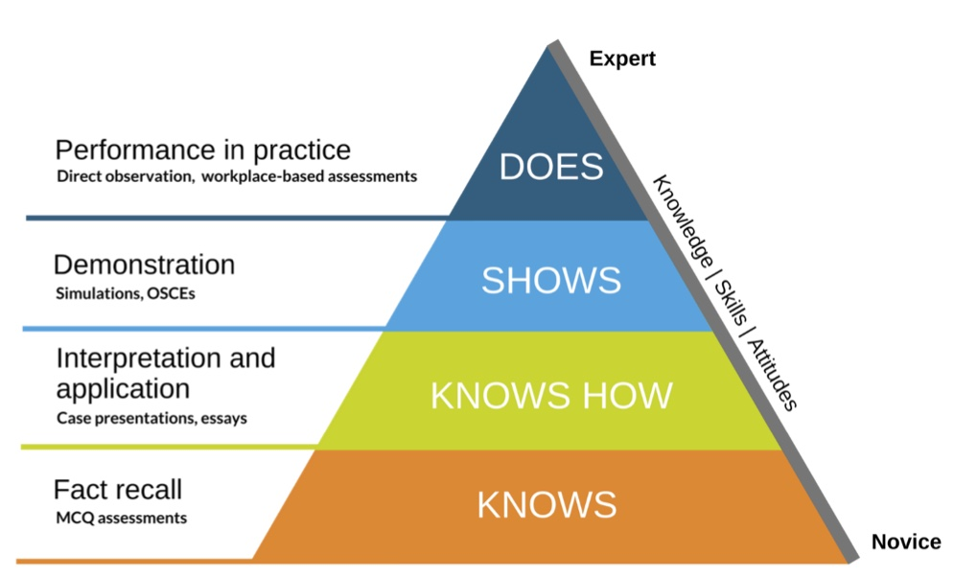
Competency Based Assessment Principlesency Based Assessment Principles
Assessment should enhance student learning
Assessment will be progressive and cumulative to encourage integration of previous material with new knowledge
Learner progress is rooted in competency, not grades
Ongoing cycles of self-assessment and advisement from faculty will ensure learners master areas of weakness and further develop areas of strength (ex: individualized learning plans)
Faculty will establish performance standards for competencies that all graduates must achieve (ex: core outcomes)
Dannefer, Elaine, and Lindsey Henson. "The Portfolio Approach to Competency-Based Assessment at the Cleveland
Clinic Lerner College of Medicine." Academic Medicine, vol. 82, no. 5, Mar. 2007, pp. 493-502.
Notes:
We cannot introduce resident portfolios without a quick detour to highlight a pillar of CBME, Assessments.
The end goal of residency should be that residents are independently able to perform in practice, ie the peak of Miller’s pyramid. Assessements should be used to guide and focus learners’s education as they progress up the pyramid.
# 3 – assessments provide insight into learner competency, are not formatted as grades
To this end, assessments should have the following characteristics:

Slide 5
CBME Assessment Characteristics
Multiple Settings
Multiple Faculty
Multimodal
Make Space for Reflection
Continous Review

Slide 6

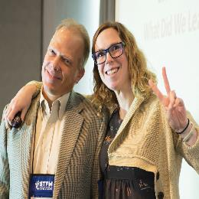

What are Portfolios?
“Instruments to collect and assess evidence of learner’s progression in tasks or competencies”
Heeneman, Sylvia, and Erik Driessen. "The use of a portfolio in postgraduate medical education - reflect, assess and account, one for each or all in one?" GMS Journal for Medical Education, vol. 34, no. 5, 2017.

Slide 7
Portfolios Follow Principles of CBME
Collection of Multimodal Assessments
Require learner engagement for success
Include learner reflection
Include individualized learning plans
Involve frequent review between learner and coach/advisor/mentor
Notes:
Portfolios are a tremendous advantage as they follow the principles of CBME – Think of a portfolio as a binder where the resident collects assessments throughout their tenure and uses it to review areas of strength and growth edges through independent reflection AND several informal reviews with their advisor or coach.

Slide 8
Resident Portfolio Best Practices
Ex: “Show how you… “
“This document is…and is valuable evidence of…”
Ex: “Think about the last time you gave bad news compared to now – how did it feel this time?”
Should be organized by the competencies the learner wants to demonstrate (ABFM Core Outcomes)
Ex: ABFM Core Outcome #5: Model professionalism and be trustworthy for patients, peers, and communities​
Should include learning objectives for guidance
Should include reflections stimulated by discussion with advisor/coach

Slide 9
Establish Evidence
Organize Evidence
Review Evidence and Set Goals
Summarize Evidence
Keep the End in Mind
Steps to creating a Resident Portfolio
Notes:
Now keeping these best practices in mind, lets go through the steps of putting together a resident portfolio. Please keep in mind that you should tailor all of this information to your programmatic needs, but hopefully there is a lot that you can adapt.
In this context, when we say evidence, we mean assessments

Slide 10
15 Core Outcomes of Family Medicine Residency Training
1 | Develop effective communication and constructive relationships with patients, clinical teams, and consultants
2 | Practice as personal physicians, providing first-contact access, comprehensive, and continuity care, to include excellent doctor-patient relationships, excellent care of chronic disease, routine preventive care and effective practice management
3 | Diagnose and manage acute illness and injury for people of all ages in the emergency room or hospital
4 | Provide comprehensive care of children, including diagnosis and mgt of the acutely ill child and routine preventive care
5 | Model professionalism and be trustworthy for patients, peers, and communities
6 | Practice as personal physicians, to include care of women, the elderly, and patients at the end of life, with excellent rate of continuity and appropriate referrals
7 | Provide care for low-risk patients who are pregnant, to include mgmt of early pregnancy, medical problems during pregnancy, prenatal care, postpartum care and breastfeeding, with or without competence in labor and delivery
8 | Diagnose and manage common mental health conditions in people of all ages
9 | Perform the procedures most frequently needed by patients in continuity and hospital practices
10 | Model lifelong learning and engage in self-reflection
11 | Practice as personal physicians, to include MSK health and sports medicine, appropriate medication use and coordination of care by helping patients navigate a complex health system
12 | Provide preventive care that improves wellness, modifies risk factors for illness and injury, and detects illness in early, treatable stages for people of all ages while supporting patients’ values and preferences
13 | Assess priorities of care for individual patients across the continuum of care—in-office visits, emergency, hospital, and other settings, balancing the preferences of patients, medical priorities, and the setting of care
14 | Evaluate, diagnose, and manage patients with undifferentiated symptoms, chronic medical conditions, and multiple comorbidities
15 | Effectively lead, manage, and participate in teams that provide care and improve outcomes for the diverse populations and communities they serve
Notes:
So Step one is keeping the end in mind. What is the end in this case?
Knowing that programs will eventually have to attest to competency in these 15 core outcomes for each graduating resident to be able to sit for the ABFM boards, it is important to remember that the resident portfolio is a collection of assessments that can be used to provide evidence of competency in each core outcome for each resident. Therefore, including the core outcomes explicitly in the portfolio will be important.

Slide 11
Establishing Evidence (Assessments)
Program Driven
Resident Driven
  Procedure logs
  Patient encounter numbers
  Rotation feedback evaluations/snapshots
  Direct Observation Feedback
  Patient comments/feedback
  In-Training Exam scores
  Simulation evaluations/OSCEs
  Skill Certifications
  Reflection questions
  Rotation evaluations
  Training modules
  Conference presentations
  Quality Improvement/scholarly projects
  Individual Learning Plans
Notes:
Step 2 is to establish evidence
Evidence in a resident portfolio should be collected by both the program and the resident – it is vital to the success of a portfolio and a integral part of CBME framework that the learner is engaged in this process.
As you can see you are likely already engaging in several of these types of assessments – it is just a matter of correlating them to the core outcomes or perhaps tweaking them a bit to address any assessment gaps you may have. Additionally, it is important to also point out that the milestones, which we traditionally have been using for rotation evaluations are only one form of assessment. The other assessments should be traced back to the core outcomes and may not include milestones.
Here you can see that there is value to subjective assessements, in the form of self reflection by the learner

Slide 12
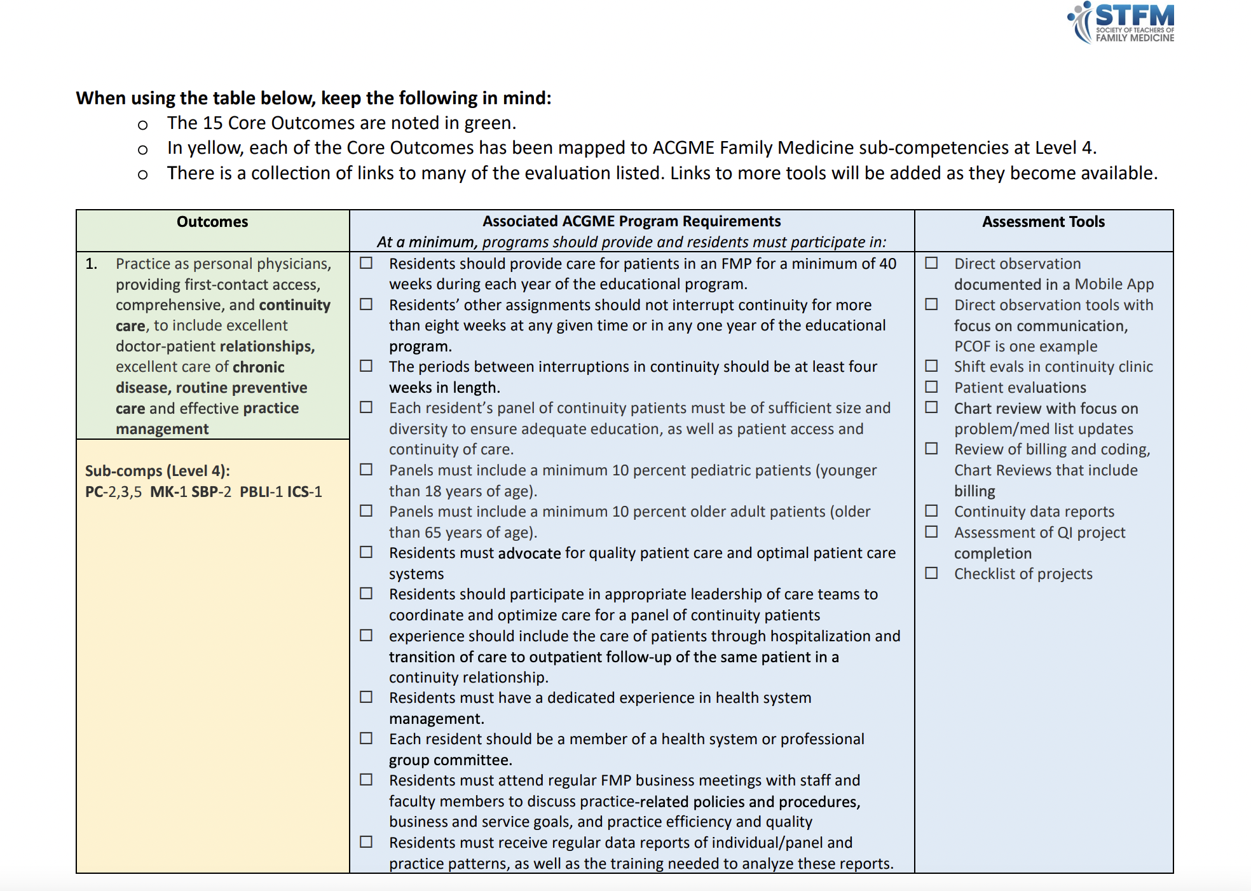
Notes:
If you are still in need of guidance on what types of assessments will provide evidence for what outcomes, we have created an outcomes assessment started pack that can be found within the CBME tool kit. You can see the outcomes on the left, the ACGME associated program, requirements in the middle, and assessments (or evidence) you can use to support competency towards each outcome.

Slide 13
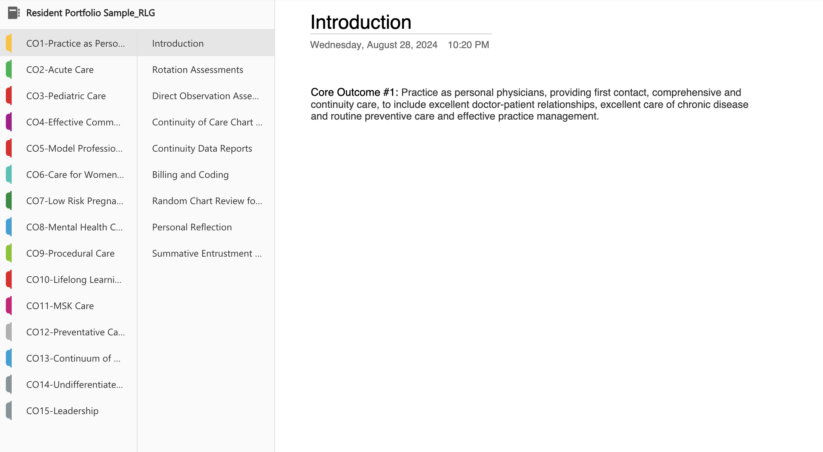
Organizing Evidence
Notes:
Ok – now that we have figured out what evidence we are going to support competency in each outcome, we need to figure out to organize the portfolio. In this example, we have used Microsoft notebook, where you can see each tab on the left corresponds to the core outcome….and then when you click on the core outcome, the core outcome is initially stated and then below it are a list of assessments that can be used to support learner competency for that outcome.
In this example, Core outcome #1 has assessments like continuity data reports, chart reviews.

Slide 14
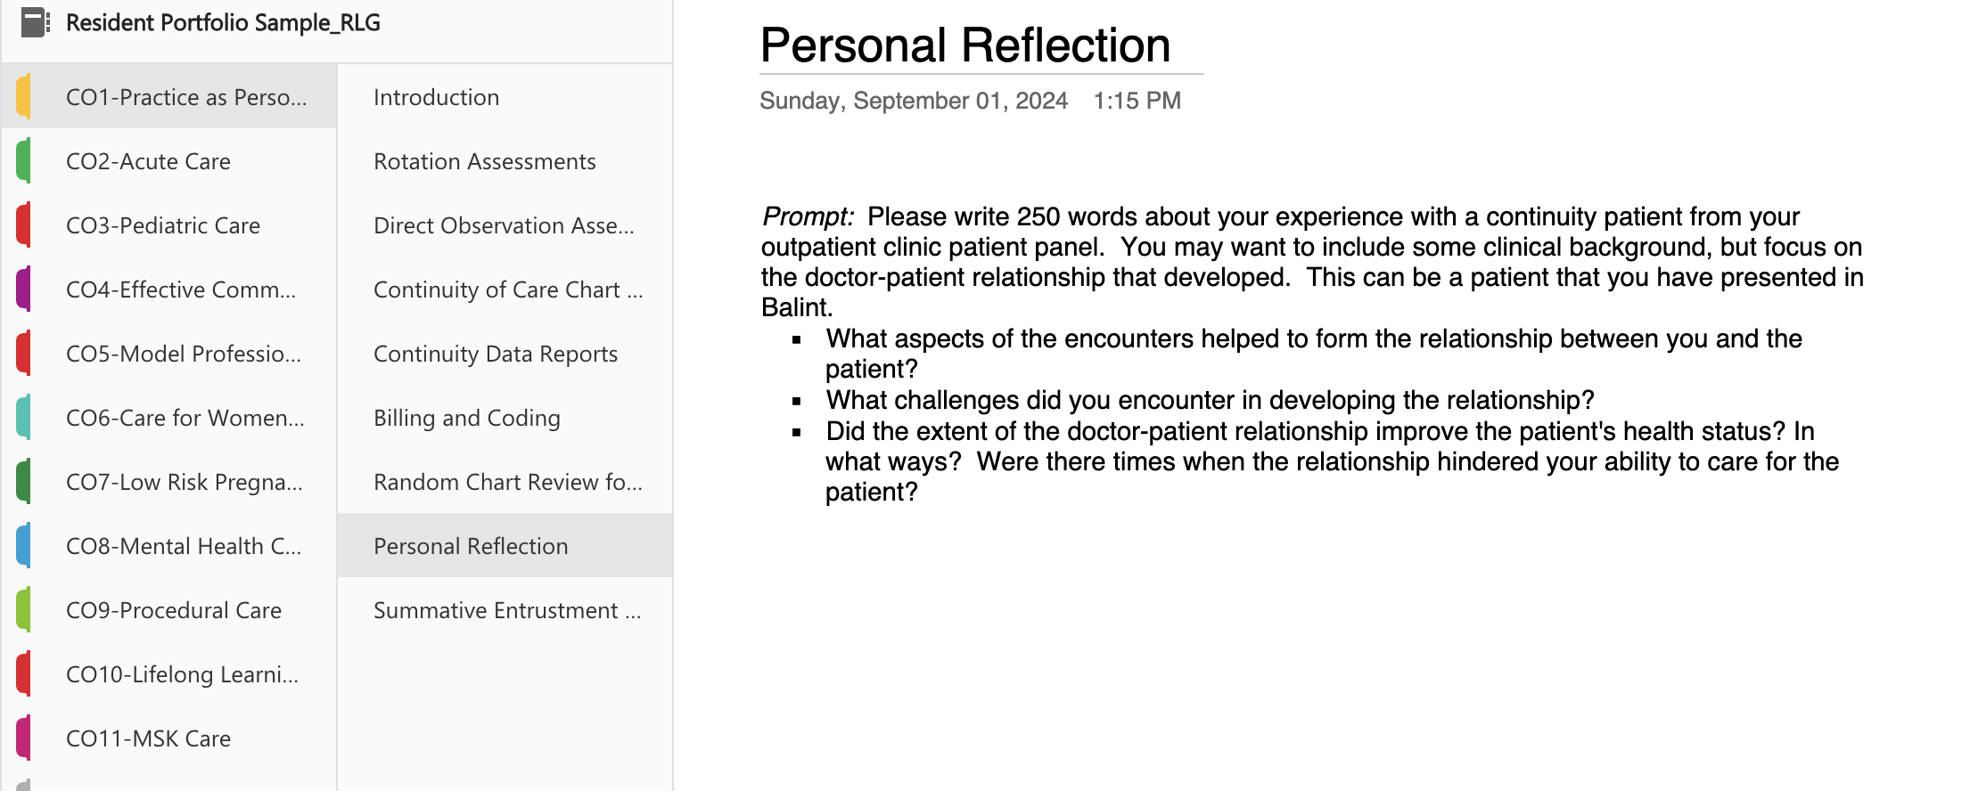
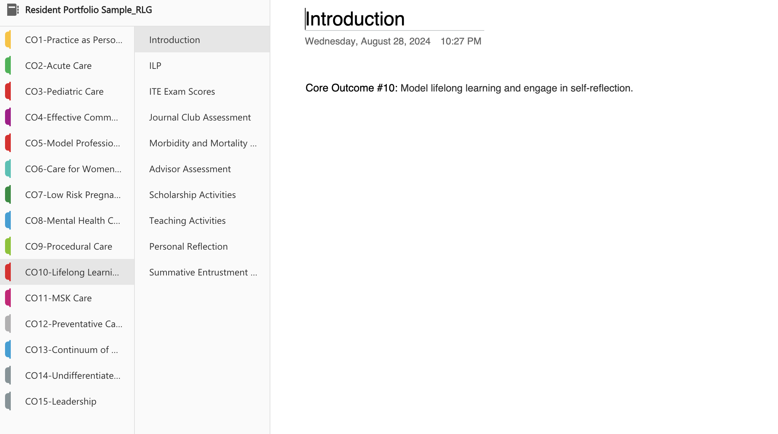
Notes:
Continuing with this example –This portfolio also makes space for a reflective piece for the resident, where they can jot down a narrative or patient experience ; you could have a reflective piece for each outcome or for specific ones that are more relevant to your program
In the life long learning outcome, as another example – the resident would include their individualized learning plan, ITE scores, and scholarship activities
Each core outcome can be set up to include all the assessements so that there is easy access for the learner and their coach or mentor.

Slide 15
Review Evidence and Set Goals (Formative)
Dynamic process between learner and coach/advisor
Informal meetings to review the contents of the portfolio
Reflective and individualized to the learner
Helps to create a narrative of learner progress rather than discreet grades
Iterative to identify learner strengths and gaps and guide individualized learning plans to reinforce strengths and address gaps
Notes:
The next two steps highlight how the resident portfolio is helpful.
The portfolio can be used during FORMATIVE FEEDBACK -->

Slide 16

Review Evidence and Set Goals (Formative)
Learners Should:
Collect evidence of performance (assessments), both successes and failures
Sort into appropriate Core Outcomes
Write reflections to document mastery of desired outcomes
Prepare an ILP with SMART objectives
Advisors Ensure Learners:
Address patterns of performance
Reflect adequately on evidence
Create appropriate objectives for ILPs

Slide 17
Summarize Evidence (Summative)
Used for advancement and graduation
More structured, less flexible to ensure fairness and equity
Learner must demonstrate achievement of each core outcome
Advisors review and ensure sufficient evidence
Needs detailed instructions for residents and faculty
Notes:
Summative Feedback: The formative portion of the portfolio asked for informal portfolio reviews to help the learner address gaps and reinforce strengths – now, the portfolio can be used as a summative tool – whereby a committee like the CCC can use it to advance learners to the next year, and most importantly attest to resident competence for graduation and ability to sit for boards. The summative portion of the portfolio has the following characteristics
There are several ways a program could choose to do this, but we recommend that this portion of the portfolio is handled by the Clinical competency committee – at a cadence that fits with program needs and requirements – at my program, we are planning on at least 2 large meetings to ensure that residents are on track with two smaller meetings for any concerns that need follow up .

Slide 18
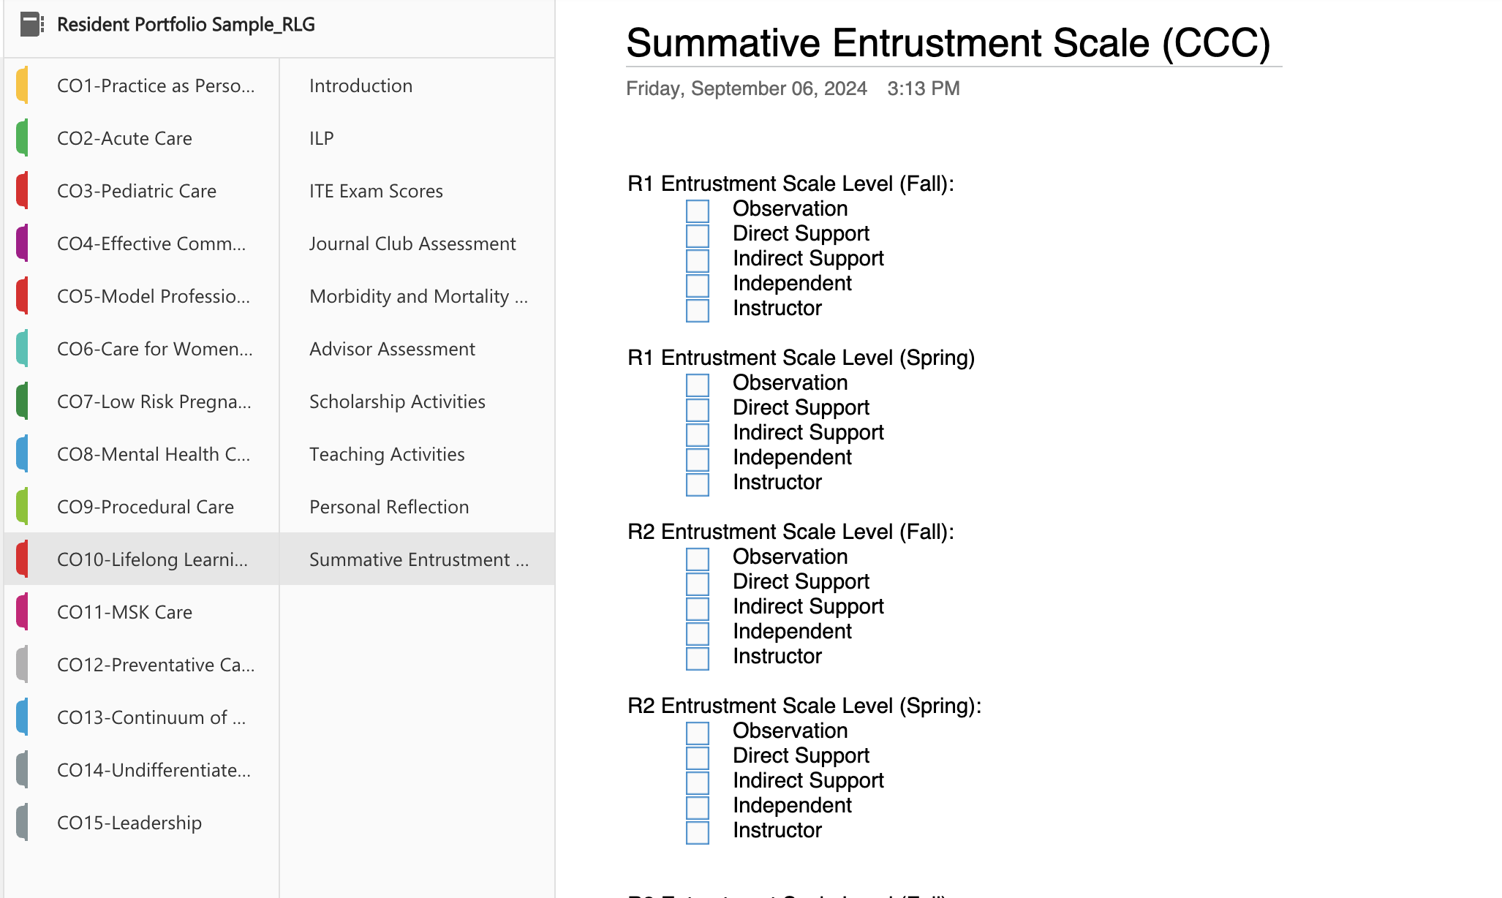
Notes:
So here is an example using the previous type of portfolio – each core outcome has a summative tab where the CCC would mark off the level of entrustment towards competency throughout the learner’s tenure

Slide 19
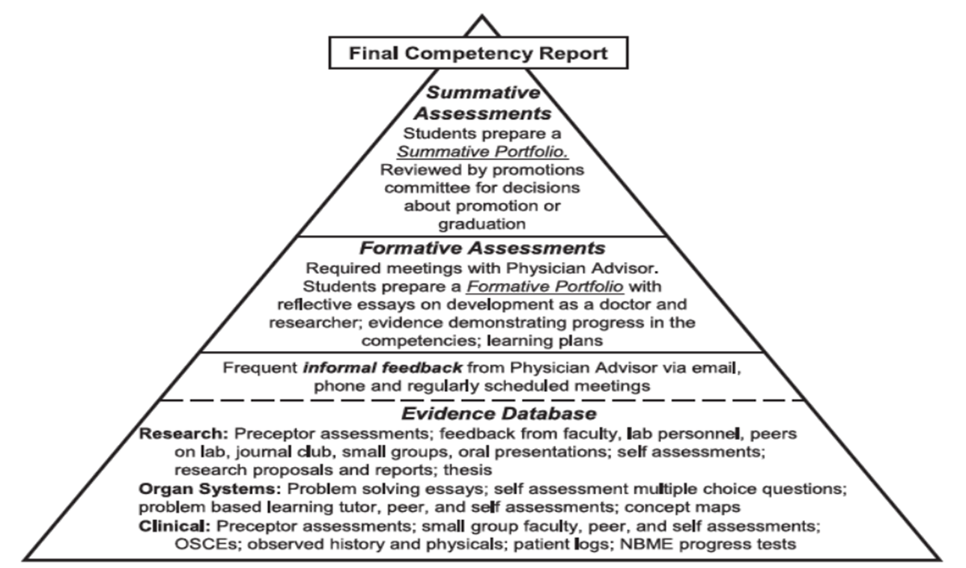
Notes:
So again, to summarize the steps of creating your own portfolio – Keeping the end in mind, you want to gather and establish the evidence to create a database – this should then be organized as a portfolio – You want to review the evidence, aka the formative portfolio , which involves resident engagement goal setting and lastly, you want to summarize the assessments (or evidence) to assist with learner advancement

Slide 20
Some Lessons Learned Thus Far…
Give residents some time and clear direction
Be clear who is responsible for what
Give everyone a lot of grace and set low expectations!
Notes:
We gave you an example of how you might organize assessments and create a portfolio…this is a relative new concept in family medicine, although has been used in other disciplines with good results – so we want to share some more lessons learned…

Slide 21

Take-Home Points
Portfolios are a longitudinal tool to gather subjective and objective assessments for residents
Portfolios follow the principles of CBME including multimodal assessments, individualized educational pathways, & learner self-reflection and engagement
Portfolios work best when there is collaboration between resident and advisor/coach
Consider reviewing your current assessment practices – they likely can be adapted to become the beginnings of a portfolio format

Slide 22
Practice Recommendations
Participants should consider utilizing portfolios as a way of better organizing the comprehensive data collected on resident performance.
Participants should consider utilizing portfolios to encourage more active participation by the resident learner in collecting performance data, which will also increase the resident's self-confidence.
Switching to portfolio assessment will create resident files that are more consistent with the Core Outcomes being attested to at graduation.

Slide 23

Resources
STFM CBME Toolkit, Webinars
Faculty Development Delivered
ACGME Learnings
AFMRD-PD Toolbox
Learning collaboratives
Faculty sharing from national/regional conferences

Slide 24

STFM Toolkit
https://stfm.org/teachingresources/resources/cbme-toolkit/assessment-tools-strategies/
Notes:
For more details, you can go to the STFM website for CBME and access the toolkit using the link you see here. This sight contains a document titled the Outcome Assessment Starter Pack which has details about assessment including links to some recommended tools and instructions for both New Innovations and MebHub. We plan to do ongoing updates as needed as well.

Slide 25

Objectives met?
Poll
Can you now:
Discover the benefits of a portfolio system and its significance with Competency-Based Medical Education
Demonstrate objective and subjective assessments that can be included in the portfolio
Discuss incorporation of portfolios and corresponding assessments into residency programs while implementing CBME
Notes:
We hope this met your expectations and you are now more able to meet the stated objectives. One one way to find out is to ask!

Slide 26

Questions
Notes:
We are now happy to answer any questions.

