Slide 1
THIS IS YOU (“TIY”)
Residency Program
Program Impact and Finances
(Date)

Slide 2
AN ASIDE…
Who is your audience/who are your stakeholders?
What is the goal of your presentation?
May need to start with “GME 101”!
Remember to tell stories when time allows!
Notes:
These are questions to address before putting together this presentation.

Slide 3
AN ASIDE…
In what ways does the program support the institution’s mission, vision, and values?
How does program leadership communicate with institutional leadership, and how are decisions made?
What revenues and expenses are expected for programs?
How does faculty and resident productivity and service interface with quality educational outcomes?
Notes:
These are questions to understand for yourself before putting together this presentation.

Slide 4
What is the value of the
“TIY” Program?
Value (“Return on Investment”) = benefits/costs
(i.e., Program Impact/Finances)

Slide 5
Mission / Vision / Values
Organization:
  Mission:
  Vision:
  Values:
Residency Program:
  Mission:
  Vision:
  Values:
Notes:
Briefly summarize, emphasizing points of alignment and mutual benefit. Have pride in yours!!!

Slide 6
Strategic Goals
Organizational goals:
Residency Program goals:
Notes:
Briefly summarize, emphasizing points of alignment and mutual benefit. Have pride in yours!!!

Slide 7
What is the value of the
“TIY” Program?
Program Impact:
  Service to our community
  Service to the hospital/system
  Physician workforce contributions
  Improving quality of care
Finances
Notes:
Outline of your presentation

Slide 8
Program Impact: Service to Community
Direct patient care services provided
  Inpatient Care (# VISITS)
  Outpatient Care (# VISITS)
“Triple Aim”:
  Better health, lower costs, improved patient experience
Notes:
Insert pictures from your clinic/hospital.
Example:
Inpatient care: 2892 adult medicine admits, 1017 to mother-baby unit
Coverage of pediatric hospitalist service, Emergency Dept call back-up
Outpatient care: 40,000 visits/yr
Community practice stabilization (support for local peds and rural clinics, or underserved patients)

Slide 9

Program Impact: Service to Community
Meeting community needs:
  Community safety net (Payer mix)
  OB/pediatric care
  Senior care
  Other specialty care
  Community outreach projects
Patient satisfaction data
Notes:
Example:
Actively accepting Medicare and Medicaid patients
Needle exchange clinic
Chronic pain clinic
Community sports physicals

Slide 10
Program Impact: Service to System
Direct revenues:
  Clinical income generation
  External reimbursements (CMS, Medicaid, state)
”Community Benefit”
Direct downstream referrals
Controlling costs:
  Unreimbursed care
  Avoiding ER over-utilization, readmissions
Replacement provider costs
Notes:
Examples:
Downstream referrals: to specialists, services
Avoiding ER utilization; avoiding readmissions; avoiding hospitalizations.
Replacement provider costs: difficult in many regions; recruitment costs, onboarding and startup costs, impact of turnover.

Slide 11

Program Impact: Service to System
Clinical Learning Environment Review (CLER):
  Patient safety
  Quality of care
  Health care disparities
  Professionalism
  Transitions of care/Teamwork
  Physician well-being
Notes:
Emphasize interface of systems goals and resident/faculty engagement with examples.

Slide 12
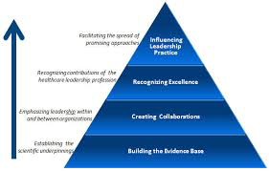
Program Impact: Service to System
Local and systems leadership:
  Institutional leadership positions
  Committee memberships
  Task force engagement
Notes:
Examples of program faculty/staff/resident engagement with systems committees and initiatives.
Note the importance of training for future leaders and that these residents will one day be those leaders.

Slide 13
Program Impact: Workforce
New providers / graduates (data)
  Committed to the community and institution
  Familiar with local environment
Reduced recruiting costs
Regional impacts:
  Catchment referral patterns (consider map)
  Regional reputation
Notes:
Insert photos of your graduates.
Examples:
8 graduates practicing in immediate area, with an additional 12 in surrounding communities who are referring to our system’s hospitals and specialists.

Slide 14

Program Impact: Quality of Care
Learning environment:
  Enhancing the adoption of “new” knowledge
  Innovations
  Regional CME
Research:
  Patient care initiatives (quality, safety, others)
  Research
Notes:
Provide examples

Slide 15
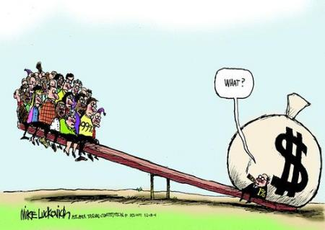
Finances
Revenues
Expenses
Performance data
Opportunities and threats

Slide 16
Residency Revenues
Patient care reimbursements
  FMC
  Inpatient, nursing home, other
Other service reimbursements
Federal funding (Medicare GME)
Medicaid GME
Other federal sources (HRSA, VA)
State funding
Grants, foundation support, other sources
Institutional direct support
Notes:
Patient care: Dependent on resident and faculty activity and reimbursement model – increases when all third year positions and faculty positions filled
Other service reimbursements: Medical directorships, Other service contracts. Administrative roles
Other federal sources:
AHECs
HRSA / FQHC
Teaching Health Center grants
PTCE grants
Veterans Administration

Slide 17

Factors affecting revenue
Payor mix of patients
Billing and collections efficiencies (deductions, write-offs, AR, etc.)
Volume of patients seen (productivity)
Service contracts (managed care; enhanced reimbursements)
RVU production

Slide 18
Revenues
“TIY” 2019 Revenues:
  Federal sources (CMS, HRSA, VA): $
  State sources (Medicaid, state lines): $
  Patient care reimbursements for clinical work: $
  Total: $
  Per resident: $
Notes:
Includes all funding lines, including GME, state support, grants, patient care revenues.

Slide 19

Revenue Threats and Opportunities
Threats:
  GME funding sources, both federal and state
  State revenue streams
  Practice pressures (EMR, PCMH, etc.)
  Threats to the THC and other federal health programs
Opportunities:
  The future of federal and state health programs
  Practice transformation
  CMS initiatives (ACO; quality payment systems, etc.)
Notes:
Understanding the financial pressures facing graduate medical education is crucial for program management.
Discussing revenues, expenses, productivity, and dashboards helps everyone work to address real needs for cost accountability.

Slide 20
Residency expenses
Salaries, benefits, retirement (faculty, residents, other providers, and support FPC and program staff)
Variable operational expenses
Fixed operational expenses
“Indirect” expenses or “overhead”: other costs not directly on the budget sheets but contributing to the support of the program
Notes:
Other salaries: stipends for other teachers (specialists, preceptors, etc.)
Variable operational expenses:
Medical and non-medical supplies, pharmacy, transcription, etc.
IT expenses: hardware and software
Malpractice and other insurances
Fixed operational expenses
Building/space, both clinic and administration
Maintenance
Equipment

Slide 21

Salaries and benefits
Salary, benefits, retirement
  Faculty
  Residents
  Educational staff
  FMC staff, additional for residency training
  Stipends for other teachers (specialists, preceptors, etc.)

Slide 22
Factors affecting expenses
Residency program size
Faculty number and structure
Staffing models of clinics
Allocations of institutional overhead
Family Medicine Clinic efficiency and allocation

Slide 23
Expenses
“TIY” 2019 Expenses:
  Total: $
  Per resident: $
“TIY” 2019 Net Cost (Revenues minus Expenses):
  Total: $
  Per resident: $
Notes:
Update for Yakima

Slide 24

Costs: revenues vs. expenses
Planning for a future in a complex and competitive environment:
  Increase revenues
    Patient care reimbursement
    New federal funding sources
    Grants
    Philanthropy
  Decrease expenses

Slide 25
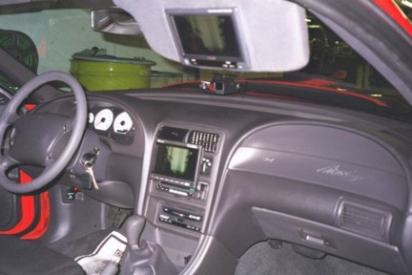
Performance Dashboard
Patient volumes/mo
New patient visits
Productivity measures:
  pts/ hr
  RVU/ visit
  revenues/ visit
Quality measures:
  Childhood immunizations
  Cancer screening
  Diabetes care
  Other HEDIS measures
  Other P4P data
Notes:
Trend information
Explain variations
Define and sample your own quality measures
Tie to pay for performance payments you may have received

Slide 26

The Value of the“TIY” Family Medicine Residency Program
Program impact:
  Patient services
  Teaching/research achievements
  Graduates
  Community engagement
Accountability for finances/costs

