Slide 1
Managing Assessment Burden In CBME
Jeremy Crider, MD, FAAFP
KrisEmily McCrory, MD, MS Med Ed, FAAFP

Slide 2


Faculty Development Webinars
What You Need to Know About ACGME and ABFM Expectations for a Shift to Competency-Based Medical Education
Reflections, Goals, & Objectives – Oh My! Best Practices for Creating ILPs
Let’s Talk About Entrustment
Assessment Tools for CBME and the Core Outcomes
Building CBME Into Faculty Development
Learning and a Growth Mindset in Your Program
Fostering Master Adaptive
How to Have Reflective Feedback Conversations and Develop a Culture of Effective Feedback
Individualized Learning and Resident Assessment: A CBME Orientation for Residents
Advisors and Coaches: The Evolving Role of Faculty and Resident Relationships
How to Effectively Use Electives to Help Residents Attain Competency in the Core Outcomes
The Role of Resident Portfolios in Competency-Based Assessment
Managing Assessment Burden in CBME
The Power of Direct Observation: Answering Residents' Most-Asked Questions

Slide 3
Learning objectives
1. Participants will be able to identify two strategies in address assessment burden.
2. Participants will be able to evaluate current assessment tools they already use for applicability to CBME needs.
3. Participants will be able to assess pros and cons of potential mobile apps in assessment.

Slide 4
Getting to know you:
What is your current role in GME?
How many years have you been in GME in any role?
Have you attended other STFM CBME webinars?

Slide 5

The Call for Competency
Shared Mental Model
Knowledge
Skills
Attitudes
Notes:
KEM
Review call from ABFM, focus on shared mental model guided of the KSA needed for Competency as demonstrated in the Core Outcomes (and Milestones)

Slide 6

How Many Assessments?
2023: 50-75 assessments over three years
Canda: 1/day to 1/week
(Warren & Rode, 2003)
Notes:
KEM
At a minimum-residency programs do 1/rotation…only 36 in three years…Call from ABFM is that we need more (

Slide 7

Feeling the burden of assessment
Notes:
KEM

Slide 8

Burden on Faculty
Notes:
KEM

Slide 9

Faculty Workload
Increased Faculty Burden
Training & Buy In
Notes:
KEM

Slide 10
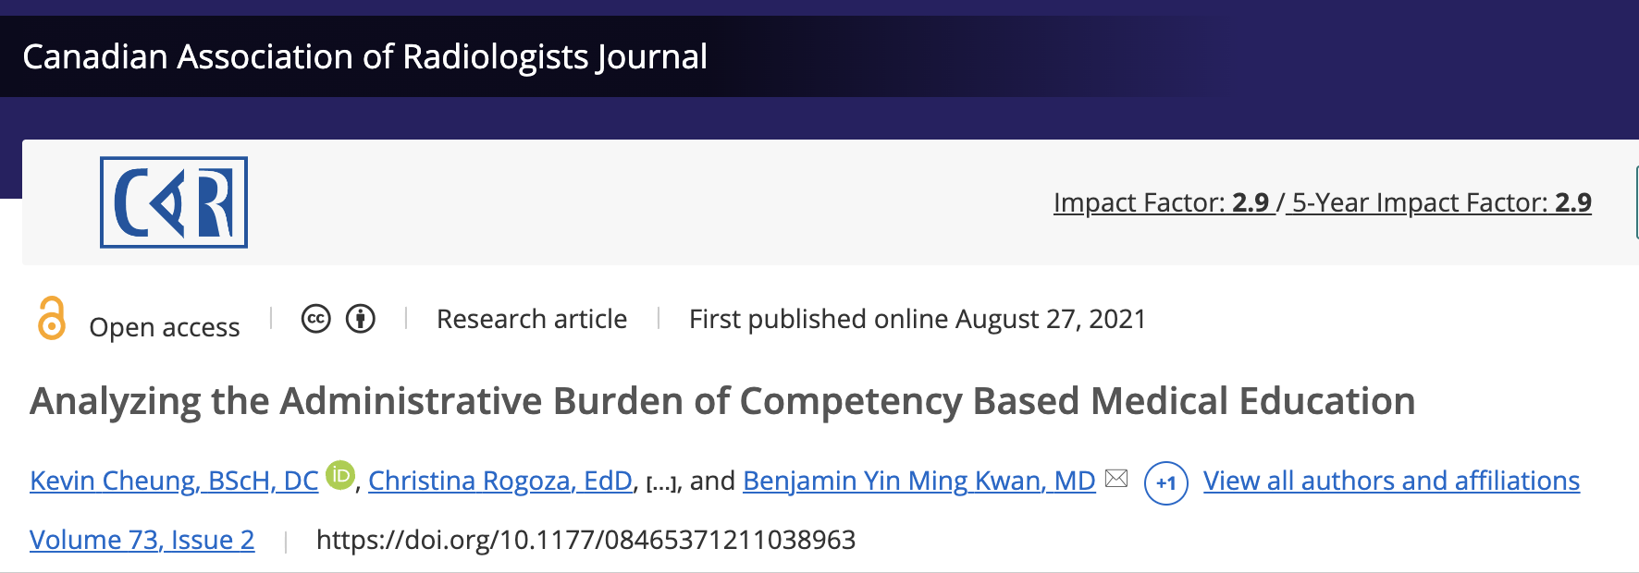
Notes:
JC
It’s probably not as bad as we think it’s going to be
Single-institution - diagnostic radiology program
Based on several assumptions, showed an additional 18 minutes of administrative burden per faculty member over a 4 week block

Slide 11

Faculty development
Entrustment
Milestones
EPAs
Assessment Scales
Notes:
JC
**Reference the previous session in this webinar series, “Building CBME into Faculty Development”
But we MUST prioritize training and development of our faculty or they will forever be overwhelmed
Clarify entrustment / Milestones / EPAs / other scales
“Tips and tricks” emails

Slide 12

Increasing faculty motivation
Recognition
Tracking achievement
Gamification
Incentives
Notes:
JC
Carrots
Field Note Tracker
Public accolades / shout outs
Gamification
Incentives

Slide 13
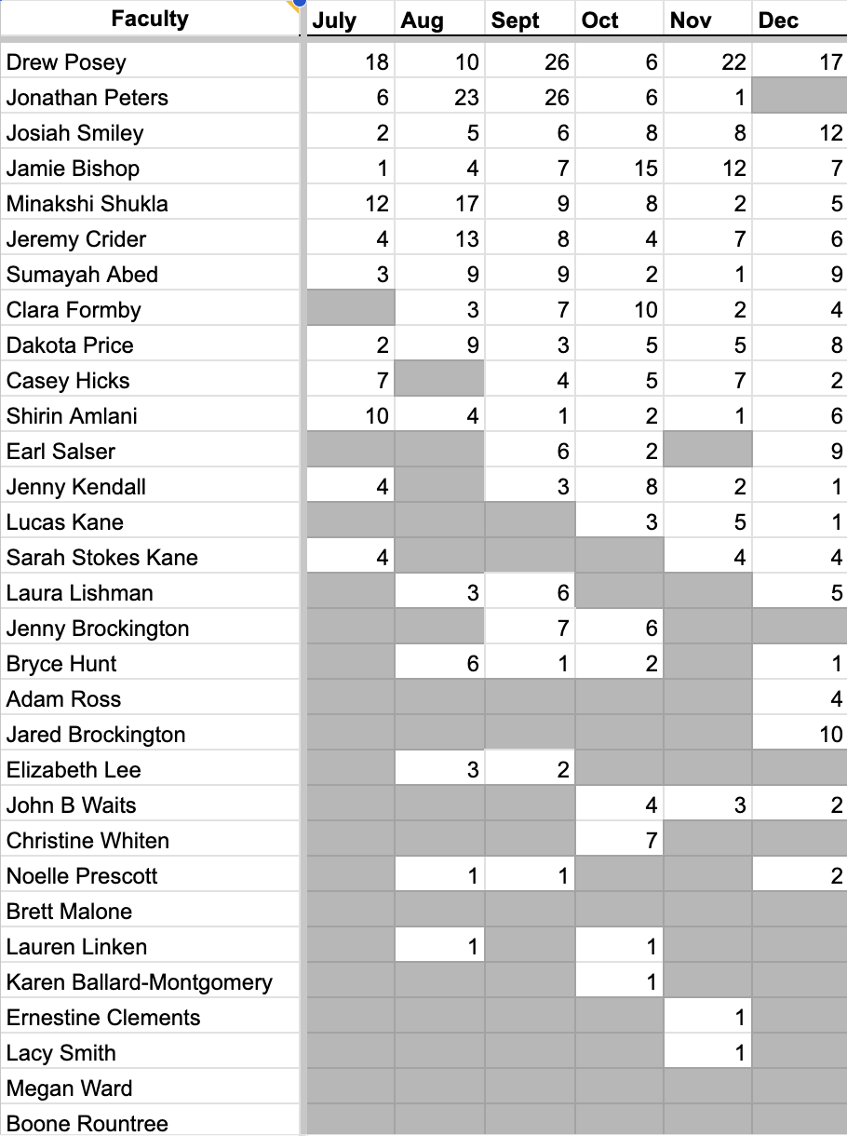
“Field Note Tracker”
Notes:
JC

Slide 14

Help faculty see the fruits of their labor
Notes:
Marx - alienation from the product
Antoine de Saint-Exupéry quote
Being on CCC increases vested interest in getting good feedback
Feedback loops on feedback: Cahaba+UAB example: Resident-led faculty development on giving feedback

Slide 15

Assessment Fatigue
Overwhelming Frequency
Time Consuming
Notes:
KEM

Slide 16

Dictation
In-app
Via email
Notes:
JC
Dictation (in-app or via email)

Slide 17

Focused Assessments
Behaviorally anchored
Based on specific instance
Formative
Limited in scope
Notes:
KEM
Discuss how we use smaller, more focused assessments.

Slide 18
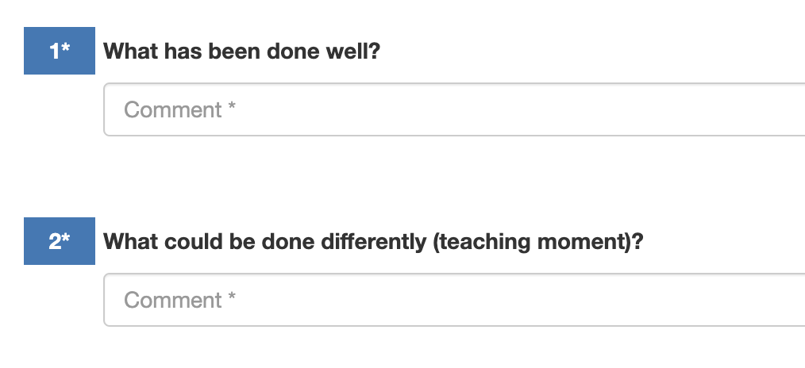
Easier assessment tools
Notes:
JC
Easier to access
Easier to complete
Easier to submit

Slide 19

Assessment Tool Limitations
Over-reliance on Specific tools
Tech Barriers
Notes:
KEM

Slide 20
Multisource Assessment
scholarly activity
administrative tasks
board preparation
quality registry
quality projects
clinician report card
advocacy
didactics attendance
learning log
ultrasound OSCE
patient safety meeting
Notes:
JC

Slide 21
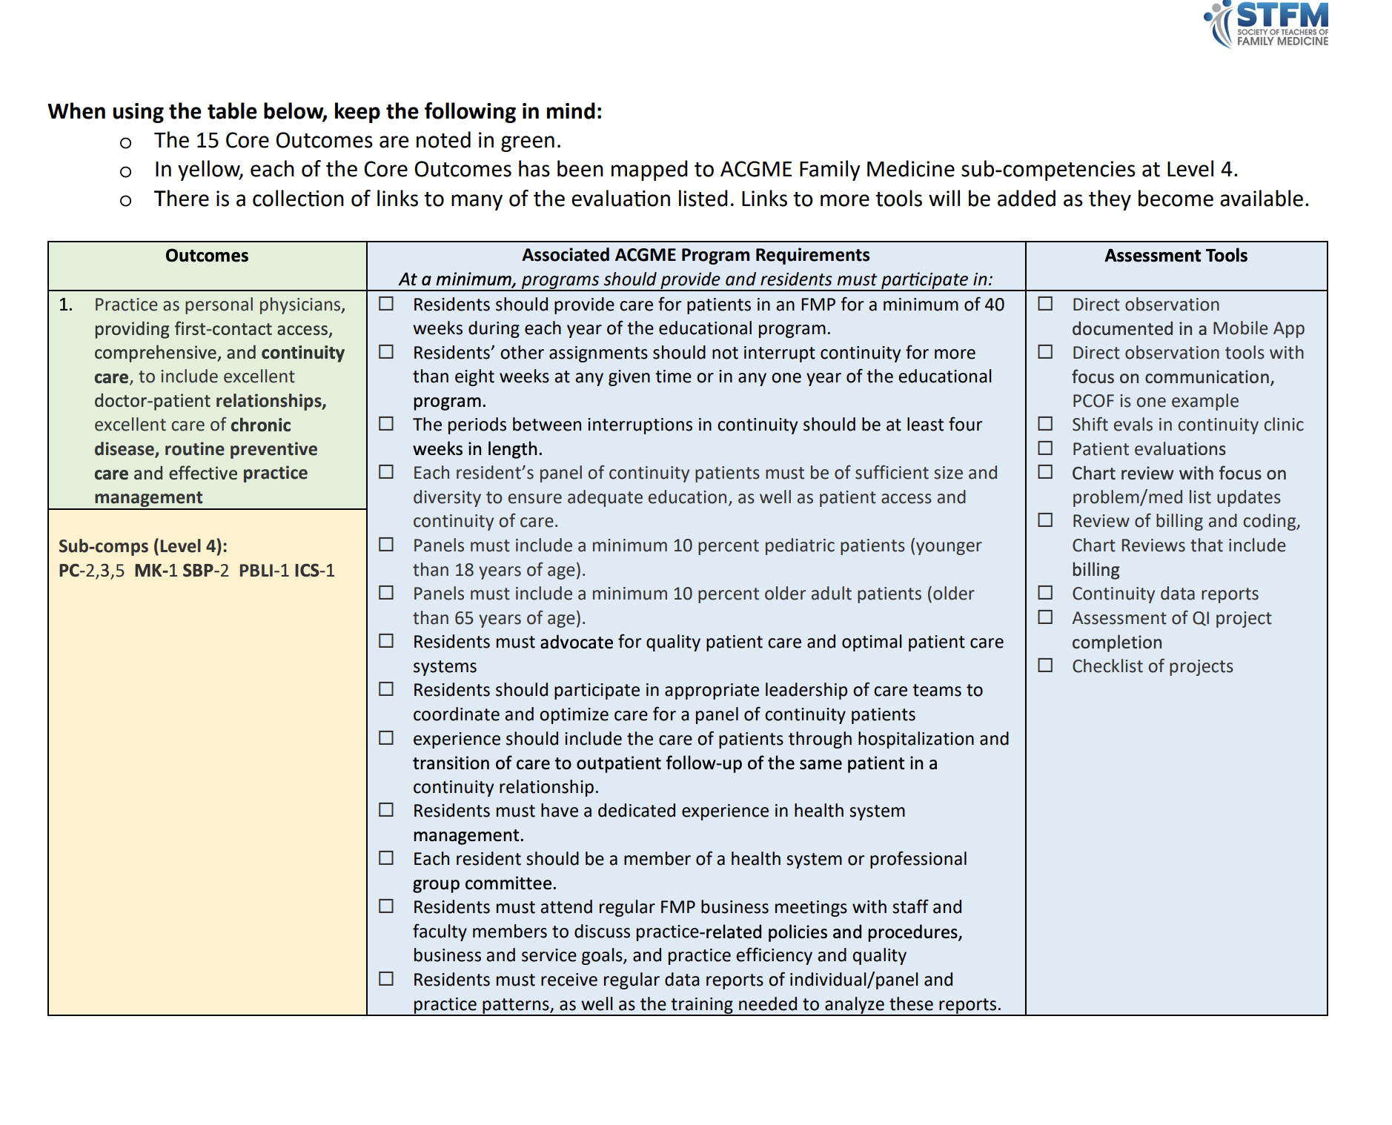
STFM CBME Assessment Starter Pack
Notes:
KEM
Add a link or QR code to the Starter Pack (will add slide at end)
Jenni will also put a link in the chat

Slide 22
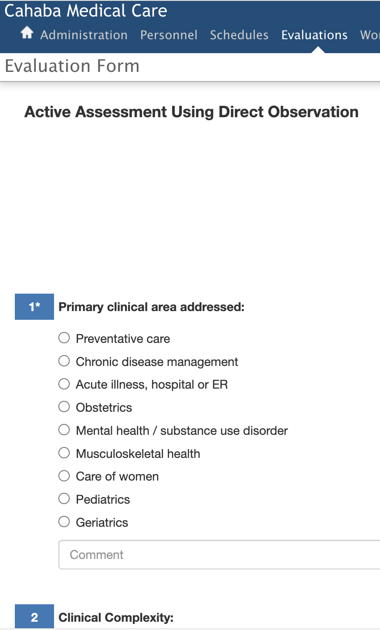
Notes:
JC
Include link/QR code to get to information on how to access these in NI and MedHub? (will add to slide at the end)

Slide 23
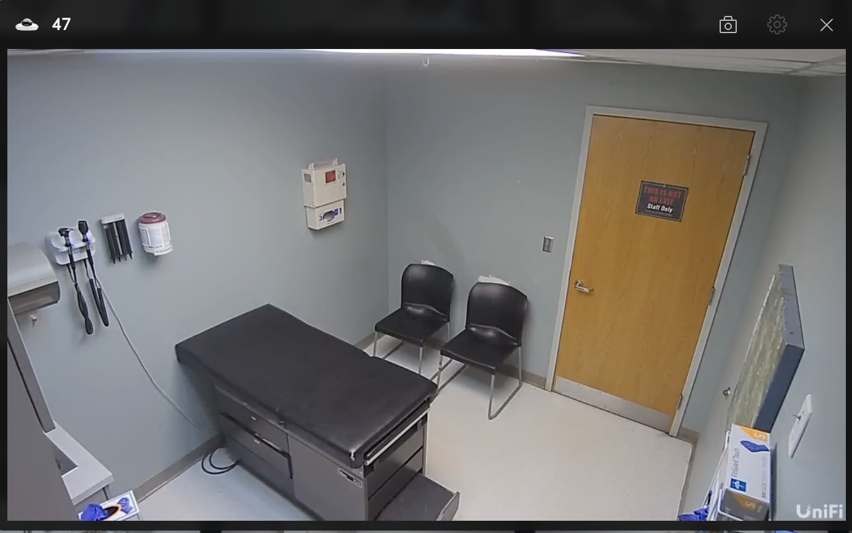
Leveraging Technology
Notes:
JC
The assessment tools cannot directly help you observe residents better …
Video precepting / camera system

Slide 24

Quality & Quantity of Feedback
Diluted Feedback
Inconsistent Feedback
Notes:
KEM
In a family medicine residency assessment program, "diluted feedback" refers to feedback that is generalized, vague, or lacking specific, actionable insights. This type of feedback often results from evaluations that attempt to cover too many areas at once or from limited observation of the resident’s performance. Diluted feedback can hinder resident development by failing to highlight key strengths and areas for improvement, ultimately reducing the effectiveness of feedback in guiding growth and skill acquisition.
Variability in Evaluators: Different preceptors or attending physicians may have unique perspectives, standards, and expectations, leading to variability in feedback.
Subjective Assessment Criteria: Without standardized criteria, evaluations can reflect personal biases or focus on different aspects of performance, causing inconsistent feedback
Training/lack of faculty development in giving feedback.

Slide 25
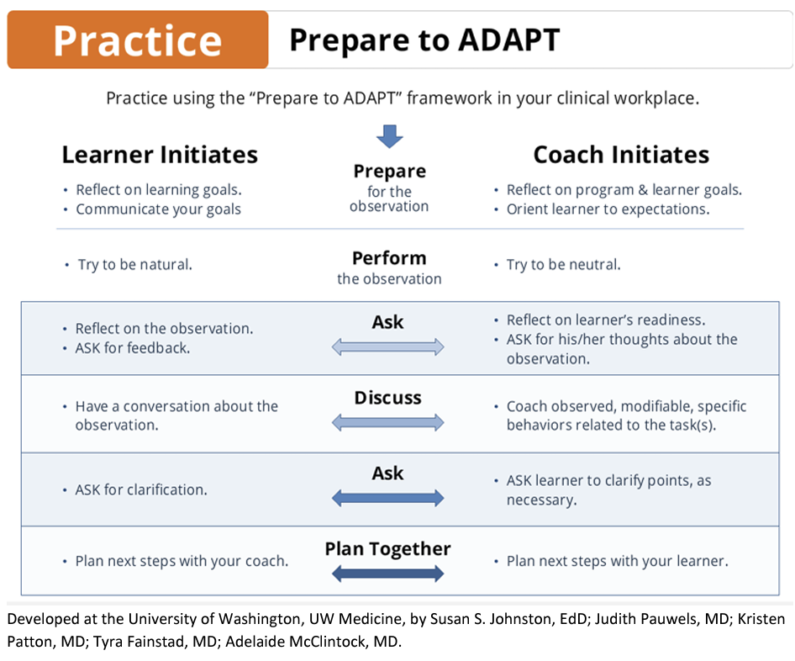
Notes:
JC

Slide 26
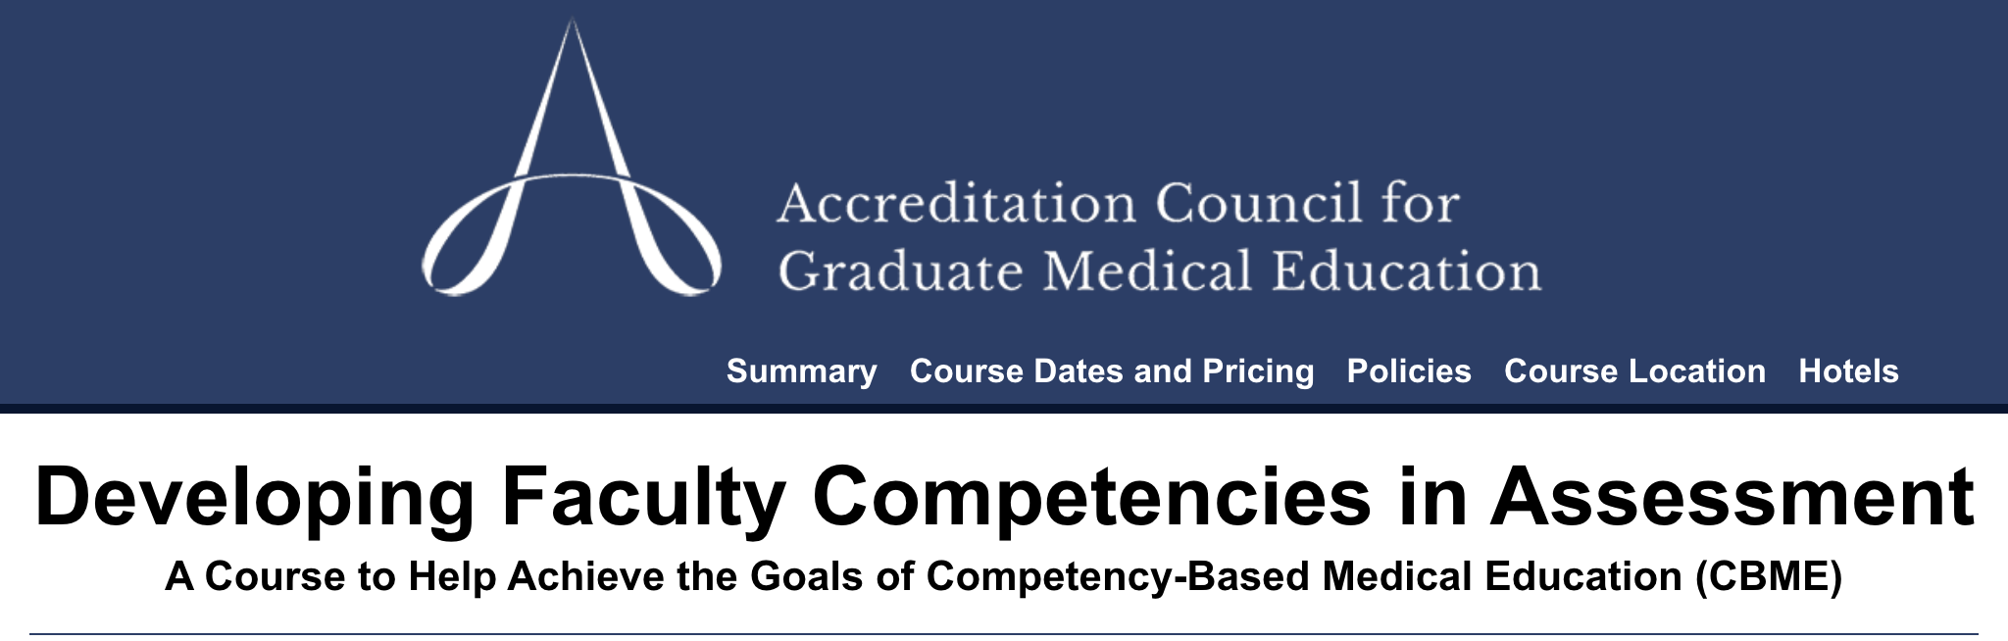
Direct Observation Simulator
Notes:
JC
(Will add information on this course on the slide at the end)

Slide 27
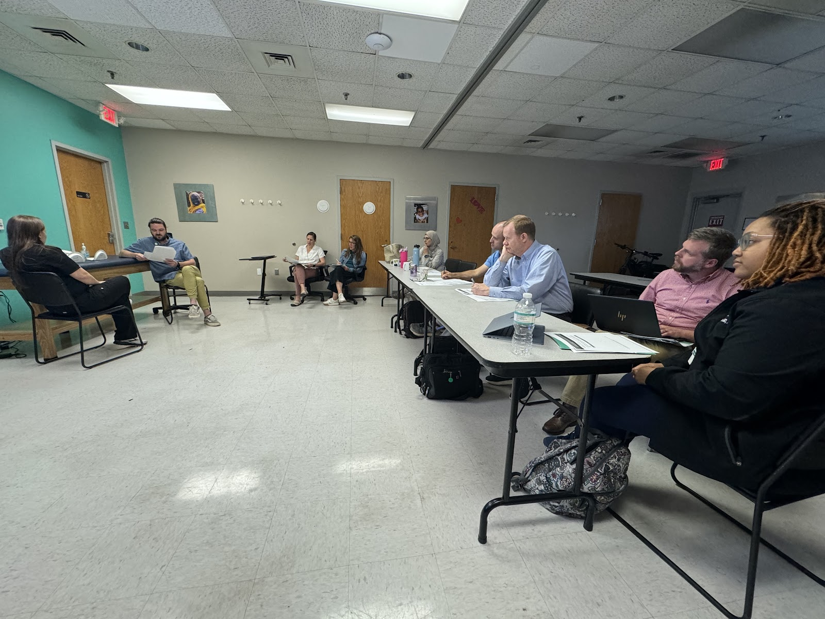
Direct Observation Simulator
Notes:
JC

Slide 28

Balancing Formative & Summative
Blurred lines
Decreased Emphasis on Holistic View
Notes:
KEM

Slide 29
Bringing formative and summative together
Use assessment tools for frequent formative feedback (daily if possible)
Bring aggregated, multisource assessments together at defined intervals for evaluation decisions
Notes:
Asking a similar question across several rotations-–each individual response is a formative assessment AND bringing them altogether (for CCC, eg.) is summative

Slide 30

Assessing Complex Competencies
Non-
technical skills
Holistic assessment
Notes:
KEM

Slide 31

Improving rating scales
Entrustment anchors
Intuitive
Relevant
Notes:
JC
The problem: rating scales that aren’t written well / are ambiguous / aren’t relevant / etc.
Moving away from likert scales and toward entrustment anchors
more intuitive
More relevant
Show an example from “direct observation” tool

Slide 32
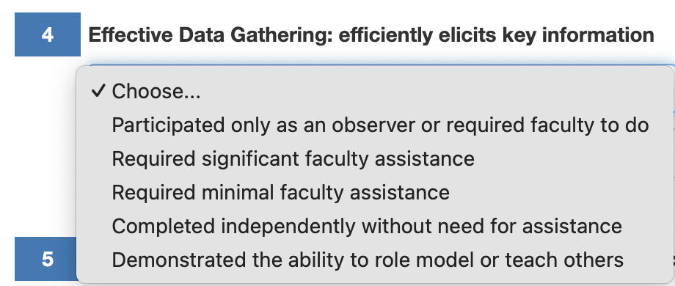
Notes:
JC
Example from Active Assessment Using Direct Observation
**See the previous session in this series, “Let’s Talk About Entrustment”**

Slide 33


Burden on Learners
Notes:
KEM
In a family medicine residency program, assessment burden refers to the extensive demands placed on residents to complete numerous evaluations, reflections, and documentation of their clinical experiences and competencies. This can include frequent formative and summative assessments, self-assessments, and feedback sessions, all of which can be time-consuming and detract from clinical learning. The high volume and often redundant nature of these assessments can lead to stress and burnout, potentially diminishing the educational value and effectiveness of the assessment process.

Slide 34

Learner Anxiety & Stress
High stakes Environment
Fear of Failure
Notes:
KEM

Slide 35

Feedback Friendly Culture
Role model feedback
Provide frequent formative feedback
Empower residents
Notes:
KEM
CBME is all about the shifting from high stakes for everything to more frequent formative assessments.

Slide 36

Improved resident orientation to CBME model and tools
Link Milestone and Core Outcomes
Use the STFM resident webinar:
Individualized Learning and Resident Assessment: A CBME Orientation for Residents
Incorporate into ILP development
Notes:
KE

Slide 37

Encourage faculty-initiated feedback
Notes:
JC

Slide 38
Empower Resident Co-production
Asking the question:
How do YOU demonstrate this?
Notes:
KEM

Slide 39
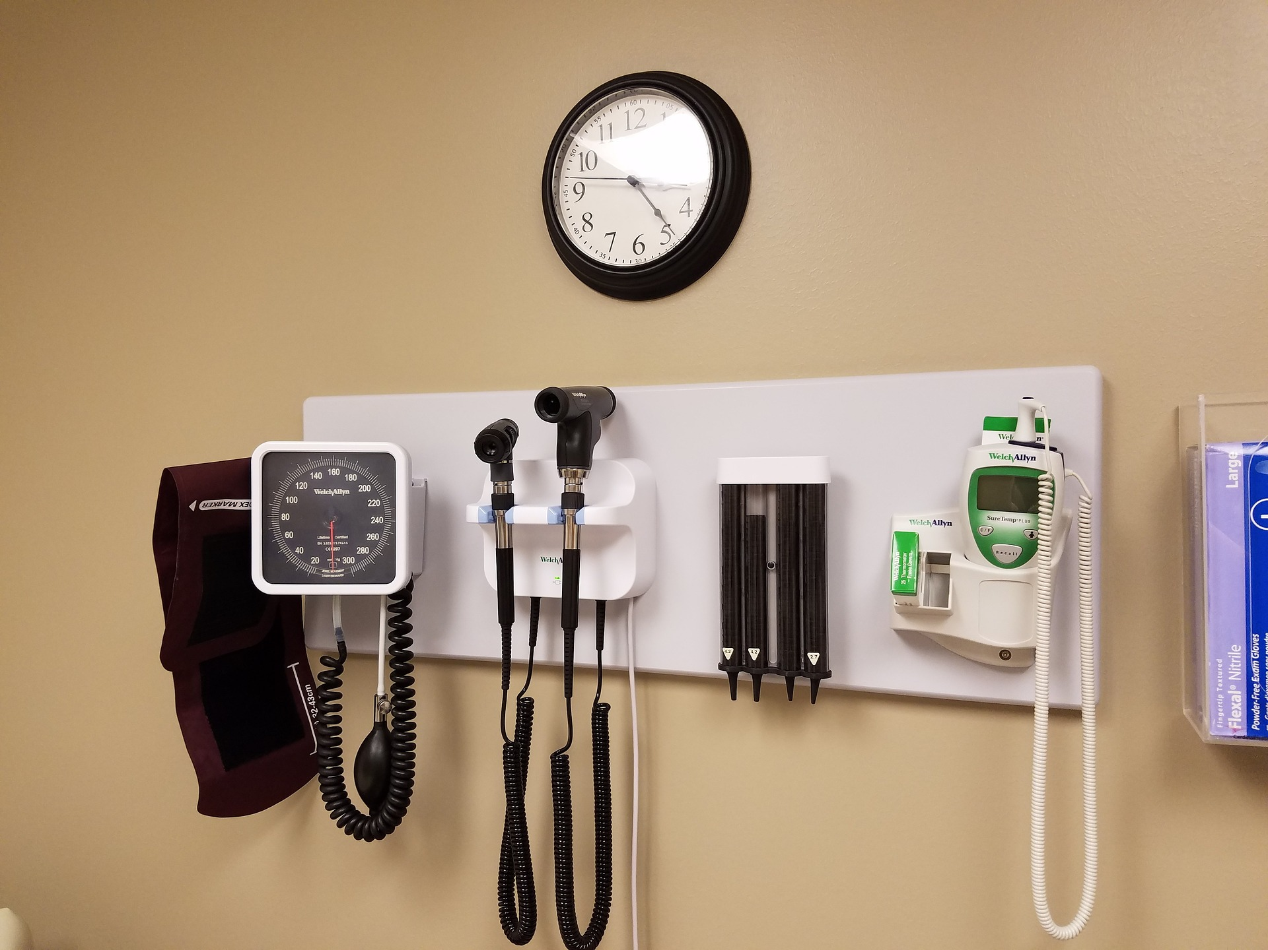
Trainee Autonomy
Perceived Reduction Autonomy
Supervision discomfort
Notes:
KEM

Slide 40
Bring it Home
Don’t reinvent the wheel! Use resources like the STFM Assessment Starter Pack to link assessments and competencies.
Don’t let perfect get in the way of good! It’s an iterative process.
Use faculty development to increase comfort with assessment.
Include residents in the process.

Slide 41
References and Resources
Cheung K., Rogoza C., Chung A., Yin Ming Kwan B. “Analyzing the administrative burden of competency based medical education.” Can Assoc Radiol J. 2022. 73(2):299-304.
ACGME Course: Developing Faculty Competencies in Assessment: https://www.acgme.org/meetings-and-educational-activities/courses-and-workshops/developing-faculty-competencies-in-assessment/
STFM Instructions for Accessing Active Assessment Using Direct Observation Tool in New Innovations and MedHub: https://stfm.org/teachingresources/resources/cbme-toolkit/assessment-tools-strategies/#35719
Newton W, Rode K. What assessments are being used in family medicine residencies? JABFM. 2023
Notes:
Cheung K., Rogoza C., Chung A., Yin Ming Kwan B. “Analyzing the administrative burden of competency based medical education.” Can Assoc Radiol J. 2022. 73(2):299-304.
ACGME Course: Developing Faculty Competencies in Assessment: https://www.acgme.org/meetings-and-educational-activities/courses-and-workshops/developing-faculty-competencies-in-assessment/
STFM Instructions for Accessing Active Assessment Using Direct Observation Tool in New Innovations and MedHub: https://stfm.org/teachingresources/resources/cbme-toolkit/assessment-tools-strategies/#35719

Slide 42
References and Resources
Assessment Starter Pack
STFM Direct Observation tool
(NI & MedHub)
ACGME Direct Observation Toolkit
Notes:
Cheung K., Rogoza C., Chung A., Yin Ming Kwan B. “Analyzing the administrative burden of competency based medical education.” Can Assoc Radiol J. 2022. 73(2):299-304.
ACGME Course: Developing Faculty Competencies in Assessment: https://www.acgme.org/meetings-and-educational-activities/courses-and-workshops/developing-faculty-competencies-in-assessment/
STFM Instructions for Accessing Active Assessment Using Direct Observation Tool in New Innovations and MedHub: https://stfm.org/teachingresources/resources/cbme-toolkit/assessment-tools-strategies/#35719

