Slide 1

Individualized Learning Plans and Resident Assessment
A CBME Orientation for Residents
Maggie Curran, MD
Olivia Rae Wright, MD
June, 2024
Notes:
Maggie

Slide 2
Today’s Objectives
By the end of today, residents will be able to:
Describe competency based curriculum (CBME)
Embrace a feedback culture
Address Outcomes as part of your ILP
Effectively engage in program improvement
Notes:
Maggie

Slide 3

GOALS of CBME
Improved workforce issues
Access to quality care
Adaptable family physicians
Notes:
Maggie
Per ABFM

Slide 4

5 Core Components of CBME
1. Outcomes-based framework
2. Progressive sequencing
3. Learning experiences are competency based
4. Teaching tailored to competencies
5. Effective programmatic assessment
Notes:
Maggie
Based on Van Melle’s framework: five core components of CBME: defining an outcomes-based competency framework; progressive sequencing of competencies within that framework; learning experiences tailored to competencies; teaching tailored to those competencies; and effective programmatic assessment

Slide 5
Outcome Based
Based on societal needs
Graduates are effective health professionals
Notes:
Maggie
Quality and accountability
Residents need to be actively engaged in the process and associated outcomes
Requires ongoing assessment and updates based on outcomes.
Need to meet the needs of the society at large and the local community

Slide 6
POLL
What do you currently know about the ABFM Outcomes:
I know quite a bit about 15 and can almost recite the first 5
I know there are 15 and know quite a bit about the first 5
I know they exist, but not much else
This is the first I’ve heard about them
Notes:
Maggie

Slide 7
The first 5 Outcomes
Practice as personal physicians, providing first contact, comprehensive and continuity care, to include excellent doctor-patient relationships, excellent care of chronic disease and routine preventive care and effective practice management.
Diagnose and manage acute illness and injury for people of all ages in the emergency room or hospital.
Provide comprehensive care of children, including diagnosis and management of the acutely ill child and routine preventive care.
Develop effective communication and constructive relationships with patients, clinical teams, and consultants
Model professionalism and be trustworthy for patients, peers, and communities
Notes:
Maggie

Slide 8
Next 5 for
2025
Year 2
Practice as personal physicians, to include care of women, the elderly, and patients at the end of life, with excellent rate of continuity and appropriate referrals.
Provide care for low-risk patients who are pregnant, to include management of early pregnancy, medical problems during pregnancy, prenatal care, postpartum care and breastfeeding, with or without competence in labor and delivery.
Diagnose and manage of common mental health problems in people of all ages.
Perform the procedures most frequently needed by patients in continuity and hospital practices.
Model lifelong learning and engage in self-reflection.
Notes:
Maggie

Slide 9
Practice as personal physicians, to include musculoskeletal health, appropriate medication use and coordination of care by helping patients navigate a complex health system.
Provide preventive care that improves wellness, modifies risk factors for illness and injury, and detects illness in early, treatable, stages for people of all ages while supporting patients’ values and preferences.
Assess priorities of care for individual patients across the continuum of care—in-office visits, emergency, hospital, and other settings, balancing the preferences of patients and medical priorities.
Evaluate, diagnose, and manage patients with undifferentiated symptoms, chronic medical conditions, and multiple comorbidities.
Effectively lead, manage, and participate in teams that provide care and improve outcomes for the diverse populations and communities they serve
Year 3
Last 5
for
2026
Notes:
Maggie

Slide 10
Outcomes (Formally known as EPAs)
6 Competencies
Sub-competencies
Milestones
Outcomes
Notes:
Rae
Outcomes describe the essential work for autonomous practice. Nobody was using the EPAs
Milestones and competencies describe the attributes of the learner and the essential skills needed to get to the outcomes
Milestones focus on ACGME core competencies and allow consideration of how residents develop, whereas the core outcomes combine multiple ACGME competencies and underscore the transition to independent practice.

Slide 11

Progressive Sequencing
Individualized
Not always a smooth curve
Notes:
Rae
We have long known that some residents are on a steeper or flatter learning curve for individual competencies. By creating a robust ILP paired with careful competency assessment we can work with residents to get them prepared for their future practice.

Slide 12

Competency Based Learning Experiences
Time/numbers not the driver
Flexibility for individual progression
Tied to graduate ability and entrustment
Notes:
Rae
ILPs which are the cornerstone of CBME to develop Master Adaptive Learners.
Effective use of electives

Slide 13
Teaching and Curriculum Design
Experience based
Coaching with actionable feedback
Responsive to individual needs
Learners actively engaged
Teaching
Learner needs
Notes:
Rae

Slide 14
System of Assessment
Multiple points and methods
Personalized, timely, and meaningful
System for decision making
Attention to bias
Progression based on Entrustment
Notes:
Rae
We will need to develop or adopt assessments that minimize bias and maximize accuracy, reliability, and ease of use.
opportunity to work with our residency management systems such as New Innovations and MedHub to create the app-based, immediate, resident-led feedback we need. These assessments will allow us to make the necessary determinations of competency.
Like all assessments, rotation evaluations should be anchored in specific behaviors, summarize multiple assessments, and conclude with whether the resident has met the outcomes of residency.
Full implementation of CBME will require a significant increase in the volume of assessments,

Slide 15

Entrustment Scale
The resident is entrusted to:
1
Observe only, or requires faculty to do
3
Perform/accomplish with intermittent/minimal assistance
4
5
Teach or role models to others
2
Perform/accomplish with significant faculty assistance
Perform/accomplish independently, no assistance required
Notes:
Rae
Based on progressive independence toward competency/readiness for independent practice

Slide 16

Competency Based Assessment – the future!
Target Outcomes
More formative, less summative
More frequent, multiple points and methods
Modify existing assessment tools first
More direct observation
Make it easy on the CCC
Notes:
Rae
There are multiple points and methods for data collection.
Methods for data collection match the quality of the competency being assessed.
Emphasis is on workplace-based assessment.
Emphasis is on providing personalized, timely, meaningful feedback.
Progression is based on entrustment.
There is a robust system for decision making.
We will need to develop or adopt assessments that minimize bias and maximize accuracy, reliability, and ease of use.

Slide 17
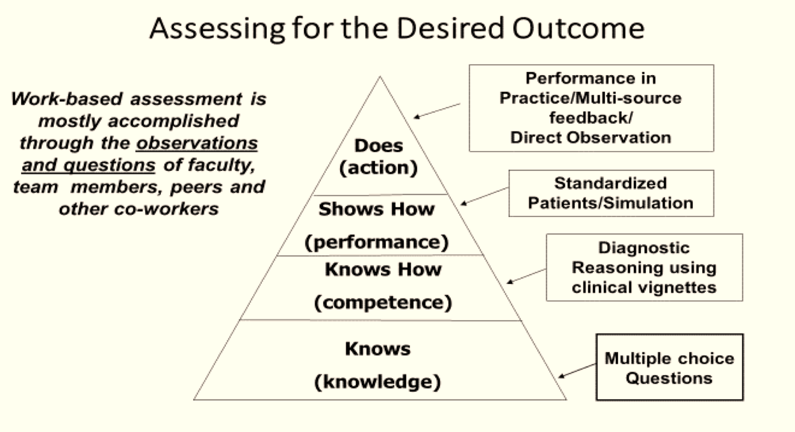
Notes:
Rae
Millers assessment pyramid. Residency should focus more on the Does section. Most assessment based on asking questions and observing.

Slide 18

Direct observation
Mitigates bias
Avoids assumptions from indirect methods
More reliable with multiple settings and multiple observations
Leads to opportunities for improvement earlier
Effective feedback in the moment is key to success
Notes:
Rae

Slide 19
Assessment System
Outcomes
Final
Semi-annual
End of Rotation
End of Day
Feedback-Documented
Feedback - Ongoing, in the moment
Graduation Summative Eval for Autonomous Practice
Usually done with advisor includes Milestones Review
Summative Feedback at the end of the Educational Experience
Combination of Formative and Summative – Shift Cards
Direct observation with Feedback documented
Based on Direct OBs
Notes:
Rae
Feedback to CCC
An assessment system in place
Personal, timely, specific, provide opportunity to reflect
Promotion associated with action plan based on feedback assessment

Slide 20
POLL
How often are you directly observed by faculty when seeing a patient?
Rarely, other than with procedures
Often, but not usually documented
Often, and almost always with documentation
Too much
Notes:
Rae

Slide 21
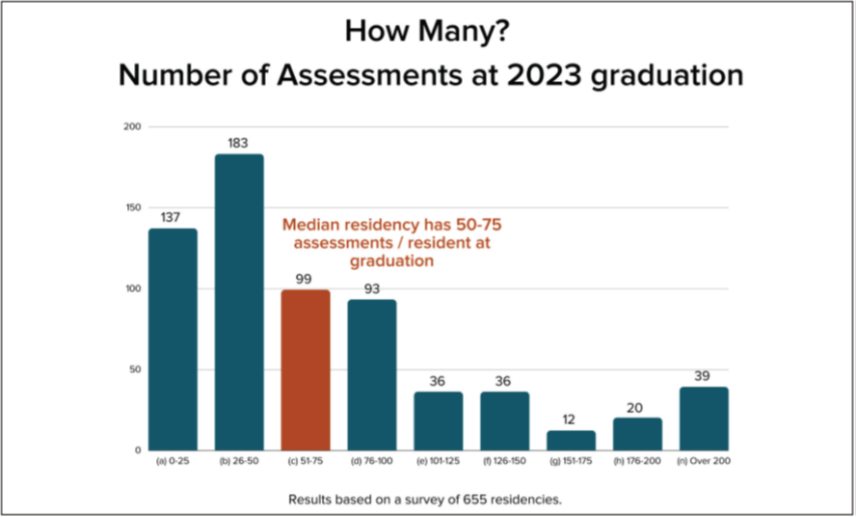
Canada does 1500!
Notes:
Maggie
In fact, a recent assessment by the ABFM for 2023 graduates showed that each resident had only 50-75 assessments for their entire training program. In contrast, our colleagues in Canada report over 1500 assessments per graduate (and their training is only two years!). I need to be clear– there is no “magic number” of assessments to show competence. However, we know the job is easier and clearer if we have more data points. I’ll turn it over to Velyn to discuss how to choose the right assessment for given situations.

Slide 22

Proposed Roll out:
  ACGME
  PD attestation of competency in Outcomes, with support of CCCs
  ABFM
    Implementation over three years
    15 Outcomes
    Five per year, sequential addition
Notes:
Maggie

Slide 23
Readiness for Board Eligibility
Currently:
40 weeks of continuity per year
1000 hours of continuity care
Measurement of continuity, referral rates, etc.
PDs attest to “readiness for autonomous practice” - using Outcomes
Notes:
Maggie

Slide 24
Barriers to overcome?
Acceptance of more direct observation
Creating curricular flexibility
Targeting and tracking Outcomes
Resident and faculty engagement
Need for shared expectations
Notes:
Maggie
Standardized training, Work overload, Residents in difficulty
Need for improved constructive and formative feedback, Need for better orientation, setting expectations

Slide 25
Next Steps for Programs
Time for development and implementation
Integration of updated resources and tools
More faculty and resident shared development
Notes:
Maggie

Slide 26
Next Steps for Residents
Participate and provide constructive feedback about the process
Be open to new evaluation tools that focus on competency
Give grace to your faculty and administrative team
Think about how Outcomes fit into your ILP
Embrace a feedback culture
Notes:
Maggie

Slide 27
Individual Learning Plans
Self-directed learning
Meant for all residents
Should be resident driven
Start with resident draft
Helps prioritize
Content should be reviewed with advisor
Incorporate feedback from program
Notes:
Maggie

Slide 28
New ACGME Requirements
“the practice is the curriculum”
More time dedicated to education and assessment/evaluation
Transition to competency-based medical education (CBME) - Outcomes
Notes:
Maggie
Transition to CBME: Most significant change since founded
Focus on community engagement, address disparities
Focus on competency, with flexibility. Move away from an overreliance on proxies such as amount of time spent training
Learning networks
More faculty time for educ
Starting with the end in mind = Outcomes
The curriculum must contain the following educational components:
IV.A.1. , IV.A.2.
a set of program aims consistent with the Sponsoring Institution’s
mission, the needs of the community it serves, and the desired
distinctive capabilities of its graduates, (Core)
competency-based goals and objectives for each educational experience designed to promote progress on a trajectory to autonomous practice.
Reference: Implementing Competency Based ABFM Board Eligibility: Newton, Barr, Hoekzema, Karuppiah, Sutuzman

Slide 29
Curriculum
Electives
Assessment
Resident Engagement
Lots of it
ILPs
Not just numbers
Feedback
Direct Observation
Feedback to faculty
Coaching
Outcomes
Learner Focused
SMART Objectives
Resident Education
Progressive
Notes:
Rae
What is CBME? I’m always suspicious of new catch phrases that are mostly talked about in the form of an acronym.
When rolling this out to faculty, it can be helpful to break it down to something more relatable.
In my mind, it’s not anything totally new, it’s being way more intentional as teaches of residents.

Slide 30

Questions?

