Slide 1
The Road to Becoming a POCUS Champion
Ryan Paulus, DO
Puja Dalal, MD, FAAAFP
November 27, 2023
Notes:
Thanks to people who are here
Thanks to those listening to recording
Thankful for the opportunity

Slide 2
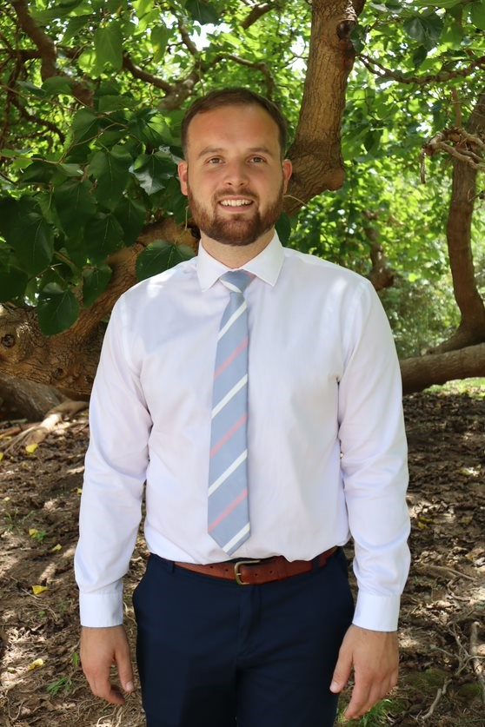
Ryan Paulus, DO
Graduated medical school in 2019
Residency at UNC from 2019-2022
First real exposure to POCUS
Developed formal residency didactic curriculum
UNC FMR Faculty 2022
Faculty lead for POCUS
Hospital work
STFM FM POCUS Educator Certificate Program - Director 2023

Slide 3
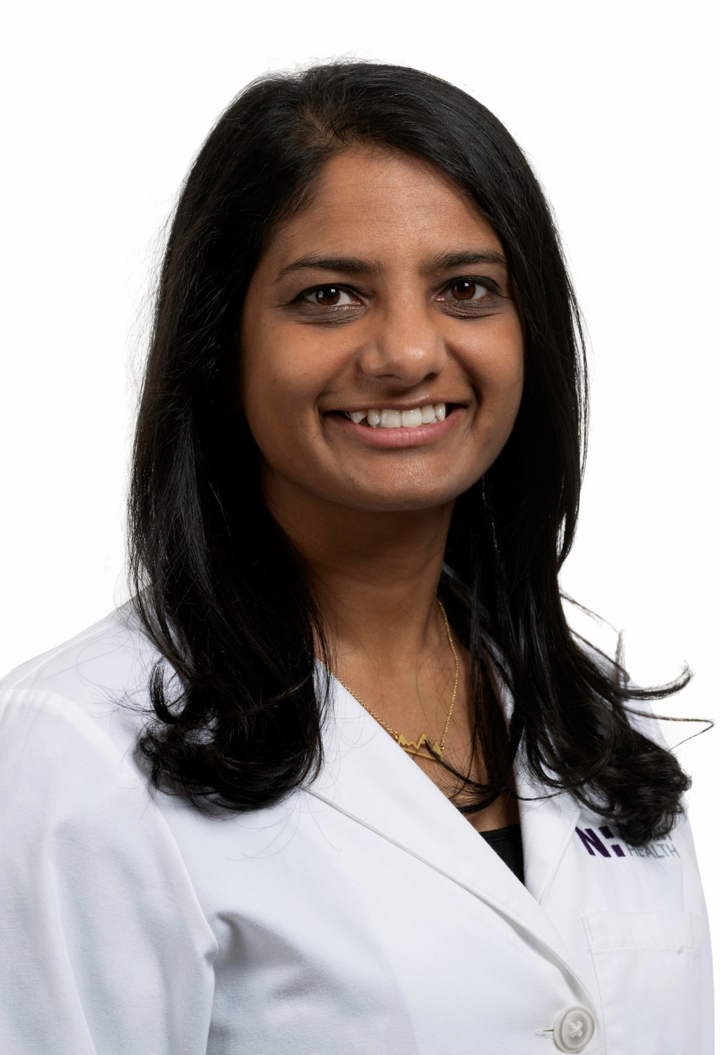
Puja Dalal, MD FAAFP
Graduated medical school in 2014
Elective in POCUS
Residency at Swedish First Hill from 2014-2017
Primary Care POCUS Fellowship at USC 2020-2021
Novant Health Family Medicine Residency Program Core Faculty 2021
Director of POCUS
Notes:
You know, the reason I decided to even do a POCUS fellowship is simple. I wanted to increase access to high quality medical care for my patients. Before I did the fellowship, I was working at a CHC in the greater Seattle area. Most of my patients were refugees with Medicaid that could not get in to specialists (or the wait time was really long) and had a very difficult time getting any form of imaging. I was doing the best I could at being not only a FM doctor, but also a cardiologist, a nephrologist, an endocrinologist, etc for my patients. Anyone else have similar experiences?
Then I found out about POCUS and all the different ways it could help my patients. So I looked in to it and decided I wanted to learn this skill. Originally i thought I would just use it in my own practice, working at a CHC or FQHC, but quickly realized that the best way for me to help increase access to care for patients was to teach this skill to other family medicine docs; and as I’m sure you guys know, there’s no better way to do that then teach the future!

Slide 4
Objectives
The importance of POCUS in Family Medicine Residency education and the need for POCUS Champions
The ACGME guidelines regarding POCUS education
How to get faculty and residents in your Family Medicine Residency up to speed on POCUS
POCUS Learning Resources through STFM

Slide 5
Audience Poll
Who are you?
medical student
resident
UME faculty
GME faculty
administrator or coordinator

Slide 6
Audience Poll
How does POCUS fit into your clinical activities?
I don’t integrate POCUS clinically
I integrate POCUS clinically once a month
I integrate POCUS clinically once a week
I integrate POCUS clinically more than 3 times a week
I integrate POCUS clinically more than 5 times a week

Slide 7
Audience Poll
Are you a POCUS Champion for your program and/or organization?
Yes
No
Not applicable

Slide 8
The Stethoscope
Notes:
The first-ever stethoscope was invented and used by French doctor René Laënnec in 1816.
A series of updates and improvements were made in the mid-1850s including the development of the binaural device we know and continue to use today.
But since then, there haven’t been too many updates to the stethoscope (Dr. Littman improved the acoustic performance in the mid 1960s)

Slide 9
Ultrasound: the Stethoscope of the 21st Century
Notes:
Although many Family Medicine Physicians (if not most) continue to use the stethoscope, bedside medicine has finally evolved and is rapidly changing.

Slide 10
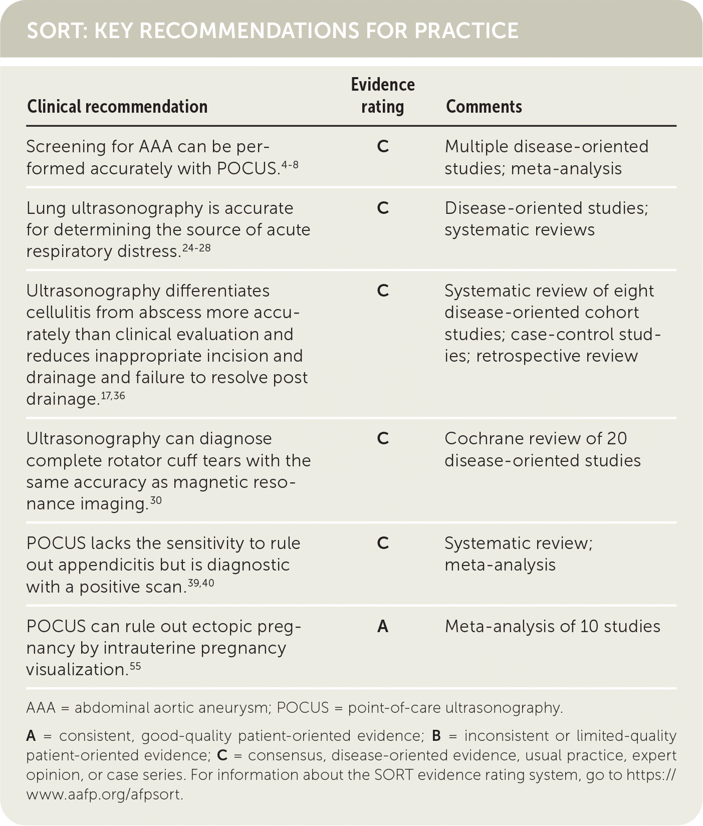
Notes:
SORT – strength of recommendation table for evidence guided recommendations in American Family Physician

Slide 11
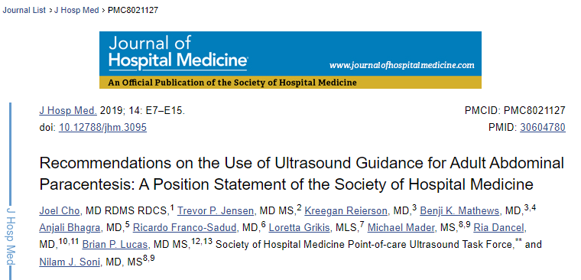
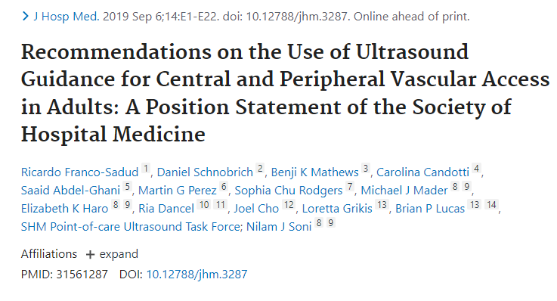
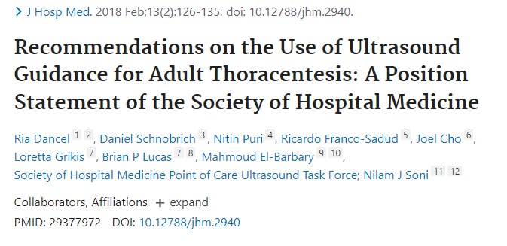
Ultrasound guidance should be used for:
Paracentesis
Thoracentesis
Central Line Placement
Lumbar Punctures
Notes:
Position statements from the Society of Hospital Medicine from 2018-1029
Reduces the risk of serious complications
Improve overall success rate
Assess volume and location of fluid
Needle insertion site should be evaluated using color flow doppler
For central line placement: Recommend using dynamic2-D ultrasound guidance to increase success rate and reduce risk of mechanical and infectious complications regardless of provider’s level of experience

Slide 12
ACGME Update
Notes:
Effective since July 2023
Notice it is currently a "should" not "must" recommendation as it is difficult to implement.

Slide 13
POCUS considerations
Helps guide real-time bedside diagnosis and treatment
Adjunct to the traditional history and physical
Does NOT replace traditional radiological ultrasound exams
Usually used to answer binary yes-no questions
Also – patients (and providers) usually love it!
Notes:
Not only patients, but physicians too. It also helps with learning when you can visualize what you hear/see

Slide 14
Missed pericardial tamponade: Now a NEVER event!
Notes:
PLAX view

Slide 15
Examples of when to use POCUS
Diagnostic
Does the patient have a gallstone or cholecystitis?
Is there an intrauterine pregnancy?
Is this an abscess or cellulitis?
Does the patient have a thyroid nodule that is concerning?
Is there a pericardial or pleural effusion?
Does the patient have ascites?
Is there a DVT present?
Does the patient have increased PVR?
Treatment/Procedures
Subacromial shoulder injection
Knee arthrocentesis/injection
Thyroid FNA
Core needle biopsy
Ultrasound guided paracentesis
Carpal tunnel injection
De Quervain’s injection

Slide 16
Tips on starting a POCUS Curriculum

Slide 17
Competence
Understand indications and contraindications for US exams
Acquire adequate images
Interpret images appropriately
Integrate US exam findings into individual patient care plans and management
Clinical Integration
Image Interpretation
Competence
Image Acquisition
Basic Knowledge
Skill Acquisition

Slide 18
Privileging
No set guidelines for privileging in FM
Typical Numbers seen in ACEP
25-50 quality reviewed exams in a particular application
150-300 exams for general competency
5-10 scans for ultrasound procedural guidance
Practice based pathways vs Residency based pathway
Notes:
Just to make sure we're on the same page, when I talk about privileging, I'm talking about institutional guidelines to an individual practioner.
These guidelines are based on emergency medicine guidelines per ACEP

Slide 19
Make connections
Does your ER use POCUS?
What middleware software is available at your institution?
Do you need to touch base with radiology?
Who are people in your institution that may be able to help teach (outside of your residency program)?
Get IT on board early
Know your industry reps and institution ultrasound coordinator

Slide 20
TIME
Dedicated FTE
Keep a probe on you at all times
Scan as much as you can
If there is a no-show on your schedule, ask your patient if you can scan them
Hospital scanning is the best for pathology
Notes:
Learning a new skill and then teaching it takes lots of time and effort – having the FTE in order to create a curriculum is vital

Slide 21
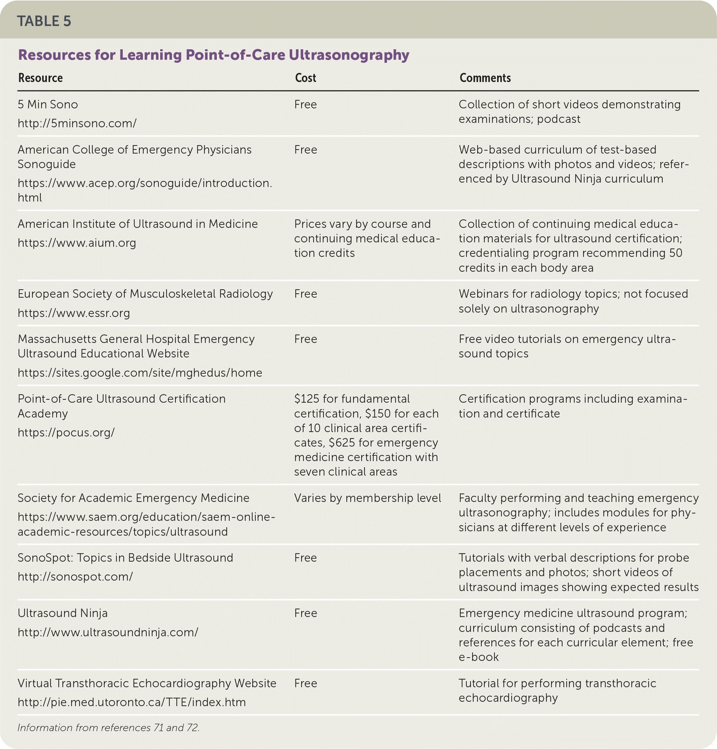
Notes:
For didactics, these are some great resources.
In the beginning, don’t redo work that is already done – there are great free, educational videos
Getting hands on practice is clutch

Slide 22
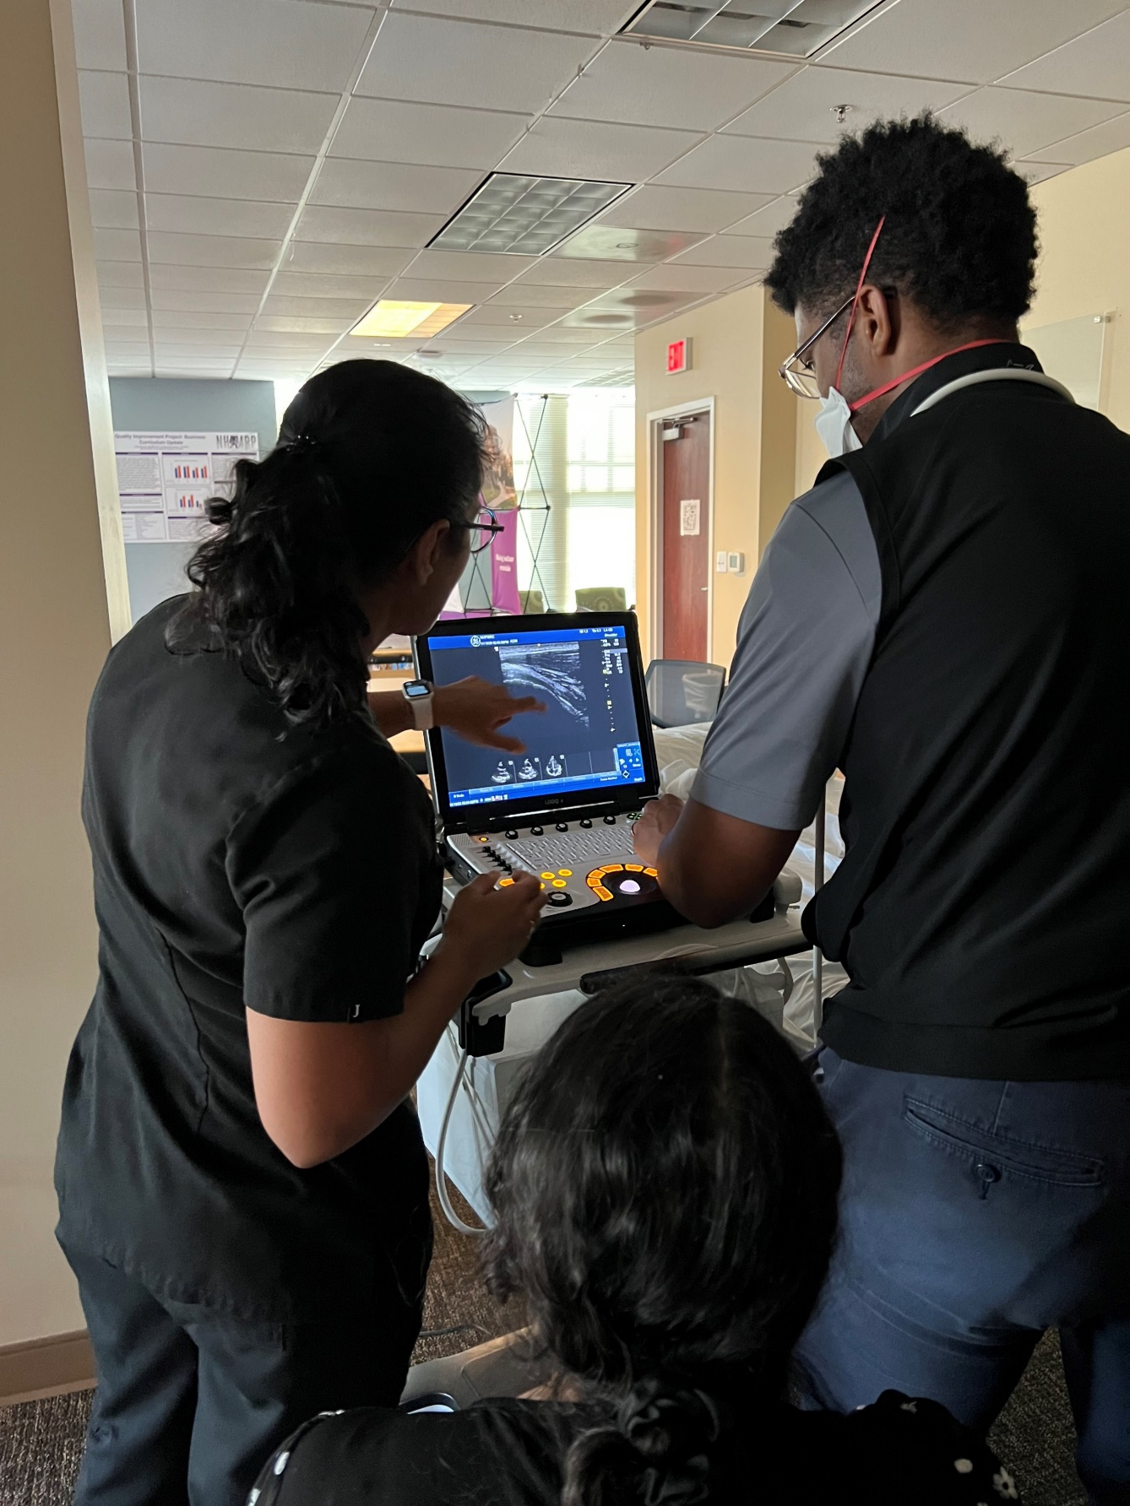
Quality Assurance
The crux of POCUS
In person at time of scan
Review scans later
Compare to formal studies
Notes:
each resident on the rotation will come up with one interesting ultrasound journal article to review and discuss once during the rotation. They will be in charge of leading the discussion.

Slide 23
Educational Scans
Definition: A scan that is performed by a non-credentialed provider who is learning ultrasound
Patients will provide verbal consent
Need to be informed for education only and will not be informed of results
No clinical decisions will be based on the scan
Any concerning POCUS findings must be reviewed by credentialed provider
NHFMR POCUS Scanning Policy

Slide 24
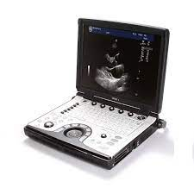
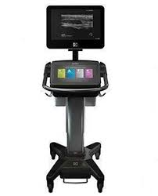
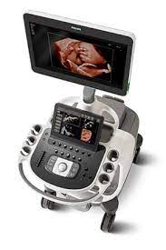
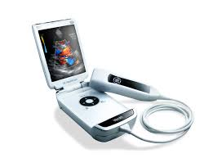
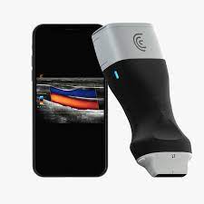
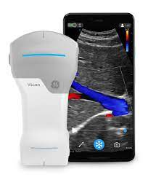
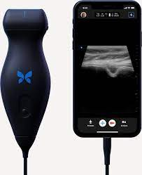
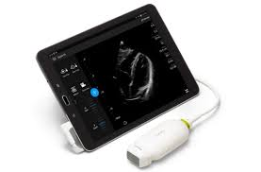
Notes:
There are all sorts of ultrasound machines to choose from now with different pros/cons
Here, we have the GE LogiqE and the Butterfly

Slide 25
Equipment Costs
Basic Laptop with 4 probes
$40-$75K to purchase
$600-$1,250 per month for 5-year lease
Pocket Ultrasound
$2-10K to purchase
$150-200 per month for 5-year lease
Notes:
The last thing I want to briefly review are some equipment costs for ultrasound machines. I’ve put up some general costs here.
And know that the correct ultrasound for an individual or practice really varies with multiple factors playing a role in the decision. I’m not going to discuss pros and cons of different machines, but would advocate that you do your homework before settling on a machine.
Also, make sure to check with your system’s policies, find out if the ultrasound machines are compatible and if the equipment can connect to your system. This is something another provider at Novant is running in to at this time.
Now, currently a basic laptop with 4 probes costs approximately $40-75K to purchase and $600 to $1250 per month for a 5 year lease
A pocket ultrasound costs approximately $2-10k to purchase and $150-200 per month for a 5 year lease.
So, let’s take an example, let’s take large joint injections (like a subacromial shoulder injection). Remember we learned that CMS reimburses approximately $100 per injection. So if you wanted to lease a basic laptop ultrasound machine for $600 per month, you need to do at least 6 shoulder injections per month to cover the cost. I think it is reasonable to do 6 large joint injections per month – now we just need to make sure to do it with ultrasound guidance (which shouldn’t be too difficult to learn if it’s a procedure you’re already doing.
Tax deduction
The other thing to consider is the section 197 tax deduction when you are trying to get someone to lease equipment for you – if you are leasing a $75K machine per month and paying $1,250 per month, you can deduct the full cost as a business expense if you and anyone else is interested – look at the IRS rules for that. You likely won’t bill as much initially as you will over the course of 5 years, but there is a tax deduction.
Extra:
Entry-level ultrasound devices cost between $2,000 and $10,000. Some offer annual subscriptions for features like HIPAA-compliant cloud storage, tutorials, and advanced imaging presets. Those are the startup costs. There are also per-procedure costs. When bought in bulk, single-use packets of sterile gel generally cost $1-$2, and disposable probe covers cost about $0.25 each. LLD cleaning products are generally less than $0.25 per use, and HLD chemical washes cost about $50 per gallon. Family physicians can perform a number of POCUS procedures that yield Medicare reimbursements of $50-$125 (see “POCUS coding,” page 39.) These far outweigh the per-procedure costs, allowing physicians to recoup startup expenses within a reasonable timeframe, although a warranty to hedge against breakdowns of the ultrasound device may be considered, depending on the cost

Slide 26
References
Bornemann, Paul. Ultrasound for Primary Care. Available from: Wolters Kluwer, Wolters Kluwer Health, 2020.
Arnold MJ, Jonas CE, Carter RE. Point-of-Care Ultrasonography. Am Fam Physician. 2020 Mar 1;101(5):275-285. PMID: 32109031.
Cho J, Jensen TP, Reierson K, Mathews BK, Bhagra A, Franco-Sadud R, Grikis L, Mader M, Dancel R, Lucas BP; Society of Hospital Medicine Point-of-care Ultrasound Task Force, Soni NJ. Recommendations on the Use of Ultrasound Guidance for Adult Abdominal Paracentesis: A Position Statement of the Society of Hospital Medicine. J Hosp Med. 2019 Jan 2;14:E7-E15. doi: 10.12788/jhm.3095. PMID: 30604780; PMCID: PMC8021127.
Dancel R, Schnobrich D, Puri N, Franco-Sadud R, Cho J, Grikis L, Lucas BP, El-Barbary M; Society of Hospital Medicine Point of Care Ultrasound Task Force, Soni NJ. Recommendations on the Use of Ultrasound Guidance for Adult Thoracentesis: A Position Statement of the Society of Hospital Medicine. J Hosp Med. 2018 Feb;13(2):126-135. doi: 10.12788/jhm.2940. PMID: 29377972.
Soni NJ, Franco-Sadud R, Kobaidze K, Schnobrich D, Salame G, Lenchus J, Kalidindi V, Mader MJ, Haro EK, Dancel R, Cho J, Grikis L; SHM Point-of-care Ultrasound Task Force, Lucas BP. Recommendations on the Use of Ultrasound Guidance for Adult Lumbar Puncture: A Position Statement of the Society of Hospital Medicine. J Hosp Med. 2019 Oct 1;14(10):591-601. doi: 10.12788/jhm.3197. Epub 2019 Jun 10. PMID: 31251163; PMCID: PMC6817310.
Franco-Sadud R, Schnobrich D, Mathews BK, Candotti C, Abdel-Ghani S, Perez MG, Rodgers SC, Mader MJ, Haro EK, Dancel R, Cho J, Grikis L, Lucas BP; SHM Point-of-care Ultrasound Task Force, Soni NJ. Recommendations on the Use of Ultrasound Guidance for Central and Peripheral Vascular Access in Adults: A Position Statement of the Society of Hospital Medicine. J Hosp Med. 2019 Sep 6;14:E1-E22. doi: 10.12788/jhm.3287. Epub ahead of print. PMID: 31561287.
The POCUS Atlas
Ultrasound Guidelines: Emergency, Point-of-Care and Clinical Ultrasound Guidelines in Medicine. Ann Emerg Med. 2017 May;69(5):e27-e54. doi: 10.1016/j.annemergmed.2016.08.457. PMID: 28442101.
Shen-Wagner J. Family Medicine Billing for Point-of-Care Ultrasound (POCUS). J Am Board Fam Med. 2021 Jul-Aug;34(4):856-858. doi: 10.3122/jabfm.2021.04.210187. PMID: 34312280.
Shen-Wagner J, Deutchman M. Point-of-Care Ultrasound: A Practical Guide for Primary Care. Fam Pract Manag. 2020 Nov/Dec;27(6):33-40. PMID: 33169960.

Slide 27
STFM Point-of-Care Ultrasound Resources

Slide 28
STFM POCUS Collaborative
Initial goals:
Create a community for people to discuss POCUS Education
Establish a communication platform for educators to share ideas on POCUS Education
Leadership post a question or tips once a month
Current Project:
POCUS Needs Assessment
Will help shape projects, goals, and action ideas for the future
Leadership
Ryan Paulus | Co-Chair
Puja Dalal | Co-Chair
James Wilcox | Co-Chair Elect
Maddie Cutrone | Resident Representative
Marenda Biggs | Student Representative

Slide 29
STFM Family Medicine Point- of-Care Ultrasound Educator Certificate Program

Slide 30
Program Overview
Yearlong program developed for family medicine educators taught by family medicine educators
Focuses on training, but also focuses on how to teach POCUS
Mixture of hands-on training, online learning, and longitudinal experiences
Provide a high-quality experience at an affordable price

Slide 31
Components of the Certificate Program
Workshop Component:
Participants must attend three POCUS workshops
Introduction to POCUS, Advanced POCUS, POCUS Educators
Mentorship:
Participants will be assigned a POCUS mentor as a point of contact through the program
Education Review:
Virtual education reviews focusing on giving feedback on images like you would to your learner
Image Portfolio:
Upload images for faulty to review and give feedback
Online Modules:
10 modules based on the core content areas modeled off teaching
Assessment at the end:
Participants must successfully pass a written knowledge assessment and an in-person skills performance exam
Notes:
John – Modules and assessment

Slide 32
Scope of Learning: What should every FM doc know?
9 core content areas
Cardiac, Pulmonary, OB/GYN, Musculoskeletal, Soft Tissue, Abdominal Aorta, Deep Venous System in the Leg, Renal and bladder, and Abdominal (Biliary).
Developed different phases of integration to reach the intended scope
Phase 1: US Fundamentals and obtaining images
Introduction workshop, modules, image portfolio
Phase 2: Learning normal vs abnormal
Advanced POCUS workshop, modules, image portfolio, mentorship, education review
Phase 3: Applying US clinically at the bedside and teaching POCUS
Advanced POCUS and educators workshop, modules, image portfolio, education review, mentorship

Slide 33
Workshops
Introduction to Point-of-Care Ultrasound Workshop:​
Basic knowledge foundation of POCUS ​
Focus on Phase 1 implementation of the scope ​
Introduce some Phase 2 application ​
Will occur at the annual conference ​
Advanced Point-of-Care Ultrasound Workshop:
Review Phase 1 learning
Main focus will be Phase 2 and Phase 3 with heavy emphasis on clinical applications and protocols
Teaching how to teach
Completion of the introduction workshop is required before enrolling
Will occur at the CPQI conference

Slide 34
Workshops
Point-of-Care Ultrasound Educator Workshop:
The goal of this workshop is to discuss POCUS education and how to integrate this into your residency program and how to become a more effective POCUS teacher
Example topics:
First steps to integrating POCUS into your program
How to teach image acquisition and interpretation
How to grow your POCUS Program
Tips on getting an ultrasound machine/overview of the machines
Billing and Credentialling
Virtual workshop offering
8-hour course
Winter/early spring

Slide 35
Modules
Roughly 30-45 mins per module
Mix of videos and text with embedded knowledge questions
10 modules focused on clinical cases of core POCUS modalities
Introduction, Cardiac, Pulmonary, OB/GYN, Musculoskeletal, Soft Tissue, Abdominal Aorta, Deep Venous System in the Leg, Renal and bladder, and Abdominal (Biliary).
Layout
Performing the US examination, normal images, and pathology examples
Will walk the participant through clinical cases of how POCUS can be used in the examination room
Format will be a preceptor teaching a resident POCUS application on a patient
Focused on learning how to perform POCUS but also how to effectively teach the modality
Includes teaching pearls

Slide 36
Modules will be free to all STFM members!

Slide 37
Mentorship
Each core faculty member will serve as a mentor to guide participants through the program
Roles:
Point of contact for participants
Facilitate ongoing communication

Slide 38
Education Review
2-hour session
Virtual group session (Zoom format)
Each session will have a POCUS modality as the topic (i.e cardiac, pulmonary, etc.)
Modeled as a “pass the pointer” format where participants will provide the images from their personal portfolio
Equip participants with the skills with running an image review and for them to get feedback on their images

Slide 39
Image Portfolio Review
Participants will upload images via Dropbox for faulty to review and give feedback.
Participants will need to upload studies in six of the nine content areas
Cardiac
Pulmonary
OB/GYN
Musculoskeletal
Soft Tissue
Abdominal Aorta
Deep Venous System in the Leg
Renal and bladder
Abdominal

Slide 40
Assessment
Written Assessment
50 questions
Majority questions will be images/clips interpretation and application
Online platform
Hands-on Assessment
Test the participants ability to obtain images and integrate them clinically
Will be completed at one of the STFM conferences

Slide 41
9 Core Faculty
Hiten Patel, MD - THE Ohio State University
Juana Nicoll Capizzano MD - University of Michigan
Nicole T. Yedlinsky, MD - University of Kansas
Ryan Paulus, DO - University of North Carolina
Brandon Williamson, MD - Texas A&M
Noah Furr, MD - Nellis Family Medicine Residency, NV
John Doughton, MD - University of North Carolina
Puja Dalal, MD - Novant Health, NC
Ben Clements, MD - University of Vermont

Slide 42
10 Faculty Instructors
Dave Stromberg, MD - UNM Family and Community Medicine
Jeffrey Pierce, MD - Contra Costa Family Medicine Residency Program
Nicholas LeFevre, MD - University of Missouri-Columbia
Neil Jayasekera, MD - Contra Costa Family Medicine Residency Program
Matthew Fentress, MD - Contra Costa Family Medicine Residency Program
Lauren Nadkarni, MD - Central Maine Medical Center
Joy Shen-Wagner, MD - University of South Carolina Greenville
Maysoon Hamed, MD - University of Texas Family and Community Medicine
Daniela Lobo, MD - Indiana University
Paul Bornemann, MD - Lexington Medical Center
Notes:
Hiten - Use this as time to do introductions and icebreakers
Ask about Program, role in residency, favorite US modality, and best 2023 experience.

Slide 43
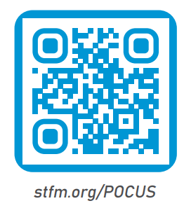
Questions?
Ryan Paulus, DO
Ryan_Paulus@med.unc.edu
Puja Dalal, MD, FAAAFP
pdalal@novanthealth.org

