Slide 1
Family Medicine in the Health Care System

Slide 2
Module Objectives
After this module the student will:
Understand the importance of family medicine in the health care system
Compare medical outcomes, access to care, and degree of health disparities, between countries with and without a robust primary care system.
Compare medical outcomes, access to care, and degree of health disparities, between states in the US.
Compare the per capita health care expenditures of the United States with other countries.
Discuss the relationship of access to primary care and health disparities.
Improve literacy of health policy literature
Demonstrate critical thinking of issues in the US health care system

Slide 3
Who can describe the US health care system?
What type of system is it?
Notes:
The students will likely answer more closely to a private system.
Insurance companies etc.
Try to get them to describe how care is provided.
Hospital or Clinic?
I’d love the electronic file of how care is delivered that was in the old syllabus.

Slide 4
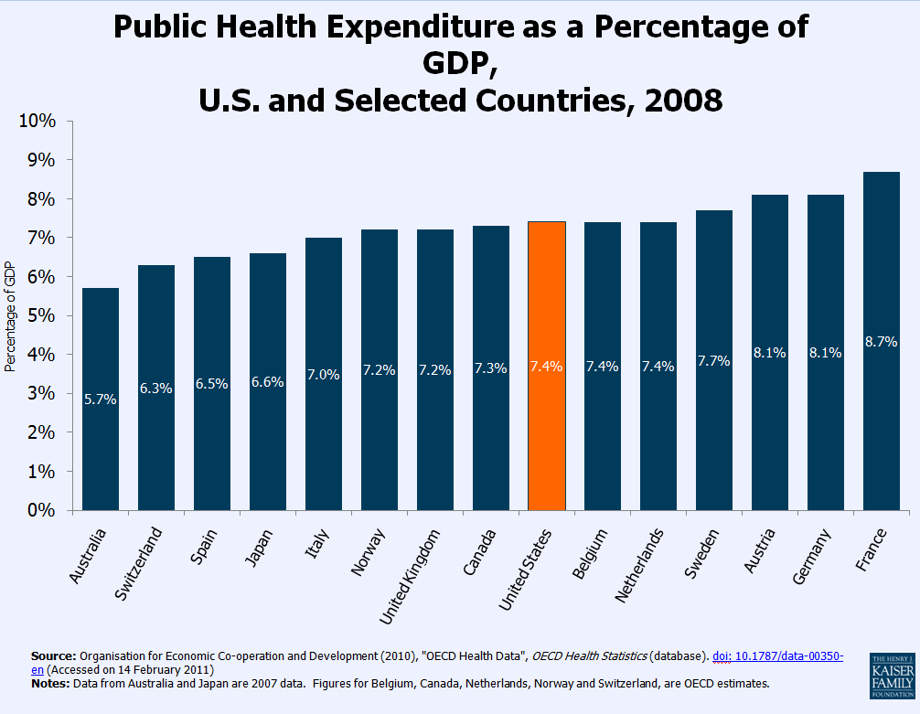
Public??
Notes:
The US spends about the same in public funds as the rest of the world but….next

Slide 5
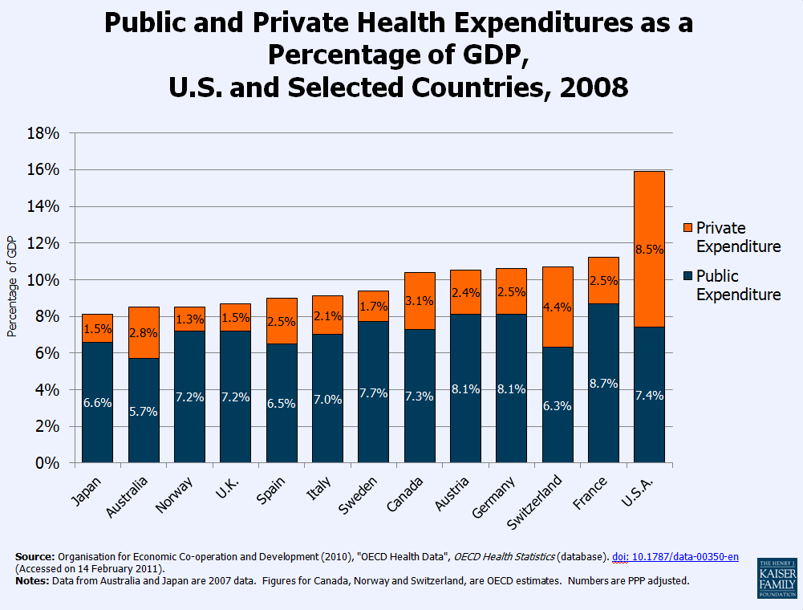
Notes:
We far outspend in private funds.
We are a mixed public/private funding systems.
All the other countries are too, but are ratio is close to half.

Slide 6
How does the US system compare to systems in other nations?
Notes:
Best ?
Worst?
Neither. About the same in most stats.
BUT we spend a lot more.
Some things we are really good other things not so good.

Slide 7
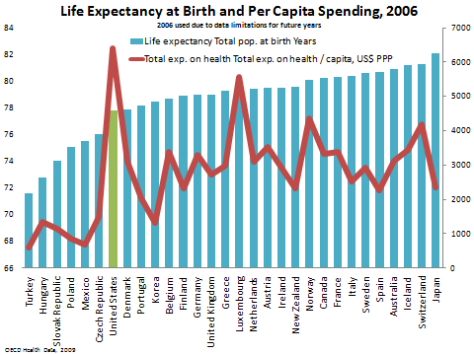
Outcomes Compared Internationally

Slide 8
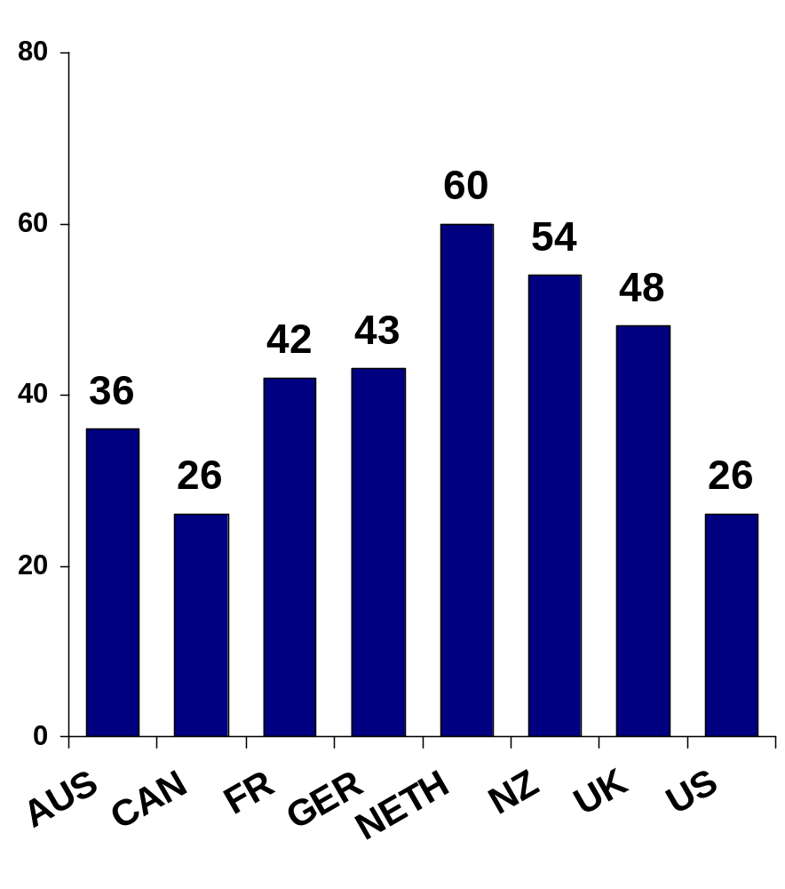
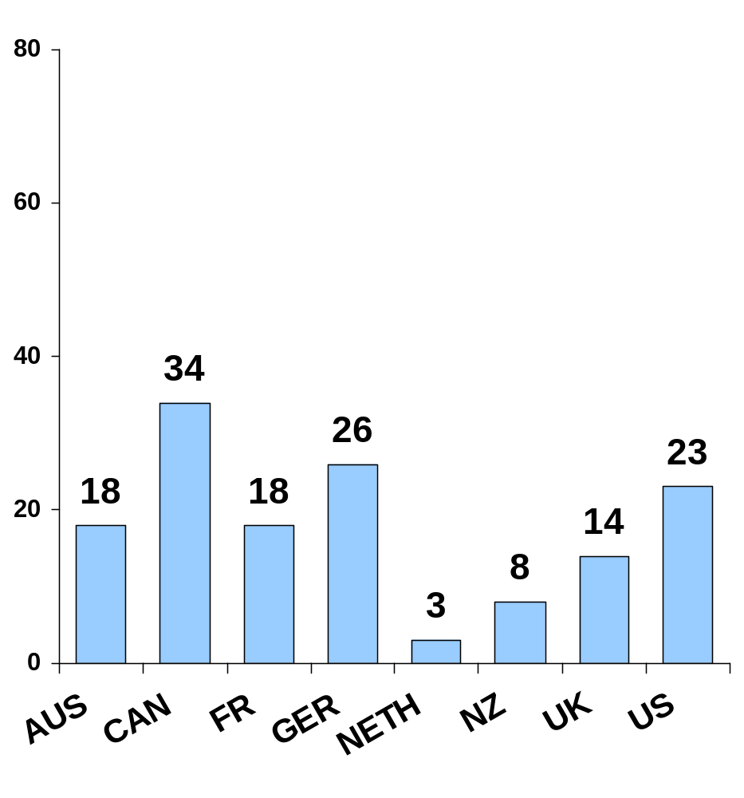
Access to Doctor When Sick or Needed Care
Base: Adults with any chronic condition
Percent
Same-day appointment
6+ days wait or never able
to get appointment
Data collection: Harris Interactive, Inc.
Source: 2008 Commonwealth Fund International Health Policy Survey of Sicker Adults.

Slide 9
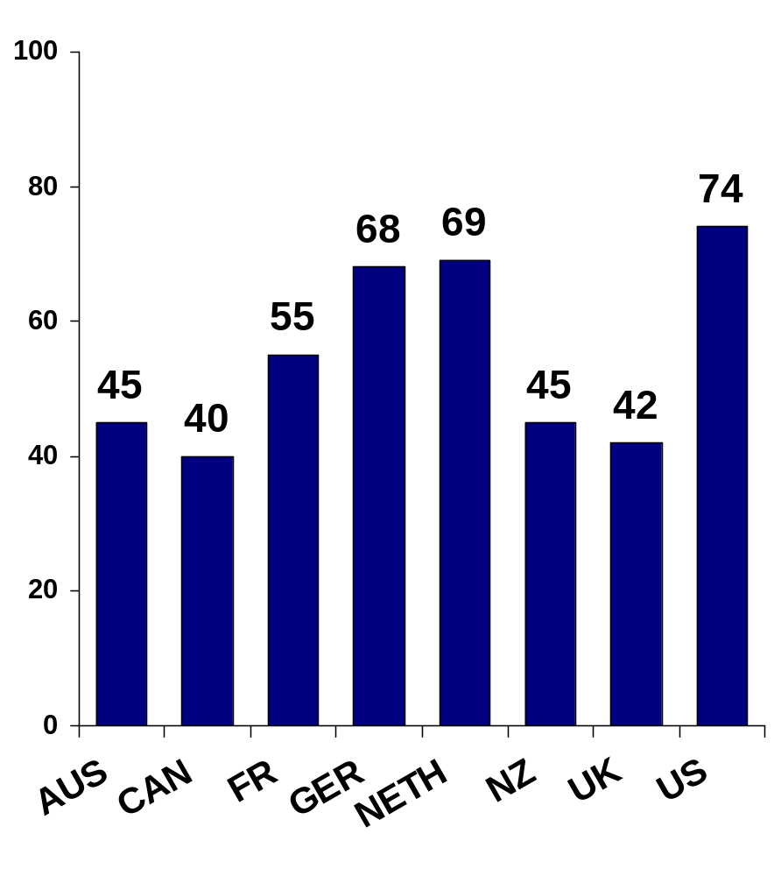
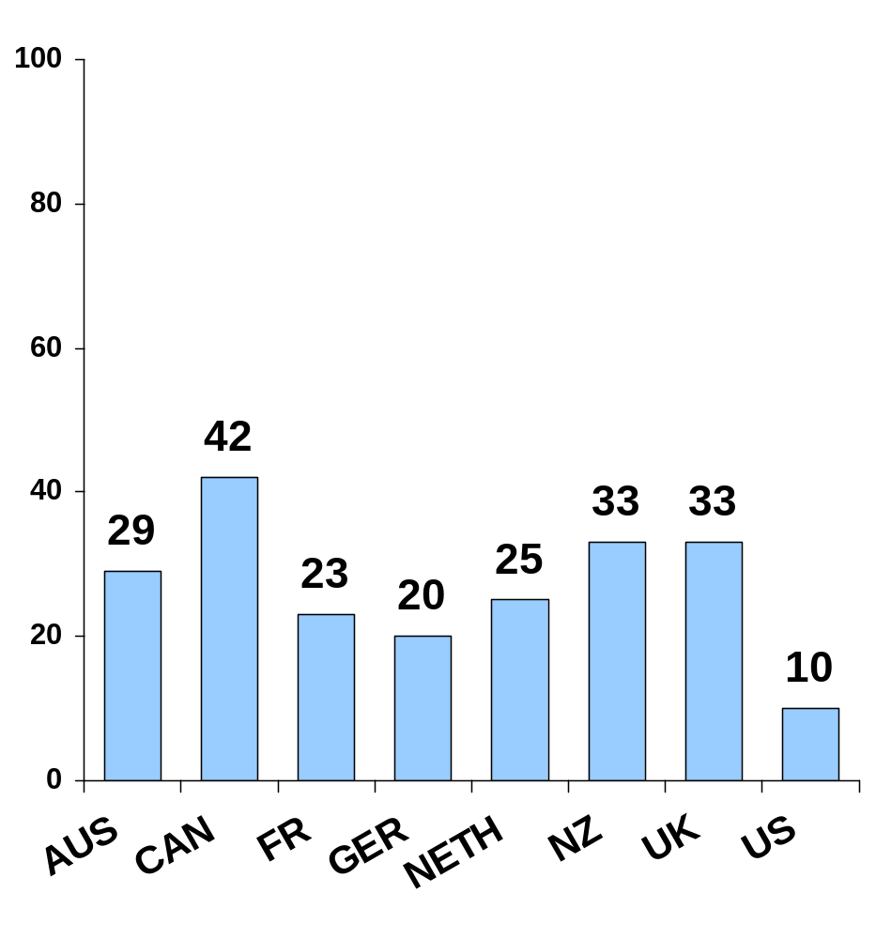
Wait Time for Specialist Appointment
Base: Adults with any chronic condition who needed to see a specialist in past 2 years
Percent
Less than 4 weeks
Two months or longer
Data collection: Harris Interactive, Inc.
Source: 2008 Commonwealth Fund International Health Policy Survey of Sicker Adults.

Slide 10
Medical Professionals Per 1,000 (2006 and 2007)

Slide 11
Medical Professionals Per 1,000 (2006 and 2007)

Slide 12
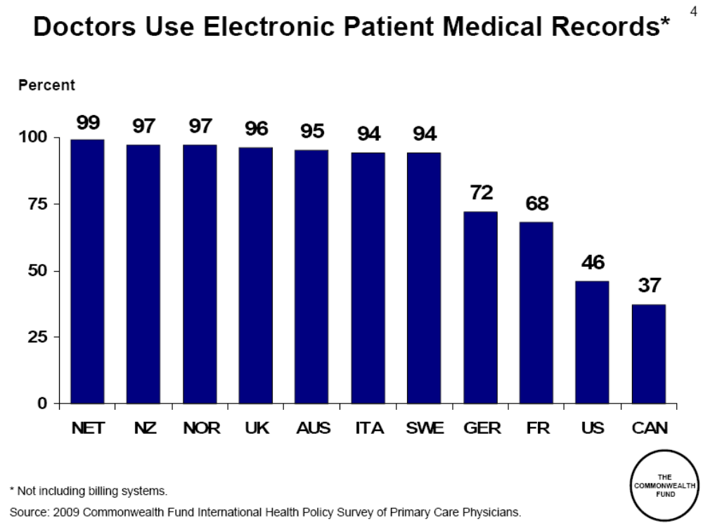

Slide 13
How does Utah’s population compare to other states?

Slide 14
What could cause these differences between states?
Notes:
Many reasons
Personal Choice
Health systems
Spending on care
Culture
Minority groups
Income
PCP/specialists

Slide 15


Slide 16
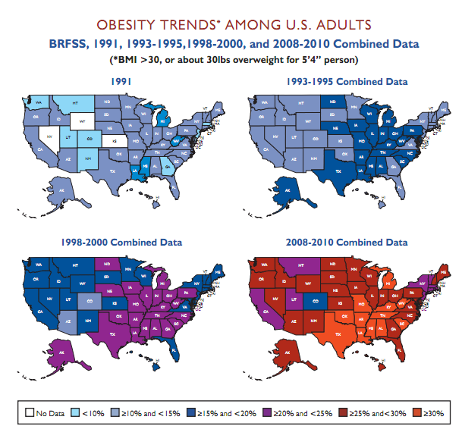

Slide 17
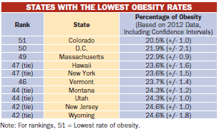
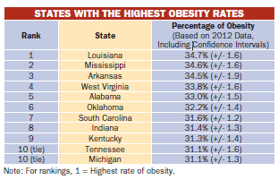

Slide 18
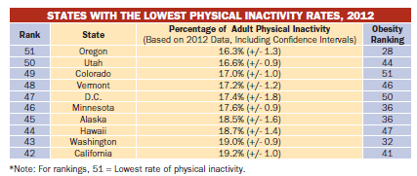

Slide 19
What is the relationship between primary care and health disparities?
Notes:
Don’t need to go deep in this now.

Slide 20
What is the role of family medicine in the US health care system?

Slide 21
