Slide 1
An Introduction to the
Role of Family Medicine in the Healthcare System
John Boltri, M.D., F.A.A.F.P.
Professor and Chair
Margit Chadwell, M.D., F.A.A.F.P.
Family Medicine Clerkship Director
Department of Family Medicine and Public Health Sciences
Wayne State University School of Medicine

Slide 2




An Introduction to the
Role of Family Medicine in the Healthcare System
Session Goals and Objectives:
1. Compare the medical outcomes between countries with and without a primary care base
2. Compare the health care expenditures of the United States with other countries
3. Discuss the relationship of access to primary care and health disparities

Slide 3

An Introduction to the
Role of Family Medicine in the Healthcare System
A comparison of the health care expenditures of the United States with other countries

Slide 4
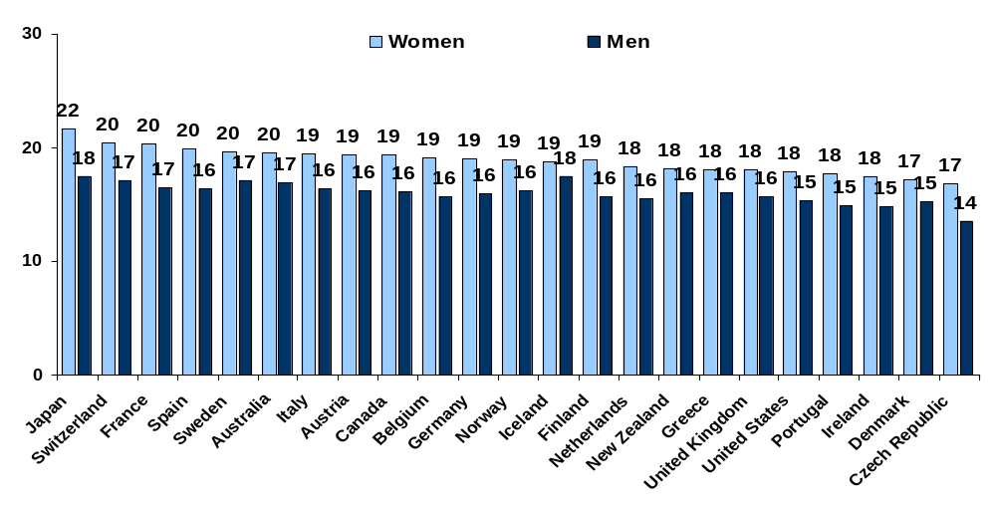
Healthy Life Expectancy at Age 60, 2002
HEALTHY LIVES
Developed by the World Health Organization, healthy life expectancy is based on life expectancy adjusted for time spent in poor health due to disease and/or injury
Years
Note: Indicator was not updated due to lack of data. Baseline figures are presented.
Data: The World Health Report 2003 (WHO 2003, Annex Table 4).
Source: Commonwealth Fund National Scorecard on U.S. Health System Performance, 2008
Notes:
This chart represents the number of years men and women expect to live if they were 60 years old in 2002, by country. The US ranks 19th.
Not shown here is life expectancy at birth. For industrialized nations this reached 79.5 years in 2009, a gain of
more than 11 years since 1960. Japan is the highest and more than 20 nations have life expectancy at birth of 80 years or more.
The US, Portugal, and a number of central and eastern European countries have a life expectancy of <80 but >75 years.

Slide 5
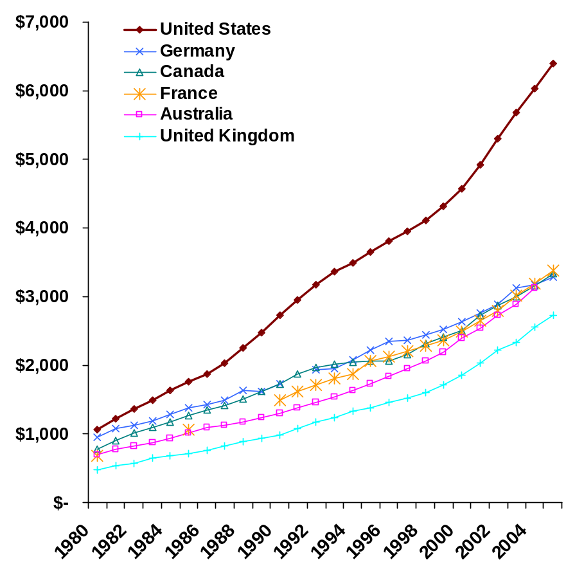
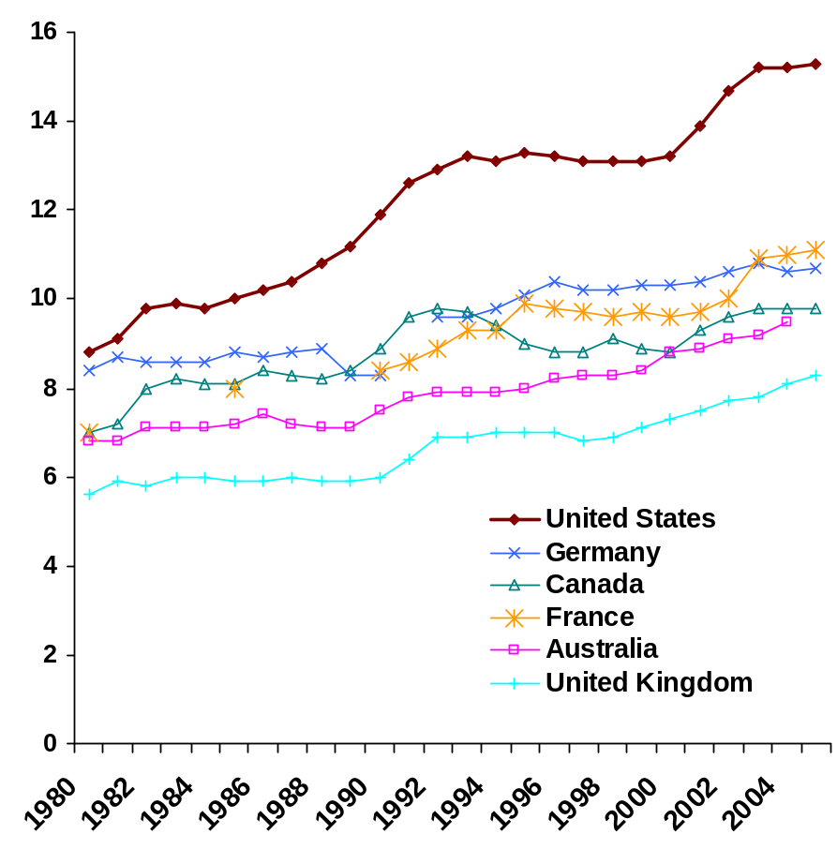
International Comparison of Spending on Health, 1980–2005
EFFICIENCY
Average spending on health
per capita ($US PPP*)
Total expenditures on health
as percent of GDP
* PPP=Purchasing Power Parity.
Data: OECD Health Data 2007, Version 10/2007.
5
Source: Commonwealth Fund National Scorecard on U.S. Health System Performance, 2008
Notes:
The US OUTSPENDS all other countries by – two and a half times the average
of industrialized nations.

Slide 6

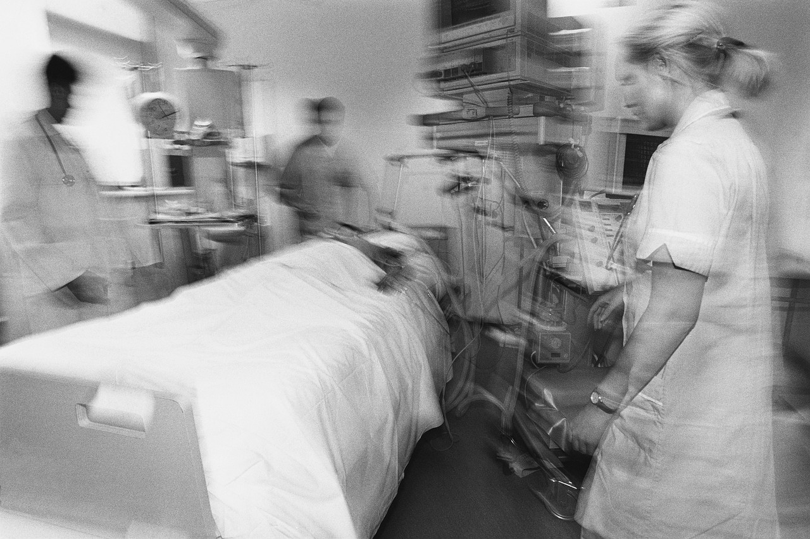
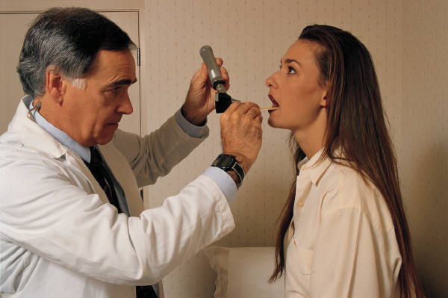
An Introduction to the
Role of Family Medicine in the Healthcare System
A Comparison of the
medical outcomes between
countries with and without
a primary care base

Slide 7
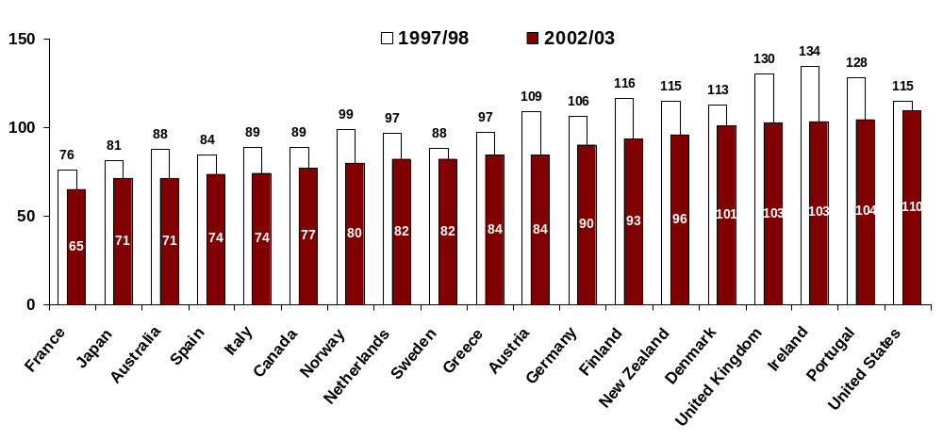
Mortality Amenable to Health Care
HEALTHY LIVES
Deaths per 100,000 population*
* Countries’ age-standardized death rates before age 75; including ischemic heart disease, diabetes, stroke, and bacterial infections.
See report Appendix B for list of all conditions considered amenable to health care in the analysis.
Data: E. Nolte and C. M. McKee, London School of Hygiene and Tropical Medicine analysis of World Health Organization mortality files (Nolte and McKee 2008).
Source: Commonwealth Fund National Scorecard on U.S. Health System Performance, 2008
Notes:
Premature mortality before age 70, can be prevented with better primary care focused on preventive measures , such as decreasing infant mortality, reducing injuries and communicable diseases, and advances in medical technology that may prevent heart disease. Other behavioral factors such as reducing alcohol and tobacco use have also been associated with reduced premature mortality.

Slide 8
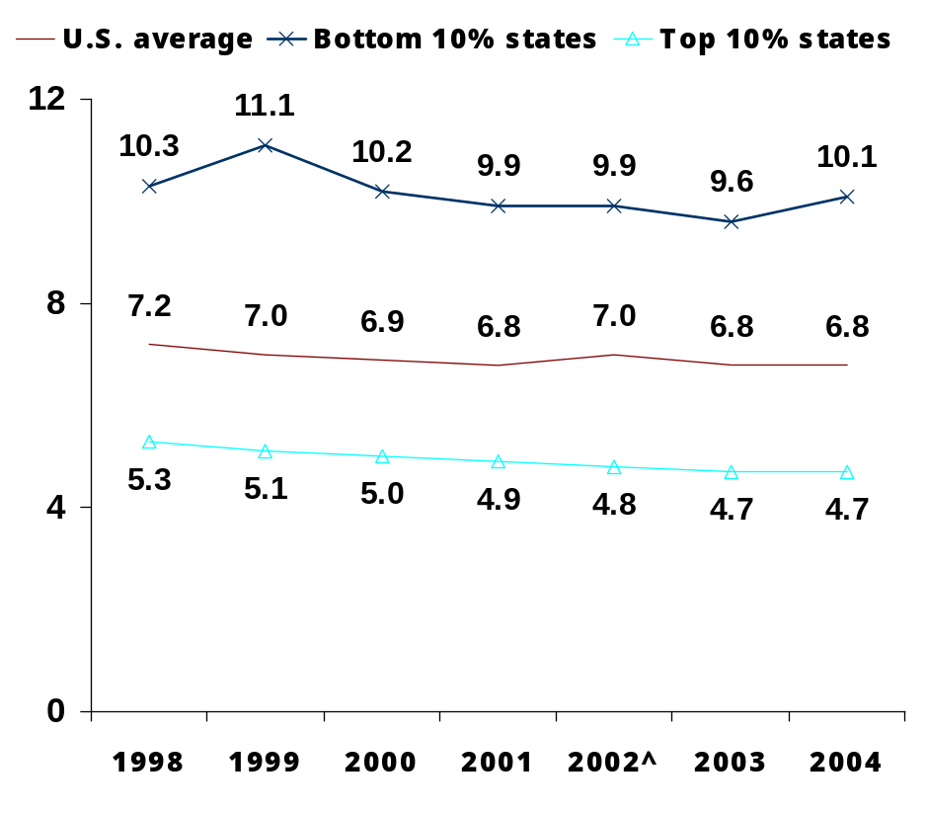
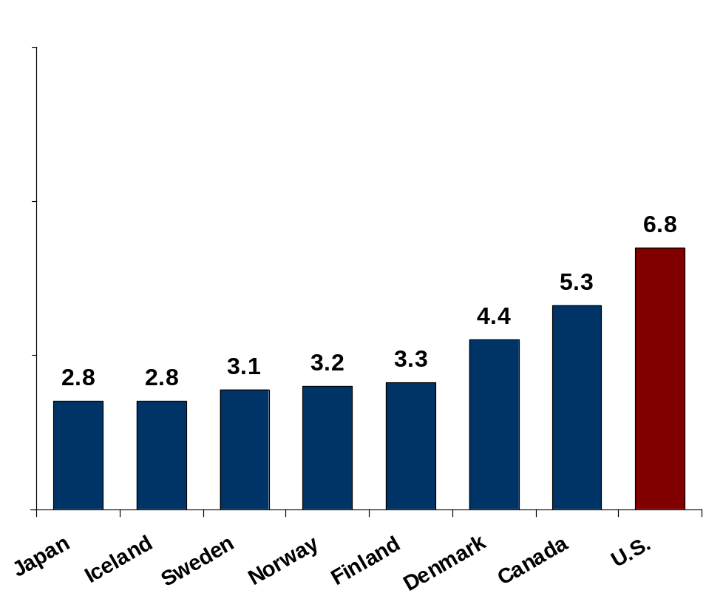
Infant Mortality Rate
HEALTHY LIVES
Infant deaths per 1,000 live births
National Average and State Distribution
International Comparison, 2004
^ Denotes baseline year.
Data: National and state—National Vital Statistics System, Linked Birth and Infant Death Data (AHRQ 2003, 2004, 2005, 2006, 2007a); international comparison—OECD Health Data 2007, Version 10/2007.
Source: Commonwealth Fund National Scorecard on U.S. Health System Performance, 2008
Notes:
Infant mortality is the death rate of babies and children <1yo. This is dependent on the economic
and social conditions that effect the health of mothers and newborns, as well as the effectiveness of the health care system. In 2004, rates were 3/1000 in Iceland, Sweden, Finland and greater than 6/1000
in the United States.

Slide 9
HOSPITAL ADMISSION RATES
Rates per 100,000 population
Adapted from: OECD (2011), Health at a Glance 2011; OECD Indicators, OECD Publishing.

Slide 10
HOSPITAL ADMISSION RATES
Rates per 100,000 population
Adapted from: OECD (2011), Health at a Glance 2011; OECD Indicators, OECD Publishing.
Notes:
Hospital admission rates are a proxy for effectiveness of care. Chronic conditions, when well managed by primary care, represent a preventable source of hospital admissions. High admission rates may indicate poor continuity, poor communication, or poor coordination of care of may indicate systemic problems such as a poor supply of family physicians.

Slide 11
HOSPITAL ADMISSION RATES
Rates per 100,000 population
Adapted from: OECD (2011), Health at a Glance 2011; OECD Indicators, OECD Publishing.

Slide 12
General practitioners as a percent of total doctors
2009 (or nearest year)
Adapted from: OECD (2011), Health at a Glance 2011; OECD Indicators, OECD Publishing.
Notes:
This graph represent the number of general practitioners (Family Docs) as a percent of the total. The total includes pediatricians, obstetricians/gynecologists, psychiatrists, medical specialists, surgical specialists and other doctors not classified elsewhere.

Slide 13
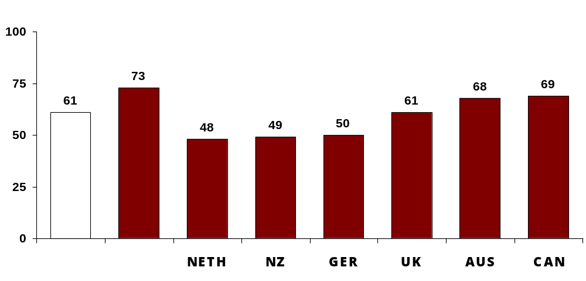
Difficulty Getting Care on Nights, Weekends, Holidays Without
Going to the Emergency Room, Among Sicker Adults
QUALITY: PATIENT-CENTERED, TIMELY CARE
Percent of adults who sought care reporting “very” or “somewhat” difficult
2005
2007
United States
International Comparison
AUS=Australia; CAN=Canada; GER=Germany; NETH=Netherlands; NZ=New Zealand; UK=United Kingdom.
Data: 2005 and 2007 Commonwealth Fund International Health Policy Survey.
Source: Commonwealth Fund National Scorecard on U.S. Health System Performance, 2008

Slide 14
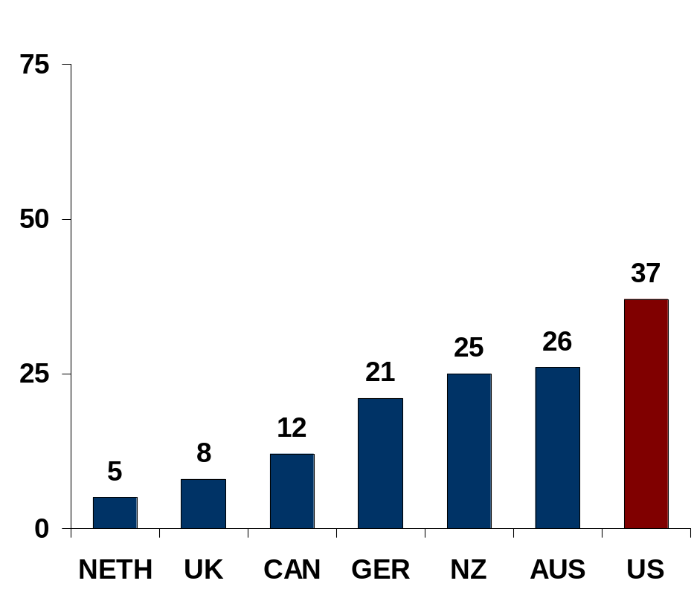
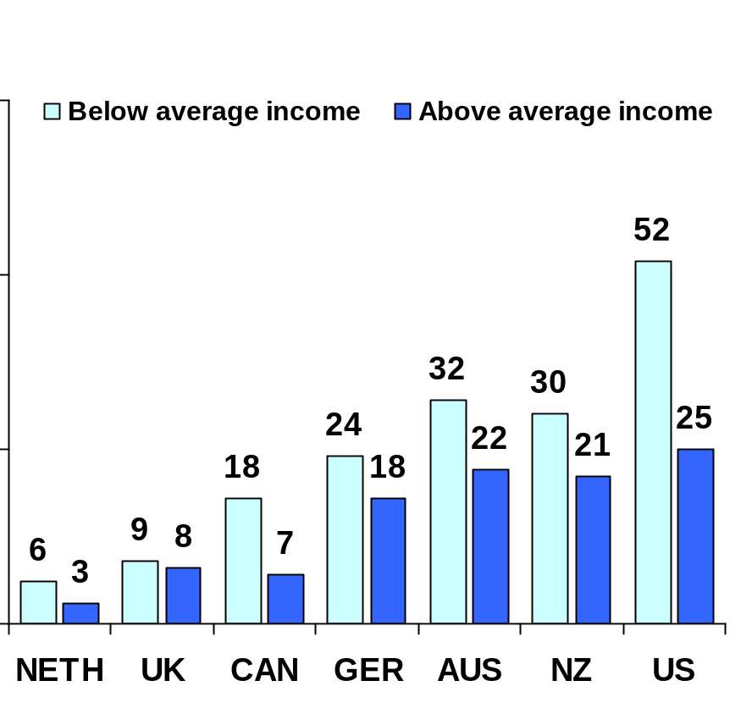
Access Problems Because of Costs, By Income, 2007
ACCESS: PARTICIPATION
Percent of adults who had any of three access problems* in past year because of costs
* Did not get medical care because of cost of doctor’s visit, skipped medical test, treatment, or follow-up because of cost, or did not fill Rx or skipped doses because of cost.
AUS=Australia; CAN=Canada; GER=Germany; NETH=Netherlands; NZ=New Zealand; UK=United Kingdom; US=United States.
Data: 2007 Commonwealth Fund International Health Policy Survey.
14
Source: Commonwealth Fund National Scorecard on U.S. Health System Performance, 2008

Slide 15
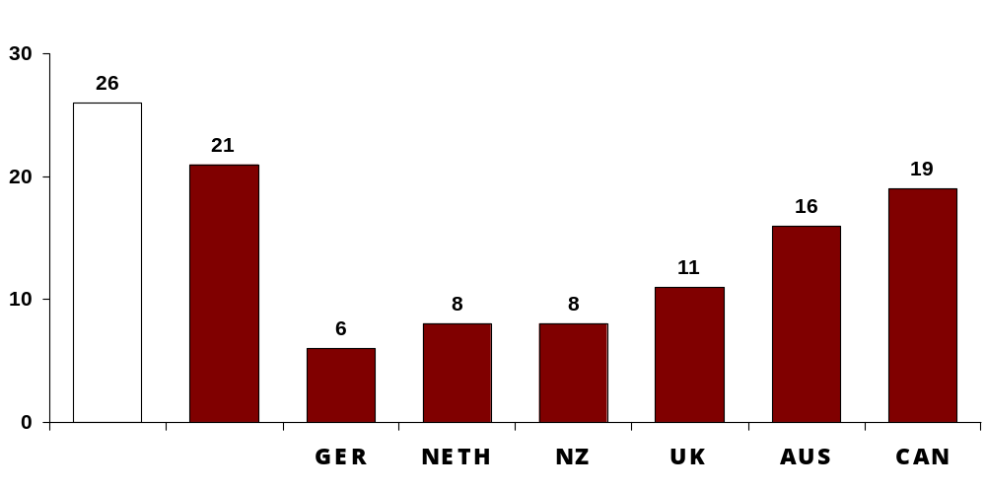
Went to Emergency Room for Condition That Could Have Been Treated by Regular Doctor, Among Sicker Adults
EFFICIENCY
Percent of adults who went to ER in past two years for condition that could have been treated by regular doctor if available
2005
2007
United States
International Comparison
AUS=Australia; CAN=Canada; GER=Germany; NETH=Netherlands; NZ=New Zealand; UK=United Kingdom.
Data: 2005 and 2007 Commonwealth Fund International Health Policy Survey.
Source: Commonwealth Fund National Scorecard on U.S. Health System Performance, 2008

Slide 16
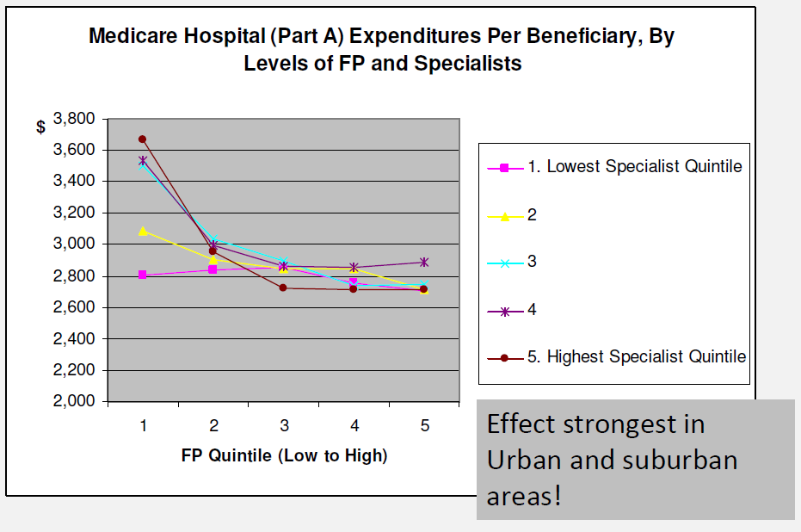
More = Less
Source: The Robert Graham Center, Bob Phillips, MD MSPH, Director, 2011
Notes:
This graph demonstrates that if there is a preponderance of specialists and few family physicians the costs for caring for Medicare beneficiaries is relatively high but once the relative density of family physicians reaches a critical level, the overall cost for caring for Medicare patients decrease to under $3000 per year for part A regardless of the specialist density.
Adding one FP per 1,000 population, or 100 per 100,000 reduces readmission odds for:
– Pneumonia 7%
– Heart Attack 5%
– Congestive Heart Failure 8%
• 46 FPs per 100,000 population = -$81 million per year
• 100/100,000 population = -$579 million per year (83% of PPACA target)

Slide 17
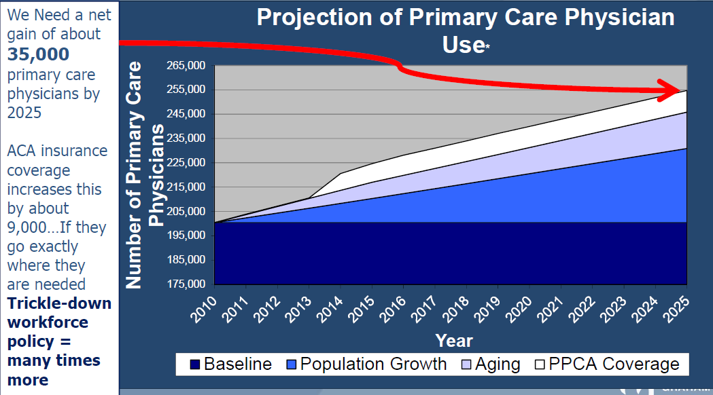
AHRQ Workforce Report
Source: Evidence and Tools for Advocacy from the Robert Graham Center, AAFP Center for Policy Studies. Jennifer L Rankin PhD, May, 2011
Notes:
Regardless of how you look at it, there is a shortage of primary care providers
Based on current utilization= 8,000 – 10,000 shortage, Based on evidence-based model = 67,000 shortage
And the shortage will continue. By 2025, 23% shortage based on aging and population growth alone,
28.5% shortage = based on above PLUS universal health insurance coverage
50% shortage= based on above PLUS reduced panel size for PCMH models

Slide 18
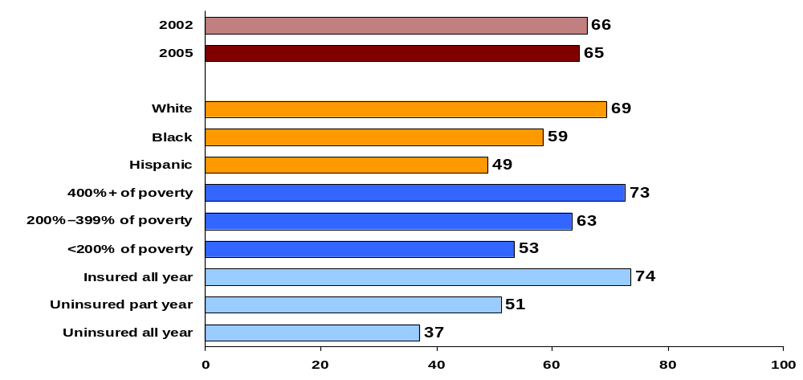
Adults with an Accessible Primary Care Provider
QUALITY: COORDINATED CARE
Percent of adults ages 19–64 with an accessible primary care provider*
U.S. Average
U.S. Variation 2005
* An accessible primary care provider is defined as a usual source of care who provides preventive care, care for new and ongoing health problems, referrals, and who is easy to get to.
Data: B. Mahato, Columbia University analysis of Medical Expenditure Panel Survey.
Source: Commonwealth Fund National Scorecard on U.S. Health System Performance, 2008

Slide 19
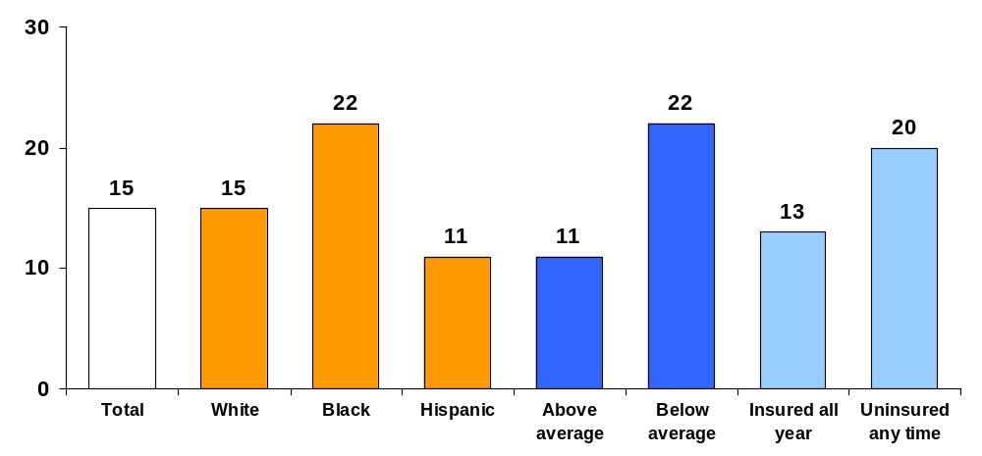
Went to Emergency Room for Condition That Could Have Been Treated by Regular Doctor, by Race/Ethnicity, Income, and
Insurance Status, 2007
EQUITY: COORDINATED AND EFFICIENT CARE
Percent of adults who went to ER in past two years for condition that could have been treated by regular doctor if available
Race/ethnicity
Income
Insurance status
Data: 2007 Commonwealth Fund International Health Policy Survey.
Source: Commonwealth Fund National Scorecard on U.S. Health System Performance, 2008

Slide 20
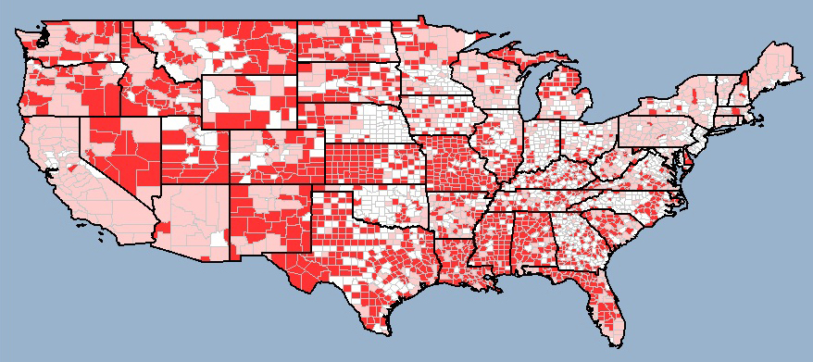
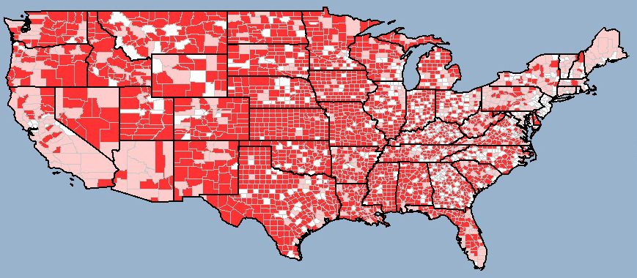
Primary Care Health Professional Shortage Areas
Primary Care Health Professional Shortage Areas (2006)
Primary Care Health Professional Shortage Areas, Family Physicians Removed (2006)
Source: Health Landscape Primary Care Atlas (healthlandscape.org)
Notes:
Family medicine training gives family physicians the flexibility to go where people need health
care and to adapt to different practice environments.
This whole-person training makes family physicians the ideal specialty to care for America's
most vulnerable and underserved communities.
This slide documents the impact family medicine has on America’s access to quality health
care. The red areas noted on the map on the left show the location of designated Primary Care
Health Personnel Shortage Areas at this time. Primary Care Health Personnel Shortage Areas
are designated by the federal government based on low physician to population ratios and/or
unique ethnic and socioeconomic status. The map on the right depicts the location and number
of shortage areas that would be designated if family physicians were removed.

Slide 21
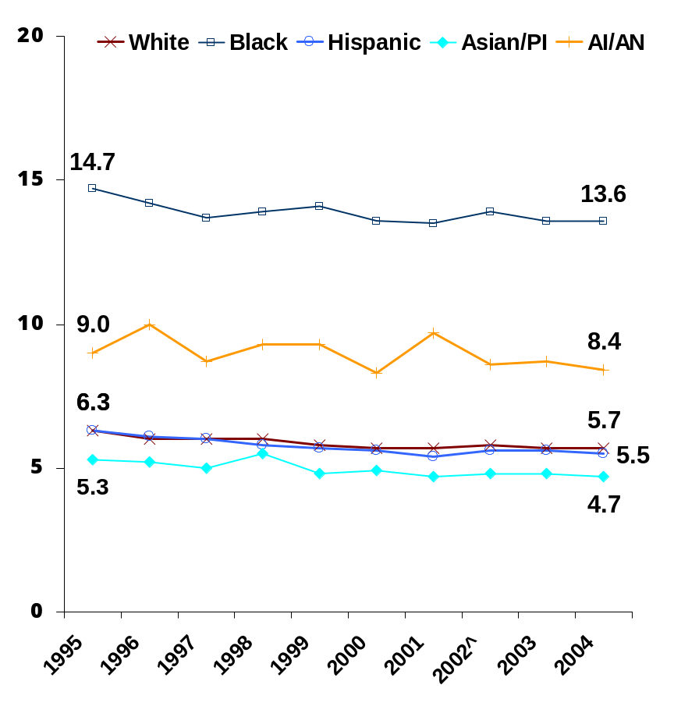
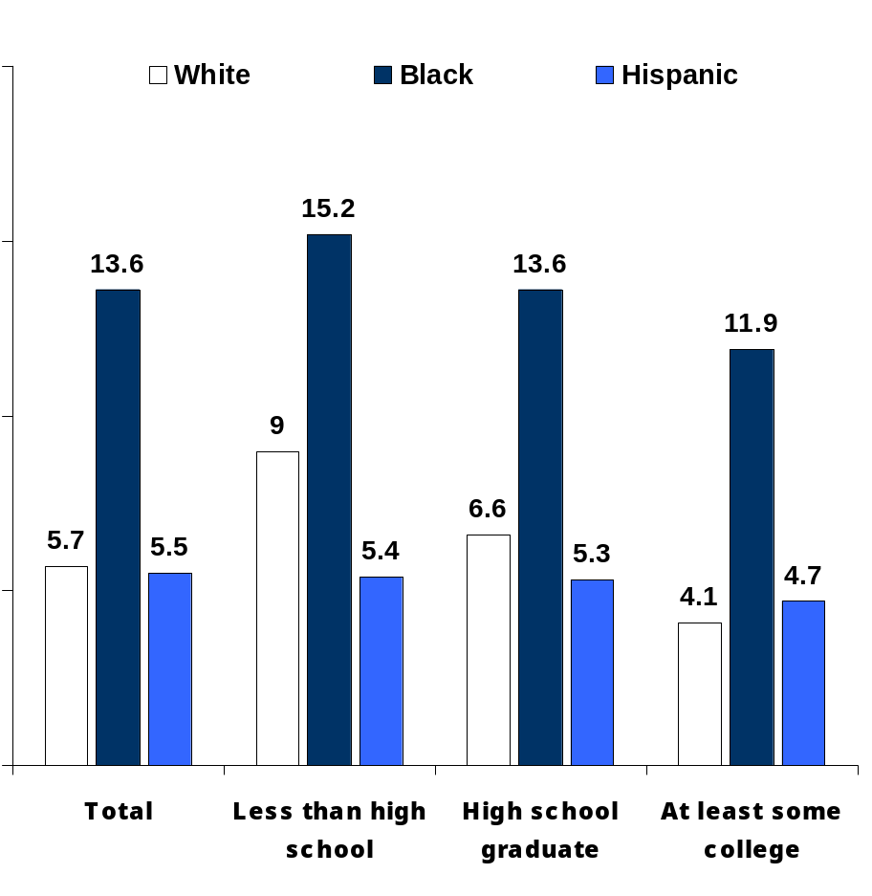
Infant Mortality
EQUITY: LONG, HEALTHY & PRODUCTIVE LIVES
Infant deaths per 1,000 live births
By Race/Ethnicity, 1995–2004
By Mother’s Education and Race/Ethnicity, 2004
^ Denotes baseline year. PI=Pacific Islander; AI/AN=American Indian or Alaskan Native.
Data: National Vital Statistics System, Linked Birth and Infant Death Data (AHRQ 2007b, Mathews 2007).
Source: Commonwealth Fund National Scorecard on U.S. Health System Performance, 2008

Slide 22
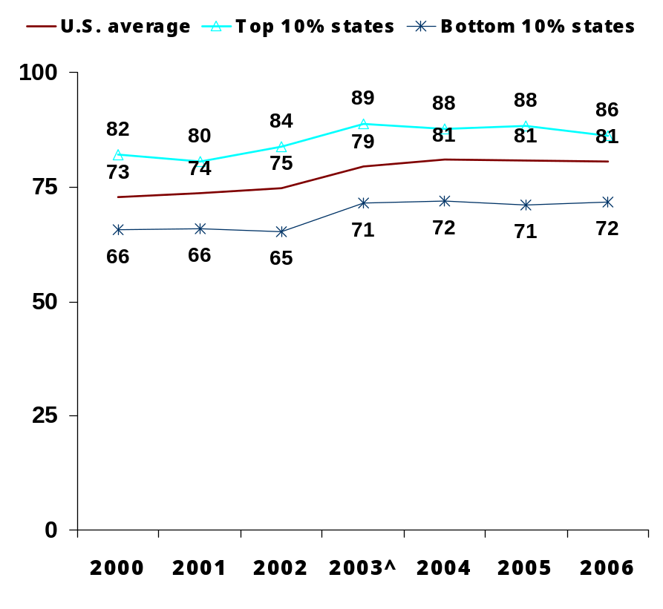
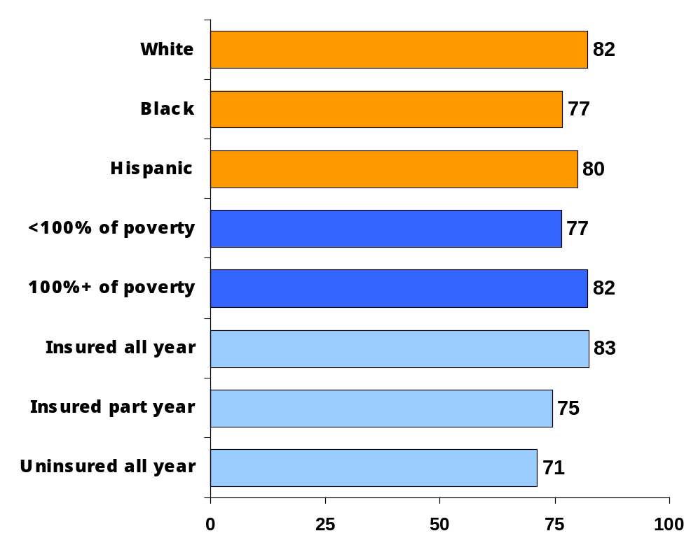
Immunizations for Young Children
QUALITY: EFFECTIVE CARE
Percent of children (ages 19–35 months) who received all recommended doses of five key vaccines*
National Average and State Distribution
By Family Income, Insurance Status**, and Race/Ethnicity, 2006
^ Denotes baseline year.
* Recommended vaccines include: 4 doses of diphtheria-tetanus-pertussis (DTP), 3+ doses of polio, 1+ dose of measles-mumps-rubella, 3+doses of Haemophilus influenzae type B, and 3+ doses of hepatitis B vaccine. **Data by insurance was from 2003.
Data: National Immunization Survey (NCHS National Immunization Program, Allred 2007).
Source: Commonwealth Fund National Scorecard on U.S. Health System Performance, 2008

Slide 23
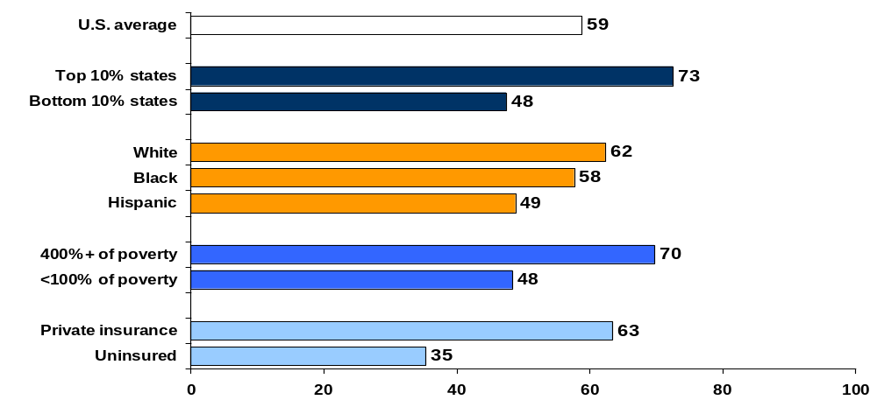
Preventive Care Visits for Children, by Top and Bottom States, Race/Ethnicity, Family Income, and Insurance, 2003
QUALITY: EFFECTIVE CARE
Percent of children (ages <18) who received BOTH a medical and dental preventive care visit in past year
Note: Indicator was not updated due to lack of data. Baseline figures from 2006 Scorecard are presented.
Data: 2003 National Survey of Children’s Health (HRSA 2005; retrieved from Data Resource Center for Child and Adolescent
Health database at http://www.nschdata.org).
Source: Commonwealth Fund National Scorecard on U.S. Health System Performance, 2008

Slide 24
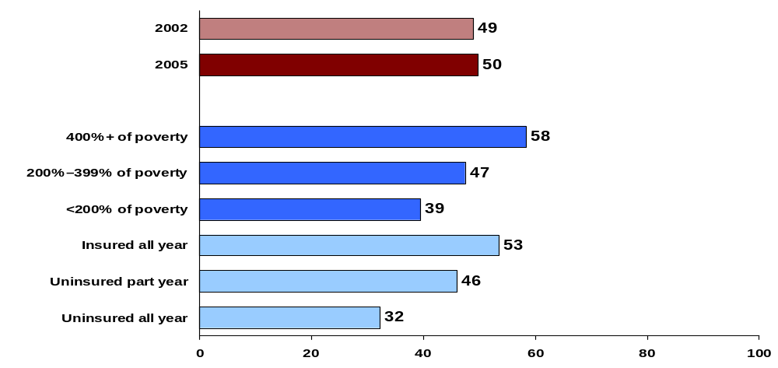
Receipt of Recommended Screening and Preventive Care for Adults
QUALITY: EFFECTIVE CARE
Percent of adults (ages 18+) who received all recommended screening and
preventive care within a specific time frame given their age and sex*
U.S. Average
U.S. Variation 2005
* Recommended care includes seven key screening and preventive services: blood pressure, cholesterol, Pap, mammogram,
fecal occult blood test or sigmoidoscopy/colonoscopy, and flu shot. See report Appendix B for complete description.
Data: B. Mahato, Columbia University analysis of Medical Expenditure Panel Survey.
Source: Commonwealth Fund National Scorecard on U.S. Health System Performance, 2008

Slide 25

An Introduction to the
Role of Family Medicine in the Healthcare System
The relationship of access to primary care and health disparities

Slide 26
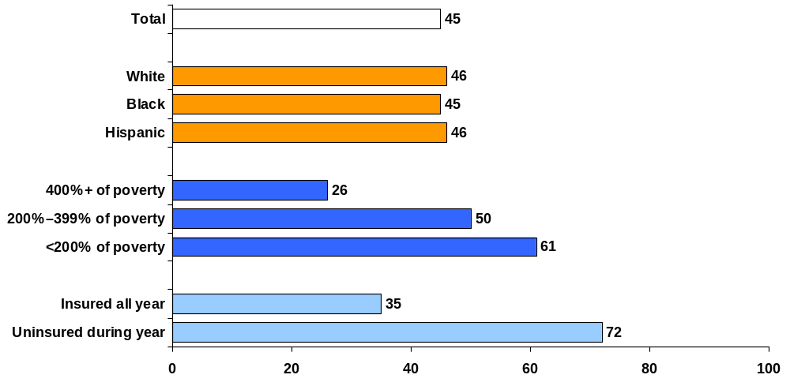
Cost-Related Access Problems, by Race/Ethnicity, Income, and Insurance Status, 2007
EQUITY: ACCESS
Percent of adults (ages 19–64) who had any of four access problems* in past year because of cost
* Did not fill a prescription; skipped recommended medical test, treatment, or follow-up; had a medical problem but did not visit doctor or clinic; or did not see a specialist when needed.
Data: 2007 Commonwealth Fund Biennial Health Insurance Survey.
26
Source: Commonwealth Fund National Scorecard on U.S. Health System Performance, 2008

Slide 27
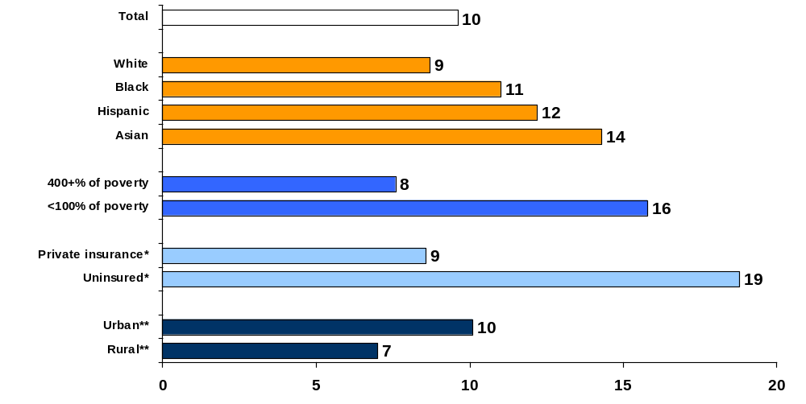
Doctor–Patient Communication by Race/Ethnicity, Family Income, Insurance, and Residence, 2004
EQUITY: PATIENT-CENTERED, TIMELY CARE
Percent of adults (ages 18+) reporting health providers “sometimes” or “never” listen carefully, explain things clearly, respect what they say, and spend enough time with them
* Insurance for people ages 18–64. ** Urban refers to metropolitan area >1 million inhabitants; Rural refers to noncore area <10,000 inhabitants.
Data: Medical Expenditure Panel Survey (AHRQ 2007b).
Source: Commonwealth Fund National Scorecard on U.S. Health System Performance, 2008

Slide 28
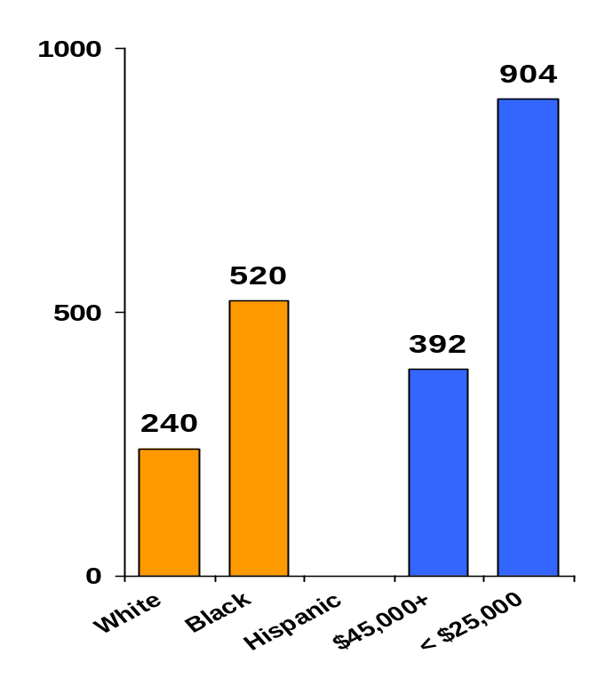
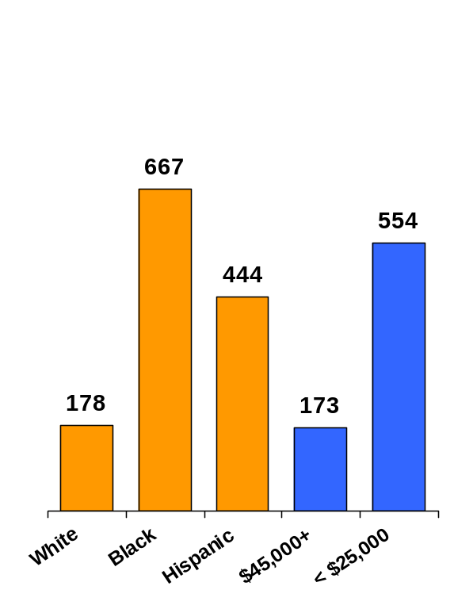
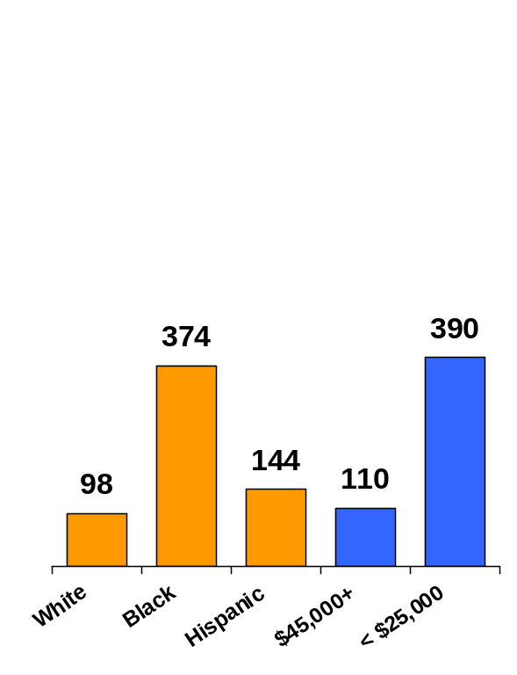
EQUITY: COORDINATED AND EFFICIENT CARE
Ambulatory Care–Sensitive (Potentially Preventable) Hospital Admissions, by Race/Ethnicity and Patient Income Area, 2004/2005*
Adjusted rate per 100,000 population
Heart failure
Diabetes**
Pediatric asthma
NA
* 2004 data for diabetes and pediatric asthma; 2005 data for heart failure. ** Combines 4 diabetes admission measures: uncontrolled,
short-term complications, long-term complications, and lower extremity amputations.
Patient Income Area=median income of patient zip code. NA=data not available.
Data: Race/ethnicity—Healthcare Cost and Utilization Project, State Inpatient Databases and National Hospital Discharge Survey (AHRQ 2007b); Income area—HCUP, Nationwide Inpatient Sample (AHRQ 2007a, retrieved from HCUPnet at http://hcupnet.ahrq.gov).
28
Source: Commonwealth Fund National Scorecard on U.S. Health System Performance, 2008

Slide 29
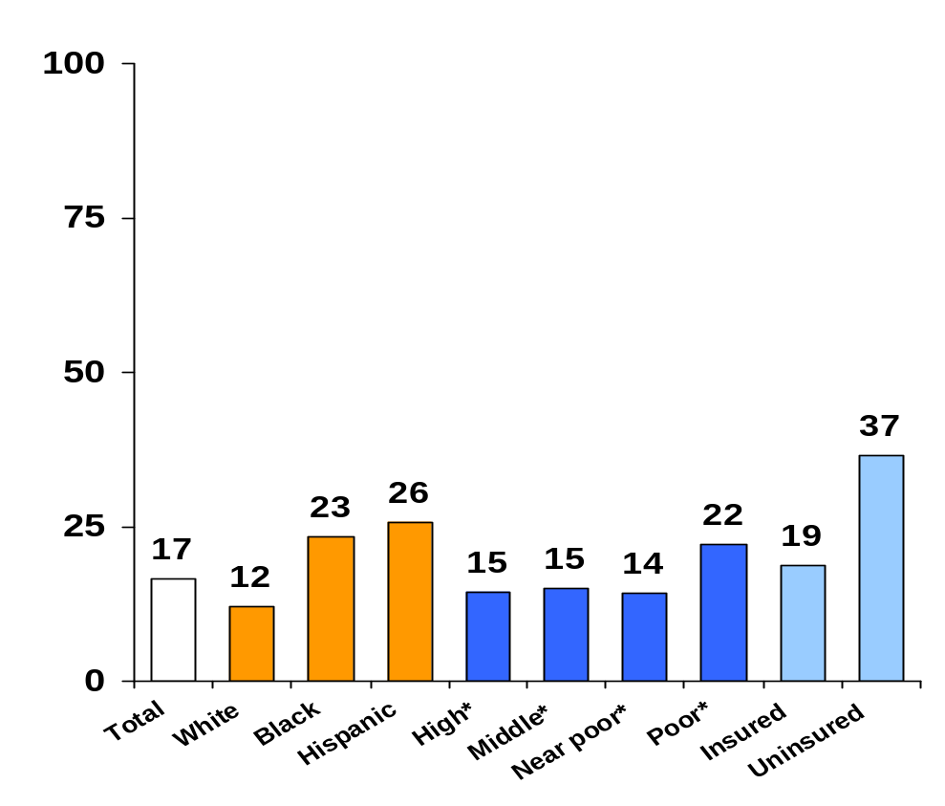
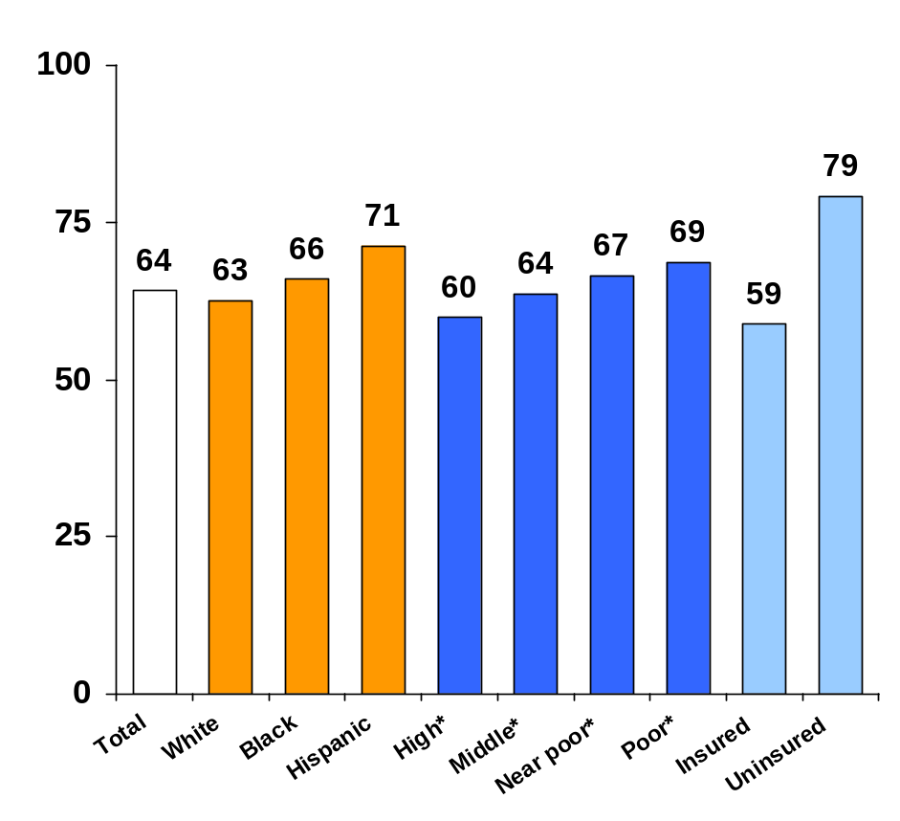
Adults with Poorly Controlled Chronic Diseases, by Race/Ethnicity, Family Income, and Insurance Status, 1999–2004
EQUITY: EFFECTIVE CARE
Percent of adults (ages 18+) with diagnosed diabetes with HbA1c level ≥ 9%
Percent of adults (ages 18+) with hypertension with blood pressure ≥140/90 mmHg
* High refers to household incomes >400% of federal poverty level (FPL); middle to 200%–399% FPL; near poor to 100%–199% FPL; and poor to <100% FPL.
Data: J. M. McWilliams, Harvard Medical School analysis of National Health and Nutrition Examination Survey.
Source: Commonwealth Fund National Scorecard on U.S. Health System Performance, 2008

Slide 30
An Introduction to the
Role of Family Medicine in the Healthcare System
Conclusions
Despite being the 2nd wealthiest nation in the world, the U.S. ranks well below most Western nations in health outcomes
On average, the U.S. spends 2.5x more on healthcare per capita than other Western countries
Access to primary care and preventive services is lowest in the poor, uninsured, and in African Americans

