Slide 1
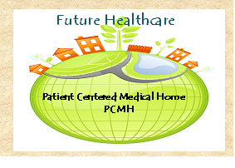
The Patient Centered Medical Home

Slide 2
Learning Objectives
Identify the attributes of a patient centered medical home
Describe some processes that facilitate caring for patients with complex chronic diseases

Slide 3
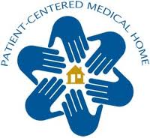
An approach to providing comprehensive primary care that facilitates partnerships between individual patients, their personal physicians, and the patient's family

Slide 4
A few of the features of a PCMH
Access and communication
Patient registry
Care management
Patient management self support
Electronic prescribing
Referral tracking
Quality Assurance
Notes:
Access and communication – there is good access for patients and consistent communication between patients and the medial teams well as between different medical providers
Patient registry – a list of patients with similar characteristics
Care management – team based care
Patient management self support
Electronic prescribing
Referral tracking
QA – uses systems to track quality and promote safety

Slide 5
Attributes of PCMH
Patient centered care
Accessibility to care
Comprehensive team based care
Co-ordinated care
Care with a focus on QA and safety

Slide 6
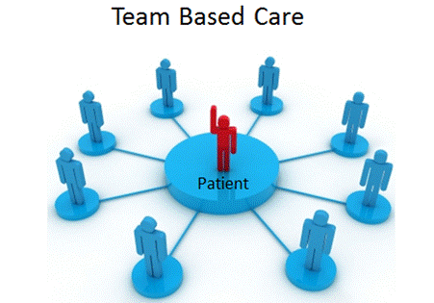
Patient Centered care
Patient centered care
Minimally disruptive medicine
Notes:
What is patient centered care? Or what about care makes it patient centered?
It is care that is relationship based and focused with the patient at the center.
Care is quality of life centered and not centered on guidelines
It is individualized and the patient is an active participant
This care encompasses minimally disruptive medicine

Slide 7

Patient centered care
Shared decision making
Promote Self care and self management
Participation in peer support groups/group visits
Patient advisory councils
Notes:
The main participants on Patient Advisory Councils are patients. Ideally the council represents the diversity of the clinic and patients are able to advise clinical staff on policy, practices, communication etc.

Slide 8

Attributes of PCMH
Patient centered care
Accessibility to care
Comprehensive team based care
Co-ordinated care
Care with a focus on QA and safety
Notes:
Comprehensive care: The primary care medical home is accountable for meeting the large majority of each patient’s physical and mental health care needs, including prevention and wellness, acute care, mental health treatment, rehabilitation, and chronic care.
Patient centeredThe primary care medical home provides primary health care that isrelationship-based with an orientation toward the whole person. the medical home practice actively supports patients in learning to manageand organize their own care at the level the patient chooses
Coordinated care:The primary care medical home coordinates care across all elements of thebroader health care system, including specialty care, hospitals, rehabilitation centers, home healthcare, and community services and supports.
QA: A systems-based approach to quality and safety:The primary care medical home demonstrates acommitment to quality and quality improvement.

Slide 9
Accessibility
Includes:
  Open access
  E-mail
  Longer hours
  Emergency provision
Notes:
Open Access refers to the ability of patients to call and get an appointment with their regular physician the same day that care is needed

Slide 10
Attributes of PCMH
Patient centered care
Accessibility to care
Comprehensive team based care
Co-ordinated care
Care with a focus on QA and safety
Notes:
Comprehensive care: The primary care medical home is accountable for meeting the large majority of each patient’s physical and mental health care needs, including prevention and wellness, acute care, mental health treatment, rehabilitation, and chronic care.

Slide 11

Comprehensive Care:
Provide preventive care, acute and chronic care, mental health.
Manage patients with complex medical needs
Notes:
For example, if a clinic has a large number of patients with diabetes the clinic might employ a nutritionist.

Slide 12
Strategies to help practices manage patients with complex medical needs
Use of an EHR
Use registries to identify complex patients
Pay additional fees to PCP to care for these patients
Care managers
Referral tracking systems
Notes:
A registry can proactively track complex or high-risk patients
Another example of a strategy is to conduct in-home assessments or staff 24/7 telephone lines to complement the practice’s after-hours coverage.
A variety of programs across the country are using and referral tracking systems

Slide 13

Community Care of North Carolina
CCNC
Primary care providers receive a per member per month (PMPM) fee to provide patient care, population management strategies such as disease management, preventive services and coordination across delivery settings, and support in implementing practice improvements.
Notes:
One example of an organization that provides additional monetary support to primary care practices is CCNC.

Slide 14
Attributes of PCMH
Patient centered care
Accessibility to care
Comprehensive team based care
Co-ordinated care
Care with a focus on QA and safety
Notes:
Coordinated care: The primary care medical home coordinates care across all elements of the broader health care system, including specialty care, hospitals, rehabilitation centers, home healthcare, and community services and supports.

Slide 15

Co-ordinated Care
The PCMH is the conductor

Slide 16
Attributes of PCMH
Patient centered care
Accessibility to care
Comprehensive team based care
Co-ordinated care
Care with a focus on QA and safety
Notes:
QA: A systems-based approach to quality and safety: The primary care medical home demonstrates a commitment to quality and quality improvement.

Slide 17
Quality and Safety
The PCMH has a commitment to quality assurance activities to improve quality and safety.
Examples
  PDSA cycles to improve diabetic retinopathy screening
  Tracking follow up of abnormal PAP smears
  Systems to ensure screening exams are up to date

Slide 18
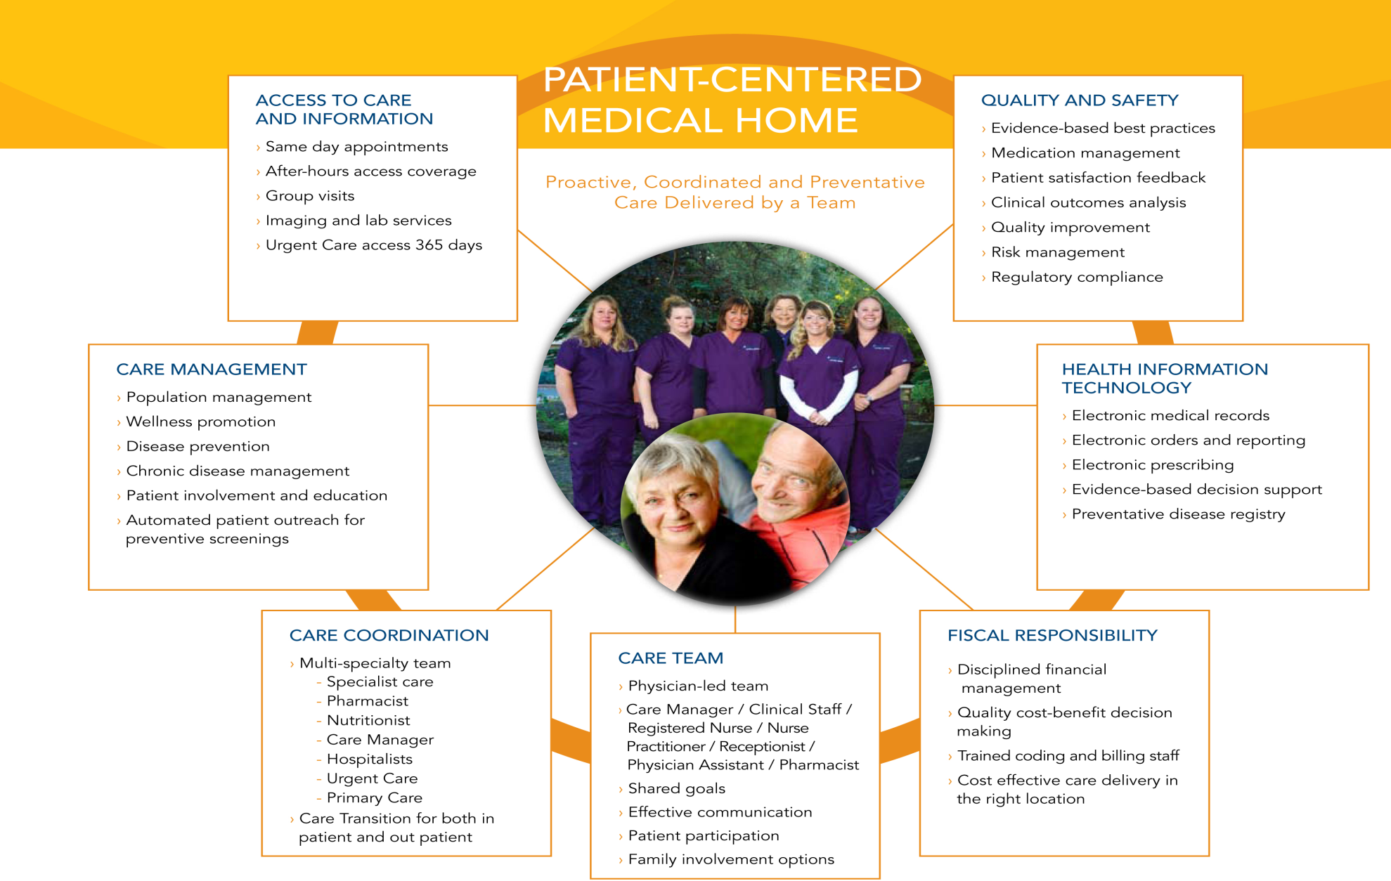
Summary

