Slide 1
Advisors and Coaches: The Evolving Role of Faculty & Resident Relationships
Randolph Pearson, MD, FAAFP, FACSM
Tonya Caylor, MD, FAAFP, PCC

Slide 2
Faculty Development Webinars
stfm.org/cbmewebinars
What You Need to Know About ACGME and ABFM Expectations for a Shift to Competency-Based Medical Education
Reflections, Goals, & Objectives – Oh My! Best Practices for Creating ILPs
Let’s Talk About Entrustment
Assessment Tools for CBME and the Core Outcomes
Building CBME Into Faculty Development
Advisors and Coaches: The Evolving Role of Faculty and Resident Relationships
Individualized Learning and Resident Assessment: A CBME Orientation for Residents
Fostering Master Adaptive Learning and a Growth Mindset in Your Program
How to Effectively Use Electives to Help Residents Attain Competency in the Core Outcomes
The Role of Resident Portfolios in Competency-Based Assessment
Managing Assessment Burden in CBME
How to Have Reflective Feedback Conversations and Develop a Culture of Effective Feedback
Notes:
Planned a series of CBME webinars. These are co-branded and co-marketed with AFMRD. We have had record-breaking registration for the live events and excellent viewership of the recordings.
Each webinar has at least one member of the task force. We’ve also included presenters from an open call we put out for CBME subject matter experts.
Also presented a ADFM Hot Topic Webinar and are participating in the development of an AAFP Residency Program Director On-Demand CME Course

Slide 3
Disclosures
Dr. Pearson
Member of STFM CBME Taskforce
Dr. Caylor
Has her own coaching practice

Slide 4
Learning Objectives
Describe the difference between advisors and coaches
List two main categories of coaching in academic settings
Describe the benefits of including non-core faculty in coaching roles

Slide 5
Poll 1
Has anyone in your residency program undergone some formal coach training?
Yes
No

Slide 6
Poll 2
2. What source of professional coaching have you used personally? (if more than one, pick the closest to A)
A. Internal coaches within my organization/university
B. Coach through Employee Assistance Program
C. External coach, paid for by organization/university
D. External coach, self-funded
E. Peer coaching
F. Never had a professional coach outside of sports or the performing arts.

Slide 7
Poll 3
3. What percent of your interactions with residents do you utilize coaching skills/approach?
A. > 50%
C. 25-50%
D. 10-25%
E. Rarely or Never

Slide 8
Evolving Role includes Coaching
Role of “coach” has origins in sports and music
Distinctly different from “advisor” or “mentor”
Advisor
Faculty- and program-centric guide on progress
Main focus is achievement of educational benchmarks
Mentor
Dual resident- and faculty-centric
Main focus is role-modeling
Coach
Resident-focused advocate for competence
Focus on achieving resident-generated goals for learning
Notes:
We've all had some sort of contact with coaches in our lives. Certainly, if we've been involved with organized sports, we have had coaches who have helped us become better players. While some coaches in my life were "participatory", most derived their coaching ability by relying on their own knowledge of the techniques that were needed to excel at the sport. As residency faculty, we are familiar with serving as advisors and mentors for our residents. In each of these roles, we also rely on our past experience or knowledge to guide the resident. As we begin to explore the concept of coaching, however, our focus shifts from a faculty- and program-centric view to one that is resident-focused. As we'll see in this webinar, allowing the resident to chart their course will improve the buy-in from the resident for their learning plan and set the stage for developing important master-adaptive learning skills.

Slide 9
Notes:
My friend, Nick Saban, described the role of coaching in this way. We’ve all had learners who tried to fly under the radar. Good residents, though, seek out opportunities to learn. As we learn more about coaching them, we’ll see how invested they become in charting their own course through residency.

Slide 10
But... Why us (and why now???)
New ACGME and ABFM standards for competence require resident buy-in
This buy-in necessitates a paradigm shift in how we view our faculty roles
Notes:
We've focused in previous webinars about the newly-implemented ABFM Core Outcomes for Family Medicine training. These outcomes were created in lock-step with the latest ACGME revisions in training requirements. As part of these new rules, individual learning plans are required as a resident-driven process. This requires us as faculty to develop skills to guide residents toward achieving the outcomes. In addition, a huge side effect of involving residents in this way is that it paves the way for them to develop skills in life-long learning—skills that are necessary for us as practicing family physicians in order to keep up with

Slide 11
The ACGME “chimes in”
“An ILP should be formulated by the learner, should include personal learning objectives, and should identify resources and strategies to achieve them. While the learner should be able to create an initial ILP, the ILP content should be guided by a facilitator (faculty member, associate program director, or program director)“
Notes:
As I stated on the last slide, the ACGME has clearly defined the process that residents and faculty should use in developing and refining the individual learning plan. This will require residents to have personal learning objectives along with identifying strategies to reach those objectives. The ACGME also says that residents should use facilitators to assist in the process. And that's where we come in—to help our residency faculty develop the skill-set needed to coach our residents in this process.
.

Slide 12
But... Why? (Internal Reasons)
Empowers residents to match their learning to their goals and future patients’ needs
Coaching supports autonomous motivation
Self Determination Theory
Growth- and forward-focused rather than deficit-focused
Encourages ownership and growth, decreases dependence
Notes:
https://www.frontiersin.org/journals/psychology/articles/10.3389/fpsyg.2021.809362/full?inf_contact_key=1d97af00d45869212e5ccbbfb3fa35821b0a3f0fd3ee5d9b43fb34c6613498d7
https://pubmed.ncbi.nlm.nih.gov/23802125/
https://www.frontiersin.org/articles/10.3389/feduc.2022.753710/full

Slide 13
Carrots & Sticks less effective for complex situations
Non-Directive Coaching improves motivation quality
-
Notes:
(Carrots/Sticks = Compliance vs Coaching =Engagement)
Principles of Self Determination – Agency, Relatedness, Competency – support more autonomous motivation
Ryan, R. et al. (2019). Supporting autonomy, competence, and relatedness: The coaching process from a self-determination theory perspective. In S. English, J. M. Sabatine, & P. Brownell (Eds.), Professional coaching: Principles and practice (pp. 231–245). Springer Publishing Company.

Slide 14
Coaching
What is it really?
Notes:
We’ll spend the rest of the webinar talking about how you can put these concepts of coaching to work in your programs as you’re helping residents develop their own learning plans.

Slide 15
Definition Coaching
A coach partners with a coachee to get them from where they are to where they want to be -K. Palamara
Notes:
Terminology and Connotations – term is used in various ways in various settings. Talking across paradigms
Start with the coaching industry definition- ICF Definition: partnering with clients in a thought-provoking and creative process that inspires them to maximize their personal and professional potential.
16th century - Hungarian village of Kocs was known for their quality horse-drawn carriages which became known as - kocsi.

Slide 16
Coaching Keywords
Keywords
Dialog – Partnership, Empowering
Coach – Deep Listening, Broadens Awareness
Coachee – Self-Awareness, Metacognition, Self-Reflection
Generative*-New Insights, Perspective, Confidence, Clarity, Goals, Strategies
Goals - Enhanced Capacity, Optimized Professional & Personal Potential
Notes:
Explicit words NOT from ICF definition – universally agreed upon to make it a little more tangible.
Coachee in this conversation is having some guided self-reflection,
Generative – new insighg into their own assumptions perceptions and behaviors,
Terminology and Connotations – term is used in various ways in various settings.

Slide 17
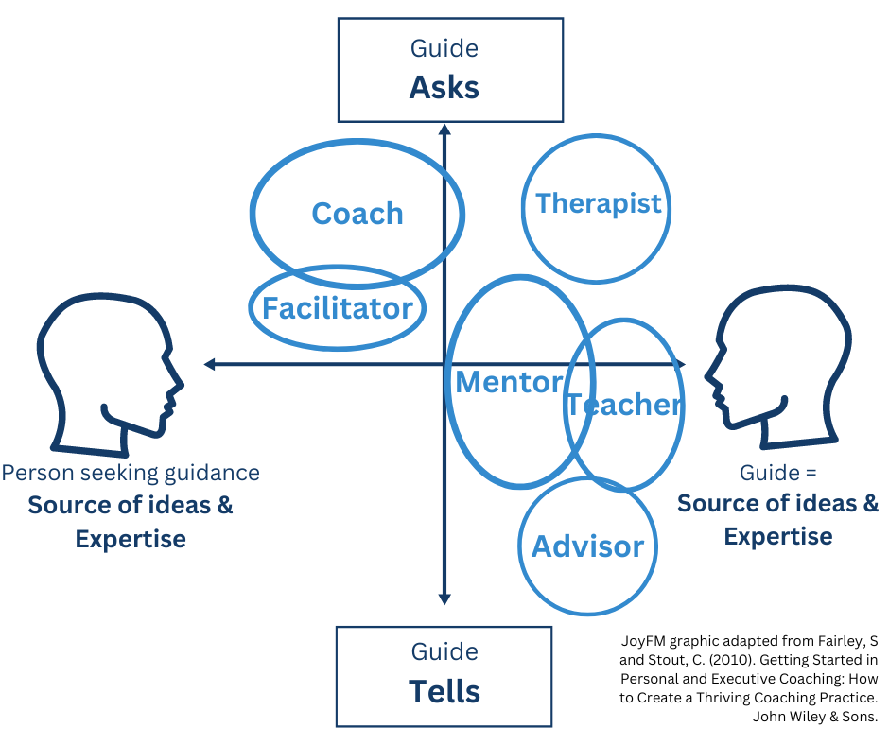
Notes:
Guide – is hopefully a trusted individual – All 3 (mentor, teacher, advisor) are CRUCIAL
HIGHLIGHT person as source of ideas
This is WHY you have to Explain -

Slide 18
Literature supports coaching for
Technical skills (e.g. procedures)
Non-technical skills (e.g. interpersonal)
Cognitive skills
Well-being
Other professional development
-Personal identity formation
Metacognition*
Growth Mindset
Appreciative Inquiry
Notes:
Inter-related.
Appreciative inquiry: Positive reflections, builds self efficacy, growth oriented instead of deficit like Randy mentioned
Other pillar would add in– Trauma-informed
Reduces stress, emotional exhaustion, depersonalization, disengagement, intolerance of uncertainty, burnout, moral injury
Improves resilience, psychological capital, quality of life, self-compassion, self-confidence, professional fulfilment, flourishing, self-confidence

Slide 19
Two Broad Categories GME Coaching
Performance
Coaching
Developmental
Coaching
Notes:
Performance can be more like that sports analogy.
Sliced and Diced differently – the new AMA GME Coaching Faculty handbook slices outcomes based categories:
Performance – Behavior/Skills based
Developmental – Thought-Based – Coaching industry simply calls Coaching
Have several things in common: Orange Blocks (Talk more about the specific skills in a bit) Relational process involving dialogue and reflection for the coachee. Resident-centered highlighting their assumptions, perceptions, and behaviors.
The Resident is taking ownership for their learning, discovering their objectives, strategies
Facilitate Growth
FUTURE focused

Slide 20
Two Broad Categories of Coaching in GME
Performance Coaching (Clinical Educator Hat)
Technical, Non-Technical, Cognitive Skills
(e.g. Sutures, Communication, DDx)
Often involves observation & feedback (others’, educator/coach’s)
-Prepare to ADAPT, R2C2, Ask-Tell-Ask Frameworks
Learner can be source of ideas
Expertise* lies with the faculty
Developmental Coaching (Formal Coach Hat)
Professional Development, Work-Life Integration
(e.g. Professional Identity, Career, Well-being)
Does not rely on observation or feedback* (coach is neutral)
Expertise & Source of ideas lies within the learner
Notes:
-already using frameworks- coaching approach to feedback.
Coaching isn’t formulaice – but there are frameworks to help – many of you are using these
Doesn’t have to have obs and feedback – skill of efficiency – can ask goals, ask questions strategies, what’s getting in the way, give them advice: Academy of Commuication in Healthcare recommends having the agenda negotiated upfront both decreases stress for you and improves patient satisfaction. Explore
Expertise ; ** Transparent about performance standards
NOT ALL situations need a coaching approach!!!! Can be cruel to try to lead them to an answer.
Many of you are already using frameworks to take a coaching approach to feedback. Doesn’t have to have obs and feedback – skill of efficiency – can ask goals, ask questions strategies, what’s getting in the way, give them advice: Academy of Commuication in Healthcare recommends having the agenda negotiated upfront both decreases stress for you and improves patient satisfaction. Explore

Slide 21
Approaches in GME
Performance Coaching
Asking and Telling
Both Contribute
Traditional Approach
Telling by Expert
Developmental Coaching
Asking Coachee as Source Ideas
Continuum?
Notes:
So really there’s a continuum. And I know the discomfort that some of you may be experiencing.
A lot of where the overlap exists is based on psychological safety, COI, rapport between the pairings, coaching can’t be mandated,

Slide 22
Master Adaptive Learners Planning, Learning, Assessing, Adjusting
“Coaching is essential to the development of the master adaptive learner (MAL)”
Wolff M. et al. Beyond advising and mentoring: Competencies for coaching in medical education. Med Teach. 2021 Oct;43(10):1210-1213.
Notes:
Working with learners to build this approach that allows for managing change more effectively, especially in suboptimal environments. If it’s not seen as prioritized, then it’s not valued.
Metacognition
Goal-setting
Self-efficacy
Motivation
Learning strategies
Self-monitoring
Feedback
Reflection
Attribution
Adjusting
Growth mindset

Slide 23
The Hats You (May) Wear
Clinical Educator – Knowledge and Skills
(Teach, Supervise, Evaluate)
Advisor – Expertise and Information
Mentor – Perspective and Experience
Sponsor – Connection and Endorsement
Coach – Internal Clarity and Confidence
Notes:
Advising – when optimal result is achievable through the application of expert knowledge: focus on educational benchmarks
Mentor: shared common pathway and impart wisdom based on experience.
Sponsor: using professional and social capital to advocate for and connect learners to opportunities.
Coach –development of professional identity, goals, strategies
Demonstrating you’re MAL to MAF first discussion.
INCLUDE you are the whole – sometimes wearing one hat and sometimes playing multiple roles in one setting.

Slide 24
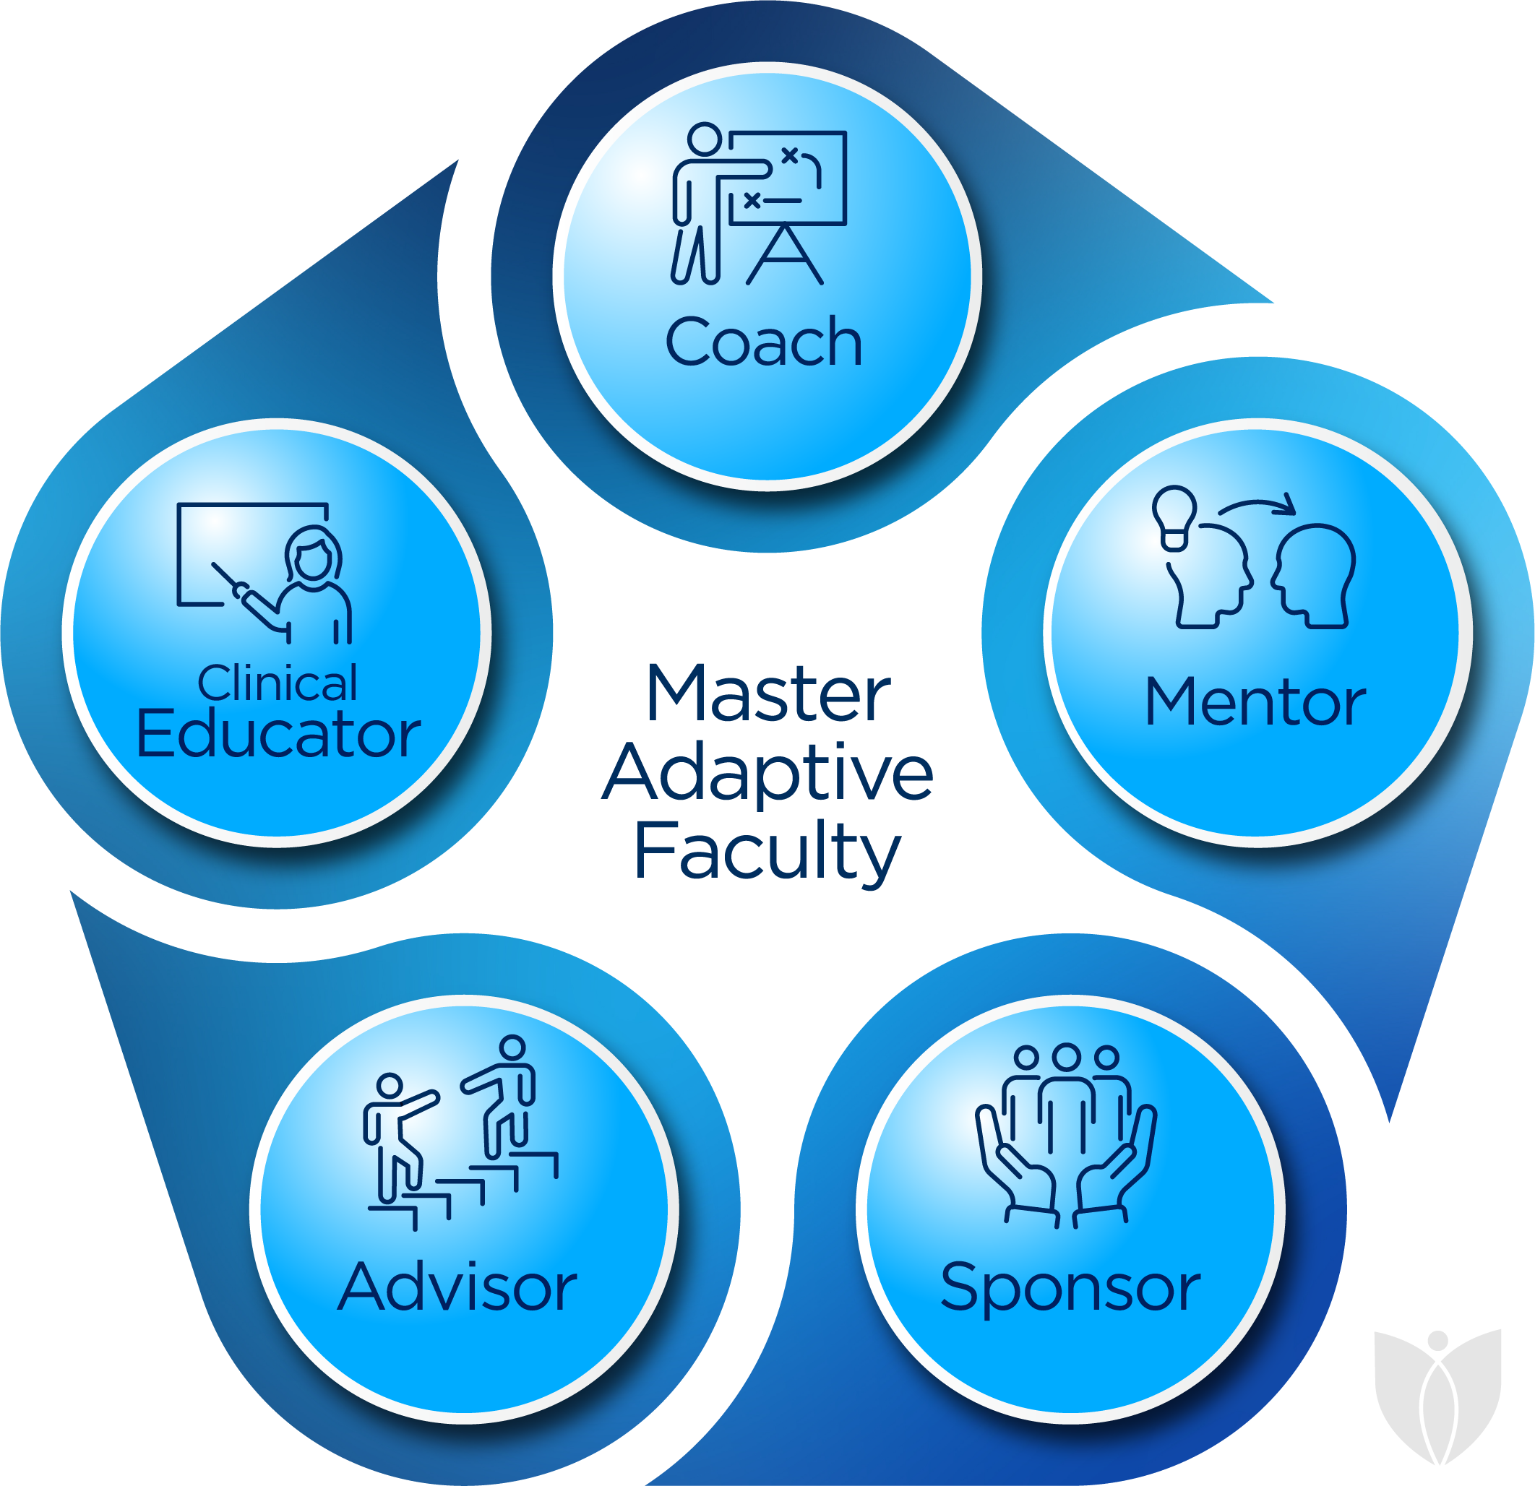
Reframe Roles with Coach-Approach Lens
Applying coaching skills
can enhance any role in many situations
Notes:
Look through Blue Coaching Lens at roles
Business world – Fortune 500 Leaders/Manager – few go and become coach certified, but all learn and apply coaching skills in their roles.
Acknowledge the discomfort.

Slide 25
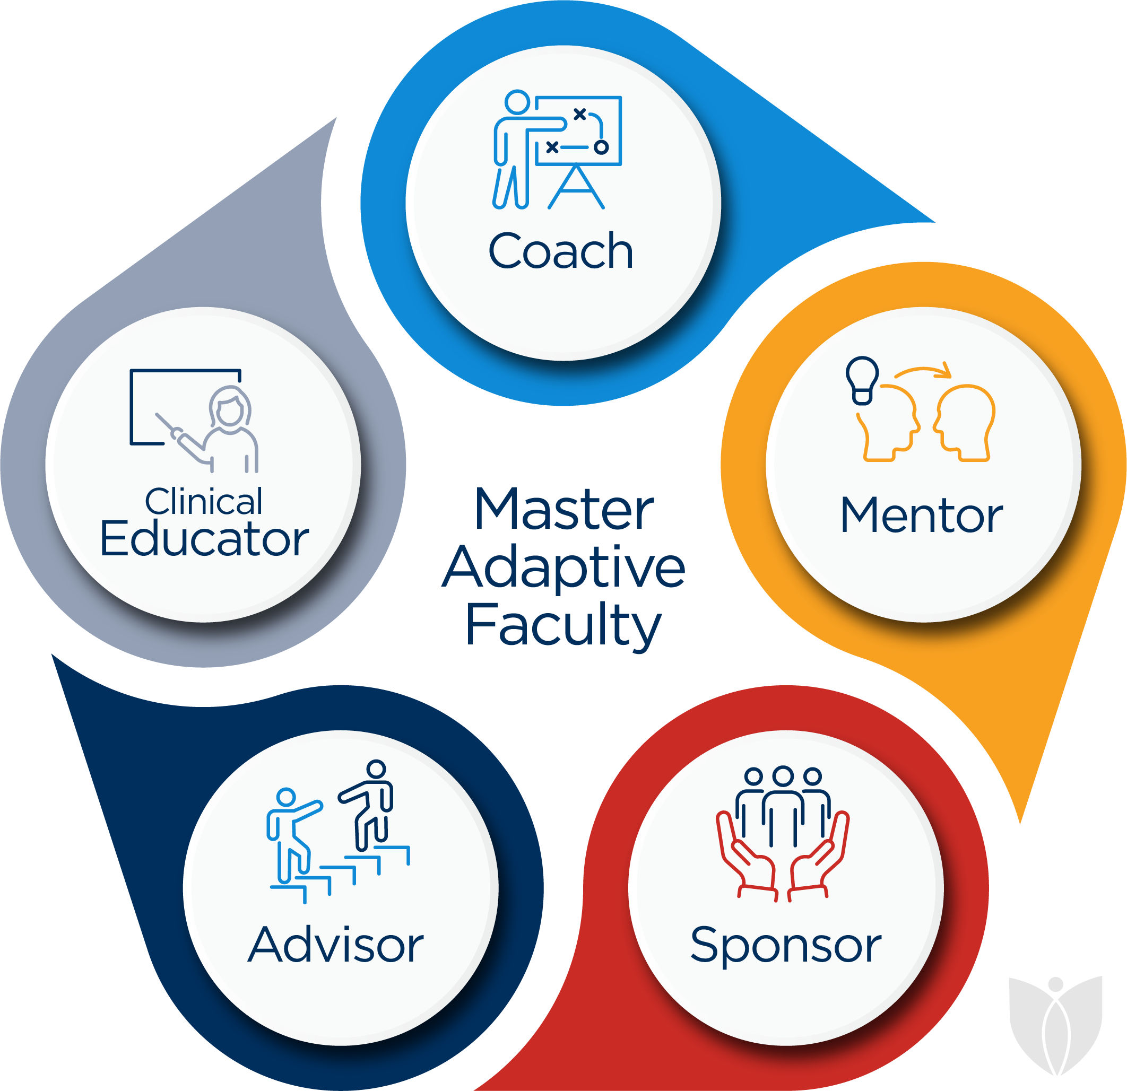
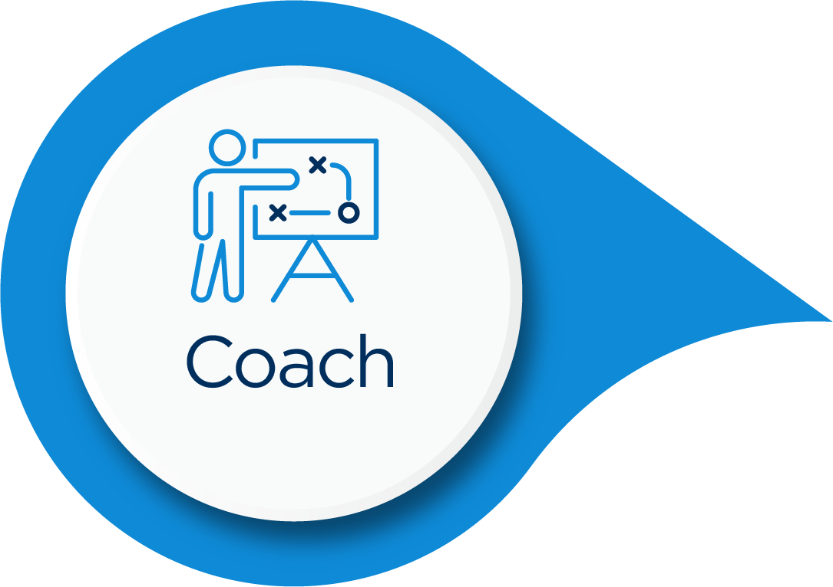
Approaches in GME
Performance Coaching
Asking and Telling
Both Contribute
Traditional Approach
Telling by Expert
Developmental Coaching
Asking Coachee as Source Ideas
Continuum?
Notes:
A lot of where the overlap exists is based on psychological safety, COI, rapport between the pairings, coaching can’t be mandated,

Slide 26
Decide based on situation and intention
Notes:
List Lens 1 or Lens 2 reasons (Circumstances, Setting, the Trainee, your Relationship, your own State)
Not ideal for all situations
Example – Your advisee comes to you to find out if they can take a 2 week away elective in adolescent inpatient psychiatry.
Example 2- In your advisee meeting your advisee expresses that they may want to give up on working at an FQHC but they’re conflicted. (Acknowledge you have biases and hopes and opinions and helpful advice) –
Perspective, and Experience? Coachiing approach in your role.
Clarity, Confidence. “What’s making you re-think it?”
1 or 2 they look the same:

Slide 27
Faculty Development
Notes:
Clinical Educator Milestone Project not an accreditation requirement and are not intended to become one in the future.

Slide 28
Coaching and Co-Creating the ILP*
Performance/Developmental Coaching ILP Co-Created with Faculty
Resident starts with the end in mind
(future practice, patient/community needs, outcomes?)
1. Identifies areas needed for growth (add info like evals)
2. Formulates 2 developmental goals and 1 well-being goal
Advisor/Faculty Coach helps/negotiates
1. Mapping Goals to Outcomes
2. Formulating SMARTIE goals*
Residents in Difficulty
ACGME Remediation Toolkit/Coaching Frameworks
-Map to Outcomes*
Notes:
Set up – the first meeting and kind of explain coaching.
*Negotiation needed? Say rural medicine, and you heard them saying they don’t like peds, As a coach, you can point out things. I hear two things that sound counter to each other – rural but not peds, I’m wondering what you perspective is as I highlight those two?
They don’t incorporate some big issues issues, poor eval on peds, and they say well I’m not going to do peds anyway. “I appreciate that. As we look through the milestones, one of the things we have to partner together in order for you to graduate and be board-certified is –”…” How might you take that in consideration? What would you want to change about your goals if anything.
work–life balance, career planning, (allowing discussions to focus this led to less outcomes for entrustment for Penn State.)
teaching skills, and research/scholarship.
summative ‘evaluators’ rather than facilitators of formative feedback
Resident–coach discussions were dynamic and changed throughout the course
of residents’ training. During PGY1, most-commonly discussed dilemmas/PLPs
aligned with leading and working within interprofessional health-care teams
(EPA10), research/scholarship (Theme 4), career planning (Theme 2), and work–
life balance (Theme 1). During PGY2, most-commonly discussed dilemmas/PLPs
aligned with improving quality of care (EPA13), demonstrating personal habits
of lifelong learning (EPA15), research/scholarship (Theme 4), and career
planning (Theme 2). During PGY3, most-commonly discussed dilemmas/PLPs
aligned with demonstrating professional habits of lifelong learning (EPA15) and
career planning (Theme 2). Later in residency, resident–coach discussions
shifted away from EPAs towards more traditional mentoring topics, including
research, fellowship applications, and professional transition into
fellowship/practice.

Slide 29
Coaching and Co-Creating the ILP*
Performance/Developmental Coaching ILP Co-Created with Faculty
Resident starts with the end in mind
(future practice, patient/community needs, outcomes*)
1. Identifies areas needed for growth (formative feedback)
2. Formulates 2 developmental goals and 1 well-being goal
Advisor/Faculty Coach Reflect, Help, Negotiate*
1. Mapping Goals to Outcomes*
2. Formulating SMARTIE goals*
Residents in Difficulty
ACGME Remediation Toolkit/Coaching Frameworks
-Map to Outcomes*
Notes:
Set up – the first meeting and kind of explain coaching. Opportunity for Growth. Thnk throu
*Negotiation needed Goal: Want to gain more knowledge about preventative care.
You note that their OP peds eval identified lack of understaning of developmental milestones ( or maybe an opportunity for growth toward a specific Outcome the CCC identified by using that fancy mapping graph, and they say well I’m not going to do peds anyway. “I appreciate that. As we look through the milestones, one of the things we have to partner together in order for you to graduate and be board-certified is –”…” How might you take that in consideration? What would you want to change about your goals if anything.
work–life balance, career planning, (allowing discussions to focus this led to less outcomes for entrustment for Penn State.)
teaching skills, and research/scholarship.
summative ‘evaluators’ rather than facilitators of formative feedback
Resident–coach discussions were dynamic and changed throughout the course
of residents’ training. During PGY1, most-commonly discussed dilemmas/PLPs
aligned with leading and working within interprofessional health-care teams
(EPA10), research/scholarship (Theme 4), career planning (Theme 2), and work–
life balance (Theme 1). During PGY2, most-commonly discussed dilemmas/PLPs
aligned with improving quality of care (EPA13), demonstrating personal habits
of lifelong learning (EPA15), research/scholarship (Theme 4), and career
planning (Theme 2). During PGY3, most-commonly discussed dilemmas/PLPs
aligned with demonstrating professional habits of lifelong learning (EPA15) and
career planning (Theme 2). Later in residency, resident–coach discussions
shifted away from EPAs towards more traditional mentoring topics, including
research, fellowship applications, and professional transition into
fellowship/practice.

Slide 31
Approaches in GME with ILP
ILP
Performance Coaching
Asking and Telling/Co-Creating
Faculty as Expert
Resident Source of Ideas
Traditional Approach
Telling by Expert
Developmental Coaching
Asking, Coachee as Source Ideas
Continuum?
Notes:
Tension is that ILP is co-created program needs/outcomes/feedback/ expertise on a developmental topic
Insight PIP
No insight may be more to the left

Slide 32
Coaching Skills
Invitation or Permission
Coachee Drives Agenda
Confidentiality
& COI*
Safe Space
Not Problem Solving
Deep Listening
Develop Awareness
Open-ended Non-leading
What, How
Question Opt Out or Pass
Partner to Define/Design Progress
Suspend Judgment
Assist Internalizing Learning
Not Giving Advice*
Assist Developing Accountability
Notes:
YOU HAVE SKILLS - FOllow along on the handouts
Contract for coaching/
Can feel INVASIVE – nothing more frustrating when you want advice to be given coaching without permission
They don’t have as many people to see and approach them to empower them
Take my coach hat off – explicit. Exception and not rule. If you give them a framework, hold loosely and check-back in
Unconditional positive regard
SMARTIE goals HERE
Postive Regard; Coach Person not Problem;
SELF Regulation
Remind you – you all already have many of the skills needed to coach. I’m goint to walkyou through the baseics and the newer things what may trip you up.
The way you walk into an exam room –
Permission for feedback (performance) or coaching.
You get to give advice in so many settings as traditional mentor, advisor, educator – empower them to learn to trust their own ideas, lessen dependence on you, facilitate ownership.
Positive regard, check your own emotions, biases,
*Performance Coaching –Co-create; Developmental Coaching You facilitate by questions.

Slide 33
Meet them at their level of
“safe-vulnerability”
Notes:
Resistant Learner
DEI, IP, Opt in
Disengaged – safety issue, burned out, exhausted
Seem like a Resistant learner: You can do all the things to create a safe-space, and they still may not feel safe. Any given day portion of our residents are deep in IP, it’s not safe for someone who evaluates them for them to let the mask slip; for some it’s related to diversity, equity, inclusion, and belonging – they may not feel safe from that stand point; they may have experienced what they saw as a breach of confidentiality and are terrified about being talked about in faculty meeting. Just give me an answer.
Or they’re disengaged – maybe because burned out, or exhausted post-call, or it doesn’t make sense the way they were brought up to have these kind of conversations with an attending.
Sometimes naming things helps – I notice a change in your body posture, eye contact, and answers when I started taking the coaching approach. I’d love to hear your experience of it and what would be more helpful to you.
If you take the time to explain coaching, be clear what approach you’re taking, get permission, be explicit about whatever the confines of confidentiality/COI, and give them an out _If I ask anything that you don’t want to answer or feels too uncomfortable, please say pass” – then they can decide how open they are with you.

Slide 34
Hammound, M, et al. (2024). ​ Coaching in Graduate Medical Education, A faculty handbook. American Medical Association; 2024

Slide 35
Operational Considerations
Notes:
We’ll spend the rest of the webinar talking about how you can put these concepts of coaching to work in your programs as you’re helping residents develop their own learning plans.

Slide 36
Approaches to Enhance Residency Coaching
Faculty Development of Coaching Skills – skills-based*, developmental
AMA resources, Books
Residency Learning Networks
External Coach Trainers/Organizations
Official Faculty Role(s) for Coaching
Certified coach training -
Leverage Established Coaching Access
University Coaching Departments*
External Coaches*
External to Core Faculty or External to Department/Organization*
Notes:
The “front line” for coaching within our program lies within our own programs. Some of you already have skilled faculty within your programs who can implement coaching strategies with your residents. However, most of us will need to take some time to develop coaching skills. There are resources available from the AMA that we’ve already mentioned, but we can also rely on shared skills and faculty development, either through our residency learning networks or by calling on coach trainers or organizations outside of our programs. A few of you might want to dive into becoming certified coaches through training programs that are available. If you’re in a university-affiliated program, your university may offer access to coaching resources. Finally, there are external coaches that can be contracted or employed to assist in this function.

Slide 37
Core Faculty vs External Faculty
Core Faculty
Contextual understanding
Existing rapport*
Access to assessments/evaluations
In-person conversations easier
Less expensive than external coaches
External Coach or Stable of Coaches (including non-core faculty)
Less context can mean less priming
Less conflict of interest*
More psychological safety
Not evaluators
Confidential*
Less expensive for non-core if quid-pro-quo or part of university benefits
Notes:
In deciding how to use available resources, you may want to decide between using core faculty as coaches vs using individuals from outside your program. Advantages of using core faculty include their understanding of the processes involved with developing ILPs as well as the relationships that exist between the resident and faculty member. Certainly, it’s more convenient to have in-person conversations with core faculty and you’ll save on expenses associated with external coaches. On the other hand, external coaches can have less conflict of interest and may provide more psychological safety. Sometimes, the expenses associated with using external coaches can be offset by offering quid-pro-quos like access to your program’s rotations or clinical experiences for residents from another program.

Slide 38
Faculty Experience of Coaching
When given support (skill development, 5-10% FTE)
Improved belonging
Decreased silos
Enhanced multi-dimensional learning
Catalyzed professional identity formation
Meaning
Professional fulfillment
Selling SK, et al. The Effects of Coaching Pediatric Residents on Faculty Coaches' Relationships, Learning, and Professional Identity Formation. Acad Med. 2023 Mar 1;98(3):376-383
Notes:
There are a number of benefits that your faculty can realize by participating in coaching activities with your residents. Many faculty report an enhanced sense of belonging and ownership for resident success. Sometimes, faculty who have not had previous experience as a coach find that their professional development is sparked. Certainly, faculty may sense improved meaning and professional fulfillment in their academic careers.

Slide 39
Opportunities for Innovation
Growing faculty skills
Mitigating burden(residents, faculty)
Faculty/Resident rapport not good “fit” for coaching
Not Defaulting to Checking “ILP box”
Engaging resident body as a whole*
Residents and ILPs
“I didn’t have time”*,“I don’t know”*
Unengaged (safe, cultural, burnout)
Confidentiality Standards/Constraints/Communication/COI
Expanding coaching support beyond ILPs
Notes:
Faculty development in coaching skills does present growth opportunity for faculty. As skills are developed, residents and faculty should see a shift of burden from the more traditional advisor role to a shared developmental model. Like many areas in residency education, some faculty may not be a fit for coaching role and the program director should work as much as possible to maximize the individual skills of the faculty. Some programs find that coaching activities extend beyond the role of ILP development and can enhance teaching in other areas of the program. In addition, coaches must be careful to maintain confidentiality as much as possible with their coachees.

Slide 40
Faculty as Coach
Must have a clearly defined role as a resident advocate
Role ambiguity is a pitfall
Although one faculty can serve as advisor/mentor/coach, a clear delineation needs to be made when shifting between roles
Some programs may elect to have different faculty serve in each role
Formation of “educational alliance” with resident
Focus on resident needs (from reflection) and goals of training (with dynamic ILP)
Must be aware of resident and faculty burden
Can’t be seen as “just another thing we have to do”
Notes:
It’s important for the role of the coach to be clearly defined. This is particularly an issue where the faculty serves in multiple roles with the resident. For this reason, some programs will choose to have a small group of faculty serve as coaches for multiple residents. As a resident-centric activity, the coach needs to maintain a focus on resident needs and goals. Again, coaching activities can’t just be another thing we have to do.

Slide 41
Methods to consider for ILPs
Using existing advisor/advisee structure
Within regular meeting
An additional separate meeting
PDs/APDs
BH faculty
Non-advisor faculty (core or non-core) as ILP coaches
Establish core or non-core faculty coach with official roles and formal training
Notes:
There are a variety of ways that you can incorporate coaching activities into your interactions with residents. You might choose to use your existing structure and include coaching activities either within your advisor meetings or in separate meetings. Some programs might designate the program director or associate program director as coach, or you may decide to use behavioral health faculty or other faculty as coaches. Whatever you choose, remember to use the resources we mentioned earlier to help develop the skills of your coaches.

Slide 42
Quote
“The ultimate goal of coaching would never be simply attaining a specific behavioral benchmark or goal. Instead, the ultimate outcome is that of facilitating the (learner)’s ability to make informed and reflective choices about their life challenges and aims.”
Ryan, R. et al. (2019). Supporting autonomy, competence, and relatedness: The coaching process from a self-determination theory perspective. In S. English, J. M. Sabatine, & P. Brownell (Eds.), Professional coaching: Principles and practice (pp. 231–245). Springer Publishing Company
Notes:
We’ll finish with a quote (read)

Slide 43
Closing Poll
How well did we do in meeting our objectives:
1. Describe the difference between advisors and coaches
2. List two main categories of coaching in academic settings
3. Describe the benefits of including non-core faculty in coaching roles
A. Excellent
B. Good
C. Fair
D. Poor

Slide 44
Questions?
Randolph Pearson, MD, FAAFP, FACSM
STFM CBME Task Force
pearson@msu.edu
Tonya Caylor, MD, FAAFP, PCC
tlcaylor@mac.com

